Slide 1
Honoring Tradition While Embracing Innovation
Dr. Andrew Sears
President, City Vision University
Eric Burger Executive Director, Shelter KC
Dr. Jack Briggs
President, Springs Rescue Mission

Slide 2
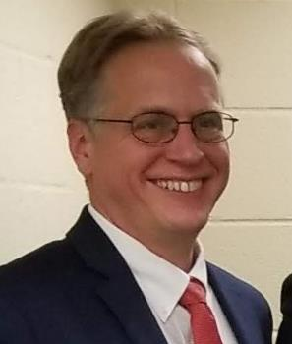
Honoring Tradition While Embracing Innovation
Dr. Andrew Sears
President Citygate Conference Workshop 2024

Slide 3
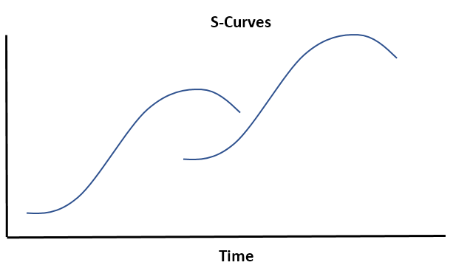
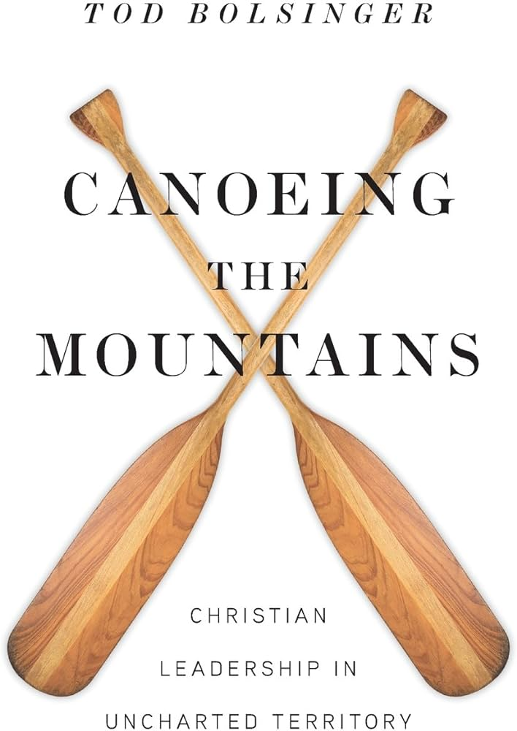
History of Rescue Mission Movement
No one puts new wine into old wineskins – Luke 5:37
Many of today's problems are a result of yesterday's solutions - Thomas Sowell
"Many of today's problems are a result of yesterday's solutions." —Thomas Sowell.
4. ???
Misalignment
3.Professionalizing
2. Scaling
1. Founding
New Wineskin
Recontextualization
New Theological Vision
(Difficult and Dangerous)
New Wineskin
Time
Notes:
Outgrew the capacity of the founder -> Need to scale
Outgrew the capacity of the staff -> Need to professionalize

Slide 4
What Causes Organizational & Movement Decline
Misalignment & Decline
Organizations decline when their theological vision and strategy become misaligned with their context &
audience
Systems & Policies
Funding Model
Culture & Staff
Programs
Strategy
Change
Happens
Theological Vision
Context & Audience
Results
Image source: https://www.toolshero.com/strategy/organizational-life-cycle-adizes/

Slide 5
Strength of Citygate Ministries: Christian Truth in Tension: AND vs. OR
Truth AND Grace/Love
Sacred AND Secular
Sharing the Word AND Deed
Faith AND Works
Great Commission AND Great Commandment
Justice AND Mercy/Forgiveness
Responsibility AND Freedom
Spiritual Counseling AND Clinical Counseling
Salvation AND Sobriety
Notes:
My story with CUM. Rescue Missions are a key part of the response to the decline of Christianity and polarization.

Slide 6
Navigating the Current Crisis: Honoring Tradition While Embracing Innovation
Staying True to Scripture
(Risk of Secularizing)
Need for Innovation
(Risk of Irrelevance: Not Keeping up with a Rapidly
Changing Society)
Potential outcome for ministries serving the poor and addicted in the US, without better navigation:
25% will successfully adapt
25% will secularize
25% will become irrelevant by not adapting
25% will not need to adapt because of limited changes in their environment
Notes:
Even this principle is in tension. The world is all Black and White vs. Grey. There are some things that need to be black and white where we need firm boundaries. This is why Christianity is a relationship, not just a set of black and white rules. Only left side, would be fundamentalist, while right side would be calling yourself Christian but essentially living by secular worldview

Slide 7
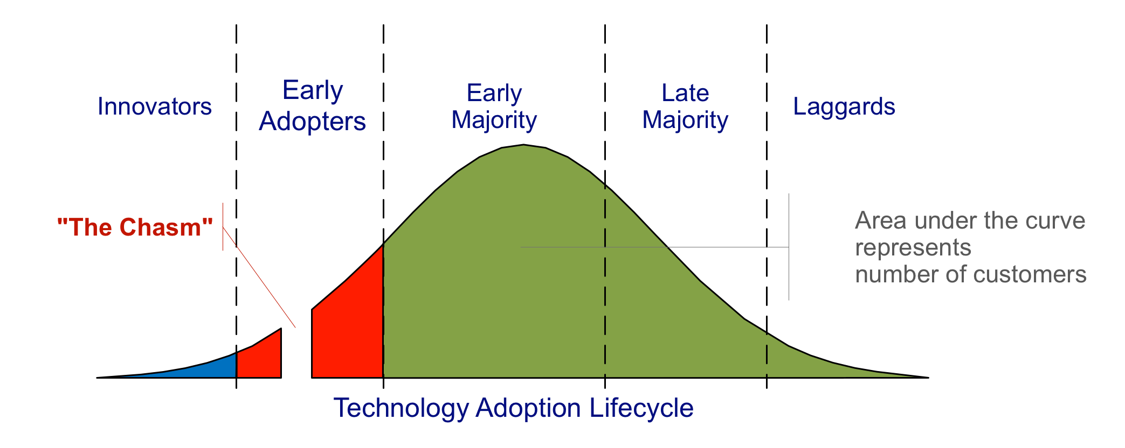
Rapidly Growing Social Problems and the Diffusion of Innovation
“Man has a limited biological capacity for change. When this capacity is overwhelmed, the capacity is in future shock.” Toffler
Many Problems Are Here
Many of Our
Solutions are Here
Image Source: Wikimedia
Notes:
Acceptability Christian Recovery as example. Widely available, effective Christian recovery programs
“The political technology of the Industrial age is no longer appropriate technology for the new civilization taking form around us. Our politics are obsolete.” Toffler
The Future (solutions) are already here, just not evenly distributed (William Gibson)

Slide 8
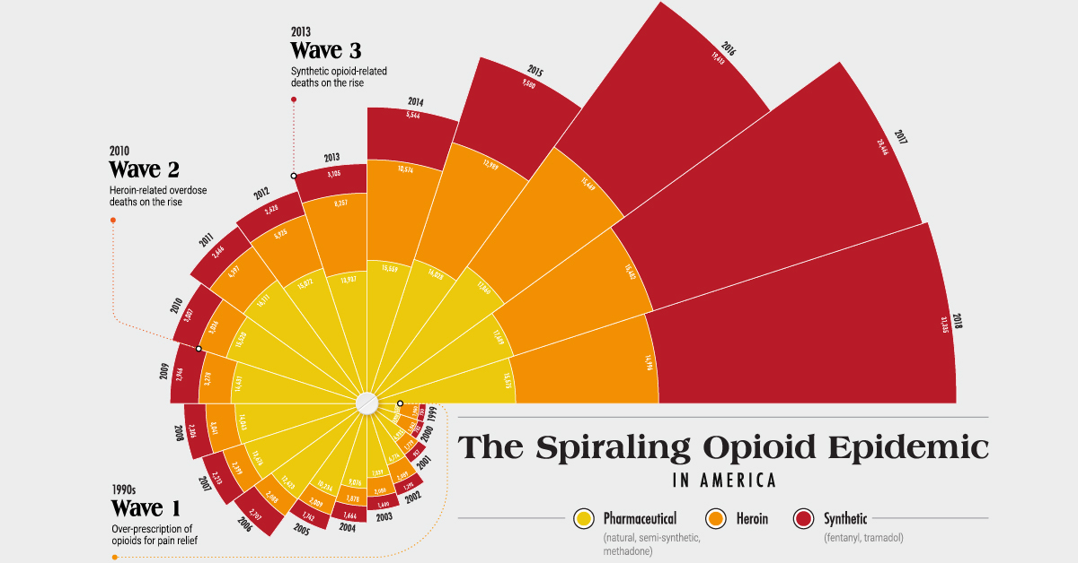
Opioid Epidemic Deaths
Source: https://www.visualcapitalist.com/the-spiraling-opioid-epidemic-in-america/

Slide 9
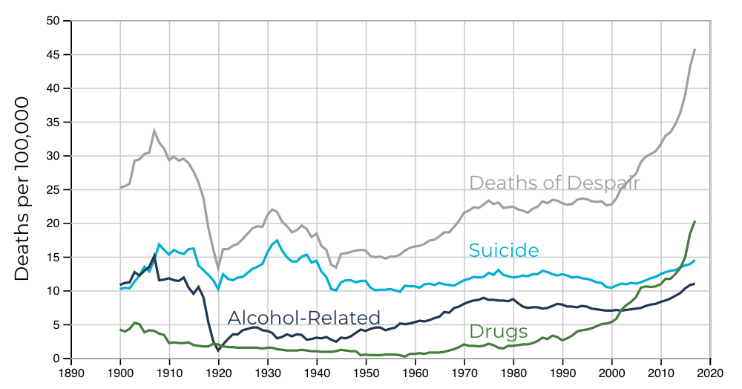
The Rise of Deaths of Despair
Source: https://www.jec.senate.gov/public/index.cfm/republicans/2019/9/long-term-trends-in-deaths-of-despair

Slide 10
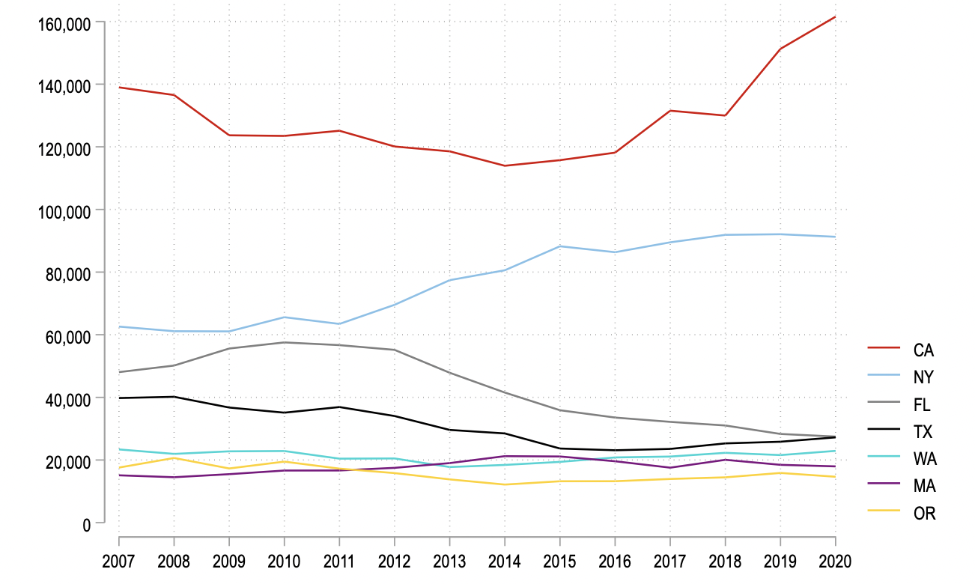
Housing and Homeless Crisis

Slide 11
Cultural Changes & Understanding Our Place in History
There are more challenges to religious freedom than any other point in US history
Two countries politically
There are more major denominational splits than at any point in US history except for around the Civil War
This is creating intense pressures to secularize from funders and the public
There is likely to be a wave of secularization of Christian institutions not seen since the wave of secularization of Christian colleges
Western Christianity
American Christianity
US Parachurch Ministries
Your Ministry
Notes:
CVU is focused on creating healthy parachurch ministries

Slide 12
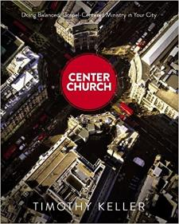
Aligning Strategy with Theology
What to Believe
How to See
What to Do
Doctrinal Foundation or Core Theology
Theological Vision
Ministry Expression (strategy)
Practical Theology
Strategic Alignment
Timeless truths from the Bible
about God, our relationship to Him,
and His purposes in the world
Theological tradition
Organizational statement of faith
Systematic & biblical theology
A faithful restatement of the gospel with rich
implications for life, ministry, and mission
in a particular culture at a moment in history
Mission, Vision & values
Ministry “DNA”
Philosophy of ministry
Theory of change
Priorities & Emphases
How the gospel is expressed
in a particular ministry in one
community at a point in time
Programs
Culture & staff
Systems & Policies
Funding model
Adapted from Tim Keller’s Center Church
Notes:
Before slides: I like to think that part of our role as a university that grew out of the rescue mission movement is as an innovation hub similar to the relationship with Stanford and Silicon Valley.
The problem is that as soon as you use the word innovation in ministry people get worried that you might change things that shouldn’t change.
Methods May Change But the Message Stays The Same
So what can change and what remains the same across generations for ministry?
The best book I’ve read on this is Tim Keller’s Center Church.

Slide 13
Dual Expertise in Developing New Wineskins
1. Tradition: Understanding
the How and Why?
Develop dual expertise
2. Innovation: Emerging
Trends & Models
New Wineskin
Recontextualization
New Theological Vision
(Difficult and Dangerous)

Slide 14
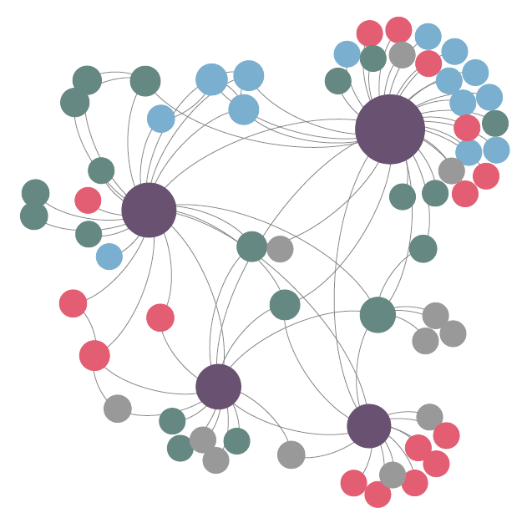
How Movements Happen
Innovation in Movements
New movement happens when someone aligns a new Theological Vision and Strategy with what God is doing in a particular context in a way that enables it to spread.
Innovation
Hub/Sub-
Movement
Examples of Innovation Hubs/Sub-movements
By Cultural Cluster: Coastal Cities, Smaller Cities, More Rural Towns, Liberal/Conservative Locations
By Function/Innovation: Christian Recovery, Direct Mail, Thrift, Social Enterprises, HR, Aftercare

Slide 15
Key Innovations in Last Generation
Citywide Direct Mail
Christian Recovery
Rescue
Missions
in the 80’s
Citygate Members
Today
Thrift Store Innovation
Nonprofit IT Innovation

Slide 16
Possible Key Innovations in Needed in this Generation
Cultural Adaptation in Post-Christian Cities
Innovation in Major Donors & Planned Giving
Values Aligned
Professionalization
Program Innovation &
Aftercare

Slide 17
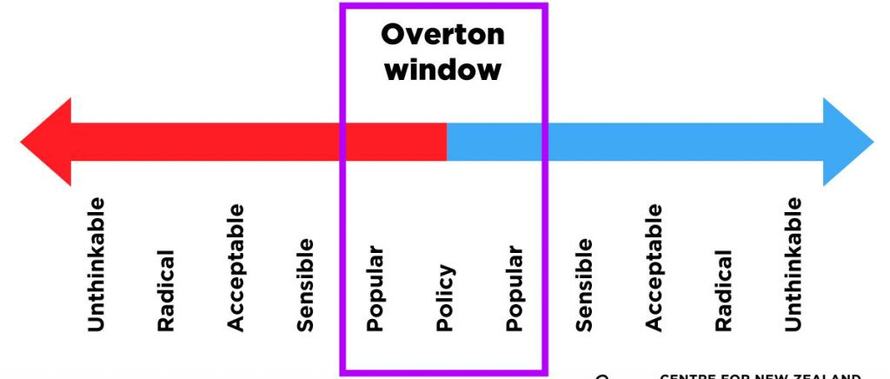
How We Limit Debate to One Side
Every Organization & Culture has an Overton window of norms and limits to debate
Notes:
Jim Wallis quote “You change society by changing the wind. Change the wind, transform the debate, recast the discussion, alter the context in which political discussions are being made, and you will change the outcomes... You will be surprised at how fast the politicians adjust to the change in the wind.” Jim Wallis (2006). “God's Politics: Why the Right Gets it Wrong and the Left Doesn't Get it”, p.22, Lion Books
― Jim Wallis

Slide 18
Overton Window of Leaders and Balancing Tradition with Innovation/Change
Tradition
Innovation & Change
Traditional Overton Window: Primarily Focused on Avoiding Secularization
Entrepreneurial Overton Window:
Must Agree with the Need for Change
Examples & Traits
Less Comfortable with Change
Most Conservative Theology Leaders from within the Tradition
Myers-Briggs SJ
Operations/Accountants
Examples & Traits
More Comfortable with Change
More Moderate Theology Leaders outside the Tradition
Myers-Briggs NP
Entrepreneurs
Notes:
Need to expand you personal and organizational Overton window
My story 1) Fundamentalist 2. Going for change oriented churches and ministries that didn’t have good risk management
3. My own experience discounting the importance of accountants

Slide 19
Christian Truth in Tension: AND vs. OR
Innovation
(Risk of Irrelevance: Not Keeping up with a Rapidly
Changing Society)
Honoring Tradition
(Risk of Secularizing: it is likely
that 100 rescue missions may
secularize in the next generation
What do you see as the biggest areas of innovation needed among Citygate members (and your organization) in the next generation?
What do you worry about where missions/ministries in the larger movement may lose their way and secularize?
Notes:
Even this principle is in tension. The world is all Black and White vs. Grey. There are some things that need to be black and white where we need firm boundaries. This is why Christianity is a relationship, not just a set of black and white rules. Only left side, would be fundamentalist, while right side would be calling yourself Christian but essentially living by secular worldview

Slide 20
Questions for Panelists
Innovation
Specific Practical Steps: What are specific steps that your ministry has taken to innovate and adapt to a changing context and needs?
Larger Movement & Trends: What do you see as the biggest areas of innovation needed among Citygate members (and your organization) in the next generation? (or What areas are we not keeping up?)
Tradition & Avoiding Secularization
Specific Practical Steps: What specific steps have you taken to decrease your organization’s risk of secularizing?
Larger Movement & Trends: What do you worry about where missions/ministries in the larger movement may secularize and how do you think that might happen? What steps as a movement do we need to do to avoid secularization? (or What are examples where you have seen secularization?)
Notes:
Potential Follow Up Questions
Dick: to what extent have you seen secularization examples and risks in rescue missions in the past 50 years?
How can we better build a movement that spreads innovation while preserving tradition

Slide 21
Panelist Responses
Eric Burger Executive Director, Shelter KC
Dr. Jack Briggs
President, Springs Rescue Mission

Slide 25
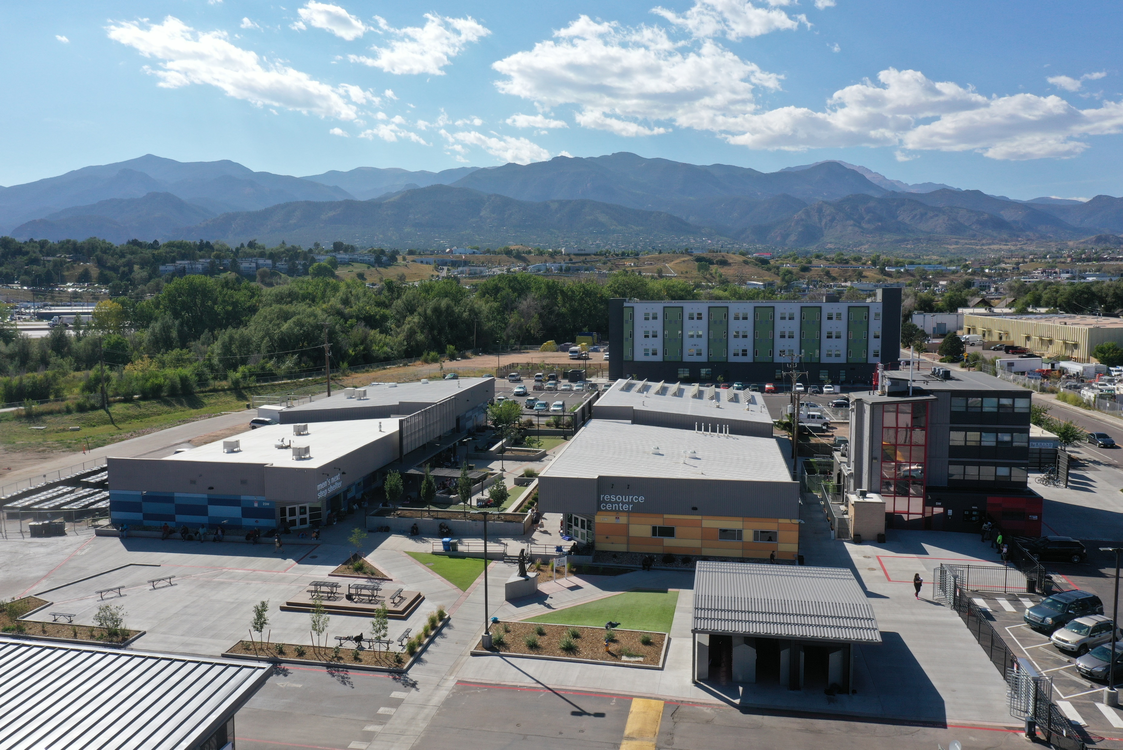

Slide 26
Tools to Balance Tradition and Innovation
Dr. Andrew Sears
President

Slide 27
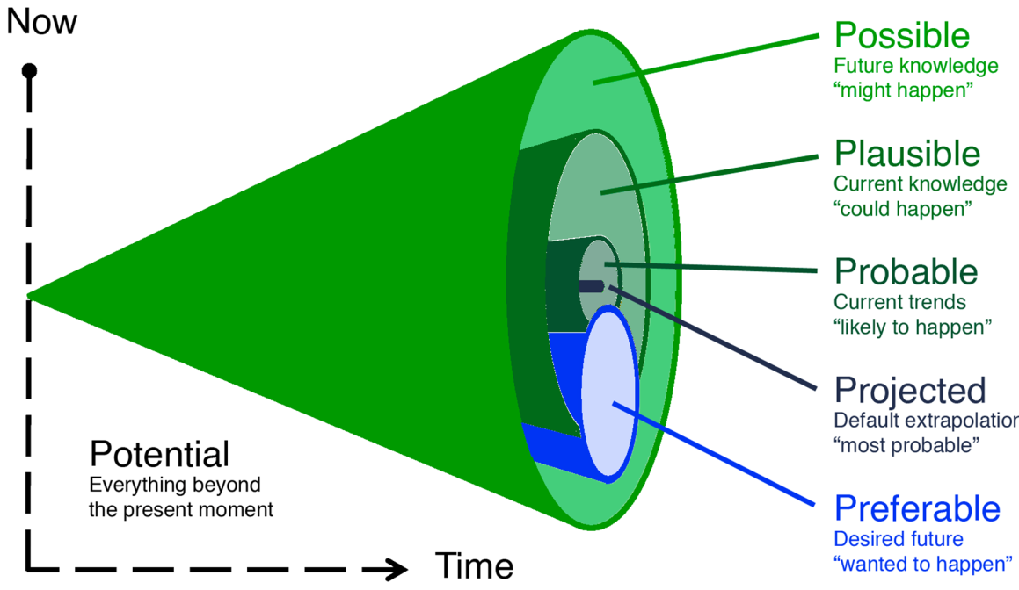
Serving as a Change Agent for a Preferred Future
25% will secularize
25% will adapt successfully
25% will become irrelevant
25% will not need to adapt
75% will adapt successfully
25% will not need to adapt

Slide 28
Biblical Pattern
God redeems & blesses Israel
Israel becomes complacent under blessing
Israel turns to other gods (Love God, Love Others)
Israel turns to God for help
Israel goes into bondage
Notes:
My expertise is more lessons from history and as an expert on parachurch ministries

Slide 29
Ministry Secularization Pattern
God redeems & blesses the movement
The movement experiences blessing
The organization becomes affluent
God initiates a new movement
The organization secularizes
Society’s cultural values change
The organization must change or be marginalized
Steps of Unintentional Secularization
The organization becomes dominated by high-end professionals (staff & board) without strong counter-cultural tendencies and values
There are extremely strong sociological & funding pressures to conform to changes. i.e. Their friends and other work environments support societal changes.
It is extremely difficult for those who have experienced success to give that up to support an organization that is marginalized
Pattern is difficult to perceive because they happen over decades or centuries.
Intervention Points
Notes:
Hiring practices

Slide 30
Top Tips to Avoid Secularization
Policies
Have a policy to only hire Christians
Join Alliance Defending Freedom, get a document review & follow best practices for legal protection
Culture
If your organization is in the “professionalizing” stage, have strategies to offset the secularizing tendencies of this (see next slides)
Programs
Align program strategy with theological vision
Train program staff in Christian integration in their fields
Funding
Diversify to maximize resiliency for cultural funding shifts
Avoid or be very cautious with any government funding
Theological Vision
Develop extended Theological Vision for your organization
Need senior, values-aligned practical theological expertise on staff
CVU Course: Aligning Strategy with Theology and Values
Systems & Policies
Funding Model
Culture & Staff
Programs
Theological Vision

Slide 31
Alliance Defending Freedom Recommendations
Free guide & membership information at www.adfministryalliance.org
Have the following statements
Statement of Faith
Statement on Marriage and Sexuality
Statement on the Sanctity of Human Life
Statement of Final Authority for Matters of Faith and Conduct
Religious Mission Statement
Code of Christian Conduct
Use the following policies & procedures
Religious Employment Criteria
Signed Statement of Faith
Religious Job Description
Facility Use Policy
Emphasize Religious Character throughout organization

Slide 32
Strategic Options to Professionalize without Compromising Values
CVU Enables Partner Ministries to Increase Staff Training by 200% to 400%
Hiring Professionals with
Intensive Values Training
1. Hiring Professionals Externally
3
Profession
alizing
Promoting staff from within
with Intensive Training
Increases
Secularization Risk
2. Promoting Staff
from within
Professionalism
2 Scaling
Frontier of Staff Quality
Frontier of Staff Quality
Hiring Program Grads with Intensive Training
1 Founding
3. Hiring Program Grads
Values Alignment
Notes:
Can’t ignore tradeoffs between different options
Key is to have balanced culture overall in the organization with everyone meeting minimum standards
One key aspect of organization strategy is the more unique your values are, the more important it is to promote from within.
What if you could increase your staff training by 2 to 4 times?

Slide 33
Ministry Emphasis in Wesleyan Quadrilateral for in Earlier Stages
Leadership dominated by those with “ministry” background & long history with organization
Fields: Bible & Theology
Fields: History
Scripture
Tradition
Experience
Reason
Ministry Cultural Center (Core Competencies)
Fields: Business, Leadership, Nonprofit Mgt
Fields: Science, Social Science, Counseling

Slide 34
How Imbalanced Emphasis in Wesleyan Quadrilateral Creates Secularization
Fields: Bible & Theology
Fields: History
Scripture
Tradition
Experience
Reason
Ministry Cultural Center (Core Competencies)
Leadership
uneducated
on historical
secularization
trend
Leadership
with limited
training in discerning theological
vision
Growth & Professionalization
Fields: Business, Leadership, Nonprofit Mgt
Fields: Science, Social Sciences, Counseling
Staff and Board dominated by high-end professionals from these fields

Slide 35
Being Overly Pragmatic Can Reverse Order
What to Believe
How to See
What to Do
Doctrinal Foundation or Core Theology
Theological Vision
Ministry Expression
Timeless truths from the Bible
about God, our relationship to Him,
and His purposes in the world
Theological tradition
Organizational statement of faith
Systematic & biblical theology
A faithful restatement of the gospel with rich
implications for life, ministry, and mission
in a particular culture at a moment in history
Mission, Vision & values
Ministry “DNA”
Philosophy of ministry
Theory of change
Priorities & Emphases
How the gospel is expressed
in a particular ministry in one
community at a point in time
Programs
Culture & staff
Systems & Policies
Funding model
Adapted from Tim Keller’s Center Church
Notes:
Before slides: I like to think that part of our role as a university that grew out of the rescue mission movement is as an innovation hub similar to the relationship with Stanford and Silicon Valley.
The problem is that as soon as you use the word innovation in ministry people get worried that you might change things that shouldn’t change.
So what can change and what remains the same across generations for ministry?
The best book I’ve read on this is Tim Keller’s Center Church.

Slide 36
Interdisciplinary Approach to Developing Balanced Vision & Values Statements
Organizational Culture & Management
Practical Theology
Secularization Studies
Notes:
Secularization studies is an interdisciplinary field of Biblical studies, theology, church and parachurch history and cultural studies/sociology.

Slide 37
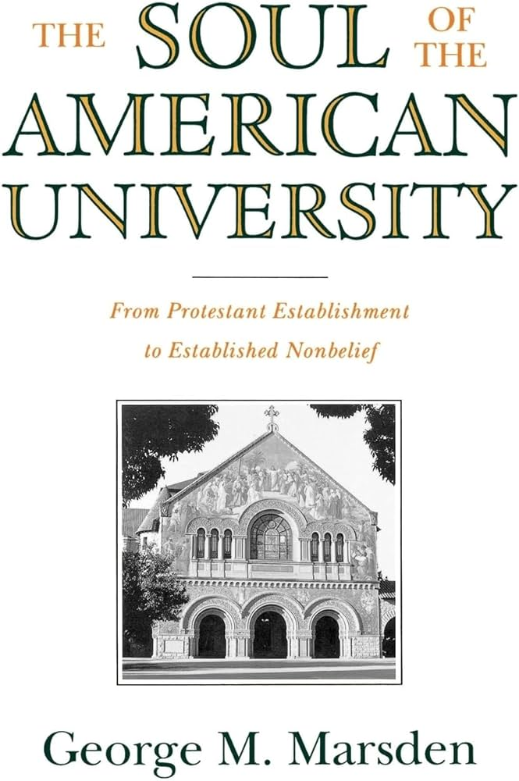
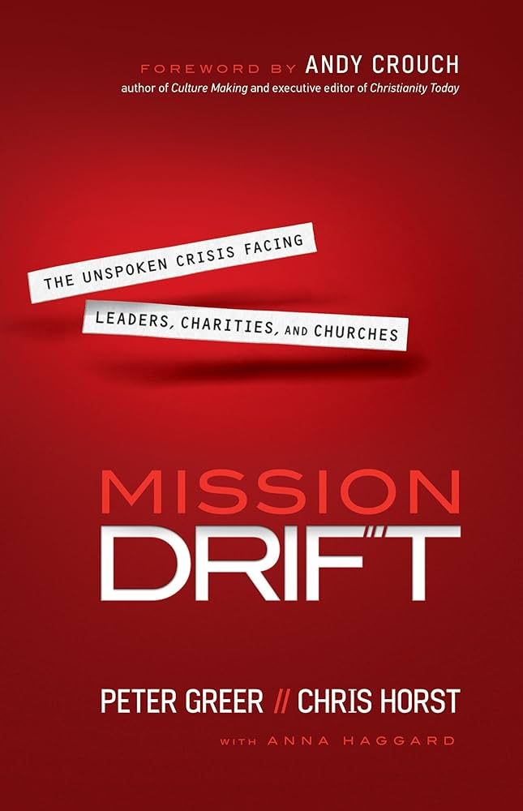
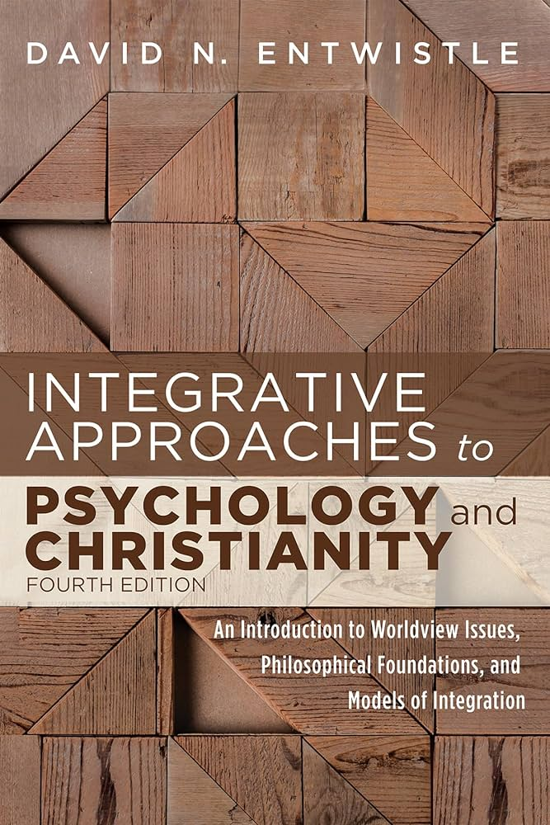
Wesleyan Quadrilateral and Culture Building in a Movement
For a movement to continue to grow without secularizing, we need to collectively build a vibrant balanced culture of innovation & resisting secularization to navigate the transition.
Fields: Bible & Theology
Scripture -> Practical Theology in Related Fields
Role: Staff Practical Theologian
Fields: History, Church/Parachurch History
Long-term perspective on secularization trend
Role: Staff Historian
Scripture
Tradition
Experience
Reason
Core Competency
Theological Pyramid
Fields: Business, Leadership, Nonprofit Mgt, Law
Organizational Alignment with Mission and Values
Role: CEO
Fields: Science, Social Science, Counseling Program Alignment from Christian integration (books)
Role: Staff Christian Counseling Integration Expert
Notes:
Similar roles in movement
Christian Higher Education: An Empirical Guide as a model for rescue missions

Slide 38
Our Vision at CVU
Movements
Staff
Program Graduates (Wounded Healers)
Generals: Our goal is to be a primary source for thought leaders out of the rescue mission and similar movements to enable the movements to continue to innovate while preserving their core values
(Doctoral Program)
Officers: Serve as an innovation and training hub among staff to enable ministries to professionalize while retaining core-values
(All Programs)
Enlisted: Serve as an aftercare partner program and an innovation hub for aftercare and program practices
Our vision is to serve as innovation hub that radically transforms the effectiveness of ministries serving the poor and addicted while preserving their core values
Notes:
CVU is focused on creating healthy parachurch ministries

Slide 39
Possible Key Innovations in Needed in this Generation
Cultural Adaptation in Post-Christian Cities
Innovation in Major Donors & Planned Giving
Values Aligned
Professionalization
Program Innovation &
Aftercare

Slide 40
Ways City Vision Can Partner with Your Organization
Clients: Aftercare or Transitional Program
Wounded Healers
Aftercare Partnership Program
Staff Training
All CVU Programs + Innovation Hub for Staff Training
Thrift Store Staff
Retail Management Certificate
Food Services Staff
Food Services Management Certificate
Development & Fundraising Staff
Nonprofit Fundraising Certificate
Internal Staff & Client Training Programs
CVU’s Credit Recognition Program
Notes:
St. Matthews Example: 55 students in 5 years. $60k. City Vision is discussed in supervision meetings and professional development. Credit recognition for both client training and staff training
If you think we should engage with other parts of your organization, please send us an email introduction

Slide 41
Appendix
Dr. Andrew Sears
President

Slide 42
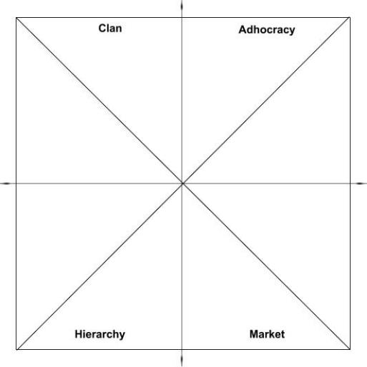
Aligning Strategy with Theology and Values Course
Ministry & Relational Competencies
• Cross-Cultural Management & Ministry
• Leadership in Under-Resourced Communities
• Christian Community Development
• Urban Youth Ministry
• Organizational Behavior & Health
• Volunteer Management
• Nonprofit Program Planning
• Vocation, Calling & Purpose of Work
• Technology, Life Balance & Addiction
• Bible & Theology Courses
• Counseling Courses
Cross-cultural
Competencies
Social Enterprise Competencies
Social Entrepreneurship
Intro to Entrepreneurship
Introduction to Business
Food Services Management
Retail Management
Educational Program Development
(Collaborate)
(Create)
Ministry Competencies
Social Enterprise Competencies
Spiritual Formation
Introduction & Capstone Courses
• Introduction to Nonprofit & Ministry Management
• Introduction to Management & Leadership
• Strategic Management
• Aligning Strategy with Theology and Values
Administrative Competencies
Fundraising Competencies
Administrative Competencies
Nonprofit Human Resources
Nonprofit Financial Accounting
Nonprofit Financial Management
Intro to Accounting
Project Management
Fundraising Competencies
Nonprofit Fundraising
Major Gifts & Planned Giving
Grant Writing
Nonprofit Marketing
Executive Leadership & Board Dev’t
(Control)
(Compete)
Notes:
Innovation
Demographic Change
Change through Education
Organizational Change

Slide 43
Why Did We Create Aligning Strategy with Theology and Values Course?
Staying True to Scripture
Need for Innovation
(Collaborate) Ministry
(Create) Social Enterprise
What if we have effective strategies and our organizations are growing but we are unknowingly secularizing?
Business Cultural Center
Administrative
(Control)
Business
(Compete)
Notes:
Many social service agencies are indistinguishable from businesses or even worse the government
Many cults still grow virally because they have an effective business model. Scientology.

Slide 44
Risk of Various Funding & Support Streams
High Risk
Government funding
Secular foundation & corporate grants
Positive PR with local news agencies
Non-Christian donors not familiar with depth of religious nature of mission
Local zoning cooperation with city
Wealthy & upper-middle class Christian donors
Middle-class and below Christian donors
Loss of tax exempt (501(c)(3)) status
Earned income
Church-based donations (evangelical)
Tithe (for churches)
Being legally allowed to exist
Low Risk
Notes:
Will vary based on where you are located

Slide 45
Acculturation, Assimilation & Biblical Engagement
Assimilation (secularization)
Biblical Engagement (“in the world, but not of the world”)
Marginalization (cultural Christians who do not attend church)
Separation (fundamentalism)
Yes
Is it important to
develop relationships
with larger society?
No
No
Yes
Is it important to maintain one’s Christian identity & community?
Source: Adapted from Berry’s Acculturation Model

Slide 46
Niebuhr’s Five Approaches to Christ and Culture
http://christianculturecenter.com/wp-content/uploads/2011/11/christ-and-culture.png

Slide 47
Experience/Reason Case Study: Springs Rescue Mission
Dr. Jack Briggs, CEO
Thought leader on leadership
Dr. Jeff Cook, Chief Programs Officer
Thought leader on Christian holistic programs serving the homeless
Anissa Boyd, Chief Human Resources Officer
Thought leader on Human Resources
Strengths
National thought leaders (reason) in leadership, holistic homeless ministry and HR
Platform
Book, CVU Faculty, Citygate Workshops, Local

Slide 48
Experience Case Study: St. Matthew’s House
National Thought Leader in Growth & Social Enterprise
Grew from $2 to $40 in about 15 years
Strong entrepreneurial core-competency
Strong staff and program graduate training
Had 55+ Students with City Vision in 5 years
Provided 46,000+ people-hours of training. Likely a more than fourfold increase in staff training hours through CVU partnership
Developed a $100,000+ education fund for clients and staff
Invested in internal staff and client training, so that program grads can get up to 16 credits and staff can get 3 credits
Many program graduates became senior leaders both in St. Matthew’s and at other missions
Provided two faculty members and one board member to CVU

Slide 49
Scripture Case Study: Engineering Ministries International
Structure
Develop future leadership through program with 10-20 full-time Fellows globally each year
Became a 501(c)(3) religious order
Training: major investment in values alignment for Fellows program
13-18 hours of training each week
Half of training internally developed
Significant portion of training outsourced through City Vision partnership
Require courses in Theology, Bible Interpretation, New Testament in addition to other values-aligned courses
Developing a commissioning program
Parachurch/religious order counterpart to ordination, but less intensive
Ensures stronger alignment

Slide 50
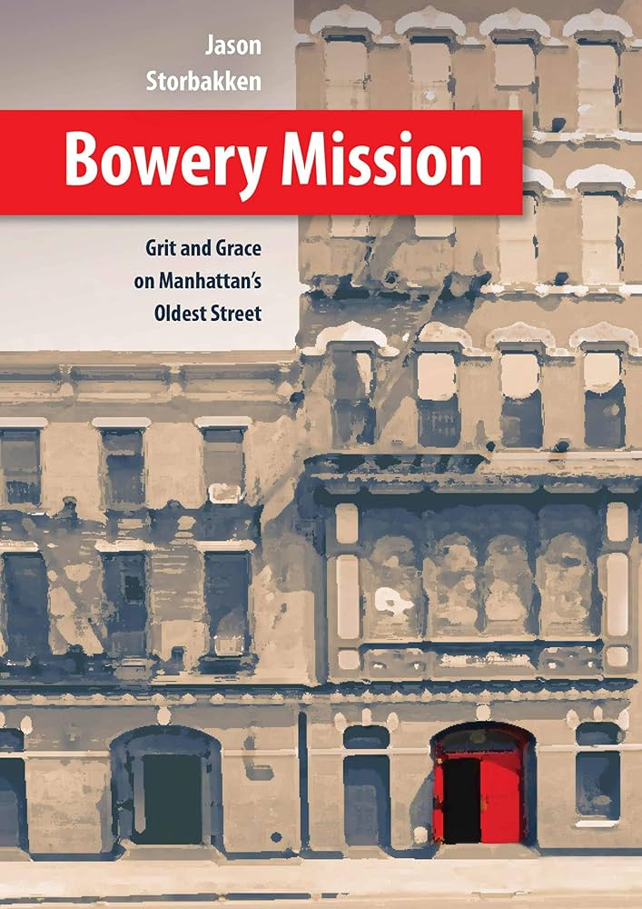
Tradition Case Studies: Bowery Mission & The Salvation Army
Bowery Mission
Third oldest rescue mission in the US
Took over operations of the oldest mission in the US, Water Street Mission (now New York City Rescue Mission)
The Salvation Army
10+ current excellent histories of the Salvation Army
Maintains tradition through policies, procedures and culture
Requires all officers to be ordained, align with denominational values and attend two years of schooling

Slide 51
Case Study for Discussion at Staff Meeting
https://docs.google.com/document/d/1uzbCNw486MxMuLeClk_DV1-DnMIZXDKdiBh_wWDky6E/edit#bookmark=id.12sprzbsmnr6
Feel free to download and change as you see fit

