Slide 1
Retraining & Equipping Your Staff
Dr. Andrew Sears, President
City Vision University
Andrew@cityvision.edu
www.cityvision.edu
Jeff Cook, Chief Programs Officer
Springs Rescue Mission jeffc@springsrescuemission.org

Slide 2
Outline
Overview of findings from over 200 interviews with rescue missions on their staff training programs
Springs Rescue Mission as a Best Practice Case Study on Staff Training
Details of best practices and common mistakes from over 200 interviews
How over 110 rescue missions have outsource portions of their staff training to City Vision University

Slide 3
Our Research on Training Needs of Rescue Missions
We are an accredited online university by rescue missions for rescue missions
  Started as a program of Citygate Network (AGRM) in 1998 and became independent in 2008
  Have partnered with over 110 rescue missions to train their staff
  Have 50+ faculty primarily coming from rescue missions and similar organizations
We have over 300 meetings a year with rescue missions and similar ministries where we ask them about:
  Their top needs and training needs
  Their existing training programs for staff and clients
Our passion is to provide quality training to help you transform lives
Notes:
My story

Slide 4
Top Findings from Research
Most pressing need:
  Worker shortage (most significant for high-end and low-end staff)
Primary long-term concern
  How to move to a more professional skilled staff due to complexities of scaling up
Staff Training/Development Strategy
  Recognize need, but wide variance in having an effective coherent strategy
  Often have a new organizational vision with same staff training plan (in other words, training plan is out of line with their vision)

Slide 5

Why Train? Improves Employee Retention
Nonprofit employee turnover rate (pre-COVID) was 21.2% (highest of any sector)
Employee quit rate increased by 25% during "Great Resignation"
Sources: Nonprofit HR, Harvard, Image source: Vox
Notes:
Most missions have been trying to solve the worker shortage by getting more people in the front door, but they would be more successful if they limited the outflow through the back door.

Slide 6

Why Train? Improve Your Effectiveness in Transforming Lives

Slide 7
Typical Rescue Mission Staff Training Strategy
Internal Training
  Orientation, position-specific onboarding
  Once a month optional staff training (possibly a leadership book club)
  Professional development in annual staff evaluation, but not effectively implemented
  Small budget line item for conferences and books for staff
External Training
  Senior staff attend Citygate conference or district meeting
  Staff must pay for accredited education on their own
  Use ServSafe for food service safety training & compliance

Slide 8
Jeff Cook’s Presentation:
Springs Rescue Mission

Slide 9
Professional Development Tracks for Springs Rescue Mission
Management and Leadership Track
Goal: to equip emerging leaders to become managers through the following sequence of 5 courses:
  ORG101: Introduction to Nonprofit & Ministry Management (for undergrads)
  or ORG620: Strategic Management Capstone (graduate)
  ORG303/ORG601: Cross-Cultural Management & Ministry
  MIN101/MIN601: Vocation, Calling & Purpose of Work
  ORG437/ORG610: Nonprofit Program Planning and Evaluation
  ORG301/ORG607: Nonprofit Human Resources
Case Management Track
Goal: to equip entry-level staff to become case managers through the following sequence of 5 courses:
  MIN101: Vocation, Calling & Purpose of Work
  ADC101: Introduction to Christian Addiction Counseling
  ADC201: Spirituality & Addiction
  ADC302: Case Management
  ADC306: Recovery Coaching & Peer Support Specialist or Certification Prep

Slide 10
Best Practices Rescue Mission Staff Training Strategy
Organizational
  Significant staff training and education component in strategic plan
  Professional development plans extensively used in annual staff evaluation
  At least do all of what a typical mission does plus…
Internal Training
  Considers "build vs. buy" decisions, knowing top sources and considers values alignment
  Senior staff visit multiple best practice peer organizations a year for innovation ideas
  Division-specific training programs
  Structured staff training program with syllabi and option to be recognized for credit
External Training
  Outsource to best-of-class external trainers: i.e. Genesis Process (credit), compliance training, CVU
  Position specific training through professional associations (SHRM, etc.)
  Development team has donors for education fund that includes both staff & clients
  May consider online video training subscription services
  Provide tuition reimbursement program that is used by 5% to 20% of employees (CVU often is the school of choice for 80%+ of students)
Notes:
Relias for compliance training: https://www.relias.com
Video: RightNow media, LinkedIn Learning, Skillshare, Udemy

Slide 11




The Importance of Tuition Reimbursement
A recent survey showed that 92% of organizations offered some type of educational benefit, with 63% provide tuition assistance or reimbursement.
  We estimate about 20% of rescue missions have a tuition benefit while about 40% are considering it
  Organizations with tuition assistance report an increase of employee applicants of 20%, increased retention of 10-40% with a 21% increase in promotions for participants and an RoI of 129%.
Sources: IFEBP Education Benefits Survey, Discover Case Study and Cigna Case Study.

Slide 12
Best Practices for Tuition Reimbursement Policy
Define which employees are eligible for tuition reimbursement
Consider whether to make having a passing grade (or a B) on a course a condition of eligibility for reimbursement
Provide a process or form to require approval
Determine what will happen if an employee leaves early
Pay fixed amount rather than a percentage (percentages can incentivize attending more costly schools and increase costs)
Follow IRS guidelines

Slide 13
Iron Triangle of Staff Alignment (Pick 2)
Strong Christian Faith
(with professional training of
faith integration with their discipline)
Bible College Grads
Corporate Hires
Program Graduates
Risk Losing Connection &
Effectiveness with the Poor
Risk Losing Effectiveness from
limited Professionalism
LPCs & MSWs
Commitment to
the Poor
(with experience and
cultural fluency)
Highest Levels of
Professionalism
Risk Losing Christian Mission
Notes:
Iron Triangle of Project Management: Speed, Price & Scope
All three are unicorns. You can’t base your strategy on always finding unicorns.

Slide 14
Strategic Options to Professionalize without Compromising Values
Hiring Professionals with
Limited Values Alignment With
Intensive Values Training at CVU
Hiring Professionals with
Limited Values Alignment
and Limited Values Training
Promoting staff from Within
With Intensive Training at CVU
Promoting staff from
Within With Limited Training
Professionalism
Frontier of
Staff Quality
Frontier of
Staff Quality
Hiring Program Grads
With Intensive Training at CVU
Hiring Program Grads
With Limited Training
Values Alignment
Notes:
Can’t ignore tradeoffs between different options
Key is to have balanced culture overall in the organization with everyone meeting minimum standards
One key aspect of organization strategy is the more unique your values are, the more important it is to promote from within.

Slide 15
What Are the Most Common Mistakes in Staff Training
Fail to recognize that the world’s changed and underinvest in training and education.
Do everything yourself. Write your own curriculum. Do all your own training.
Do not recognize that “professionalizing” staff will create “mission creep” without an intentional strategy to counter that tendency.
Have no strategic plan for training or plan is misaligned with overall organizational strategy.
Not creating a culture of lifelong learning among staff.

Slide 16
Creating a Culture of Training & Learning
The transformation from an industrial economy to a knowledge economy requires radically increased investment in training to handle complexities of a changing environment
It is very difficult for ministries to make a radically increased investment in training without outsourcing to partners like CVU
Ministries need to create a culture of lifelong learning where everyone is expected to invest in continual professional development
This radical shift toward training and learning is required to maximize effectiveness in transforming lives

Slide 17

Case Study: St. Matthew’s House
Strategy
  Great need for staff training from rapid growth
  Provided Tuition Reimbursement of $500/course to all staff
  Supervisors regularly recommended CVU to their staff in
  professional development plans
Greatly expanded staff training
  Had 45+ Students with City Vision in 5 years, only costing $60,000
  More than doubled staff training hours with CVU partnership
  Still partner with other schools, but CVU is the school of choice for the vast majority of staff (80%)
  Developed a $100,000+ education fund for clients and staff
Provided two faculty members and one board member to CVU
Credit partnerships with City Vision
  Program grads can get up to 16 credits
  Staff completing Genesis training get 3 credits

Slide 18
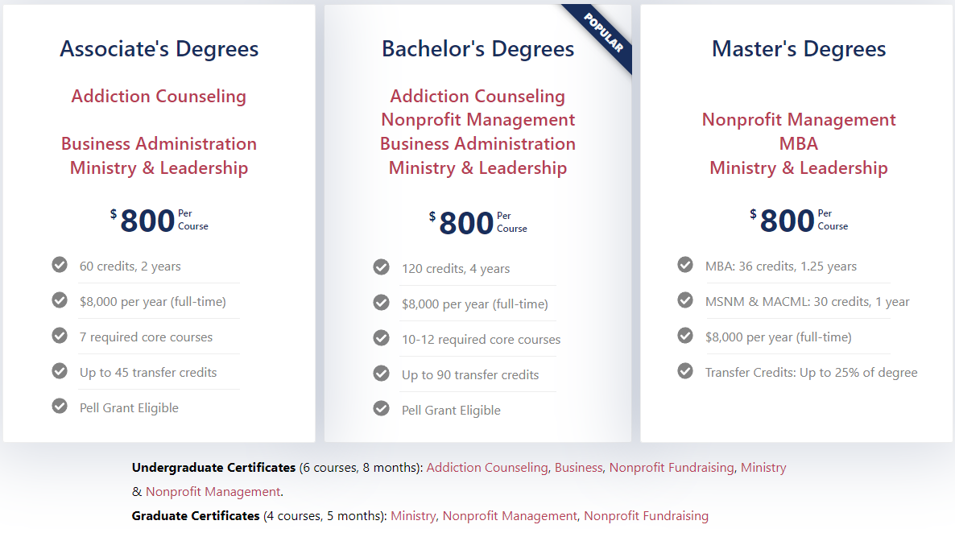
City Vision Degrees and Certificates

Slide 19
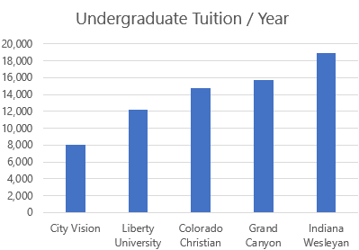
Tuition & Financial Aid
List tuition ($800/course) is 50-100% less than other schools
Rescue Mission Affiliate Tuition: $720/course
  For ministries providing only 1 student
Scholarship Partners Tuition: $550/course
  We recommend ministries budget $2,750/year/student (half time)
  Available to any ministry that sends 2 or more students a year
Maximum Pell Grant: $924/course
-$550/course tuition (scholarship partner)
$374 back to student after tuition
  Pell only available to undergraduate students
  Historically 75% of those who apply get a Pell grant
  (often those with less than $50k/year income)
Notes:
9243 in 2023-24

Slide 20

City Vision Management and Ministry Competencies and Courses
Ministry & Relational Competencies
• Cross-Cultural Management & Ministry
• Leadership in Under-Resourced Communities
• Christian Community Development
• Urban Youth Ministry
• Organizational Behavior & Health
• Volunteer Management
• Vocation, Calling & Purpose of Work
• Technology, Life Balance & Addiction
• Bible & Theology Courses
• Counseling Courses
Cross-cultural
Competencies
Social Enterprise Competencies
Social Entrepreneurship
Intro to Entrepreneurship
Educational Program Development
Transformational Change Leadership
(Collaborate)
(Create)
Ministry Competencies
Entrepreneurial Competencies
Spiritual
Formation
Introduction
& Capstone
Courses
• Introduction to Nonprofit & Ministry Management
• Strategic Management
• Introduction to Business
Administrative Competencies
Fundraising
Competencies
Administrative Competencies
Nonprofit Human Resources
Nonprofit Financial Accounting
Nonprofit Program Planning
Project Management
Fundraising Competencies
Grant Writing
Nonprofit Fundraising
Major Gifts & Planned Giving
Nonprofit Marketing
Executive Leadership & Board Development
(Control)
(Compete)
Notes:
Innovation
Demographic Change
Change through Education
Organizational Change

Slide 21
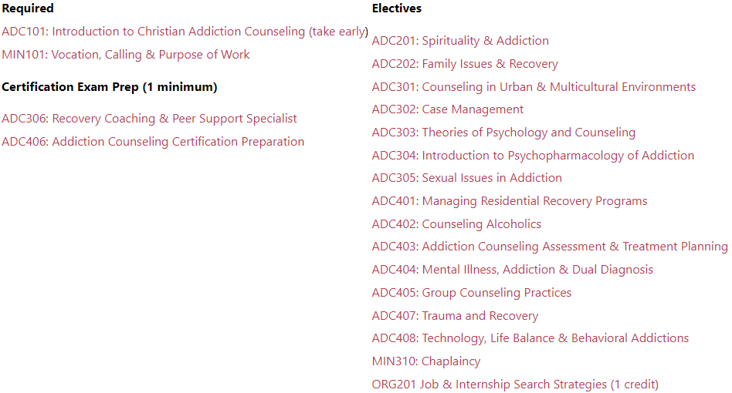
City Vision Certificate Program in Addiction Counseling
(6 courses)
Associate’s (60 credits) & Bachelor’s (120 credits) in Addiction Counseling build
on same course list with additional required courses

Slide 22
Questions & Discussion?

Slide 23
Appendix

Slide 24

Staff
Program
Participants
& Graduates

Slide 25
Build vs Buy: Curriculum Development
CO-DEVELOP
DEVELOP IN-HOUSE
UNIQUE
Q1. HOW UNIQUE IS THE CONTENT TO THE ORGANIZATION?
GENERIC
BUY
BUY
LIMITED
MANY
Q2. WHAT RESOURCES DO WE HAVE IN HOUSE?
Chart Source: https://pd.hotshotlegal.com/buy-or-build-a-framework-for-deciding-when-to-create-or-outsource-training-content

Slide 26
Build vs. Buy Questions
How closely aligned does the outside curriculum align with your values?
Does it cost more to build it yourself than buy it?
How soon does the course need to be delivered?
Does build or buy significantly improve the quality of the offering and better address needs?
Can you buy a license for unlimited use, or do you have to continue to pay for each learner as you add them?
How hard is it to build and do you have the resources internally to build it?
Is there a relational advantage to developing or delivering the curriculum yourself?
Some questions adapted from https://www.caveolearning.com/blog/6-questions-for-learning-leaders-to-solve-build-vs.-buy-scenario

Slide 27
Levels of Outsourcing for Educational Programs
Fully Outsourced Sub-program
Program Model
Credit Recognition
Course
Curriculum (you teach)
Videos
Books
Articles

Slide 28

Importance of Christian Worldview Values Alignment Across Subjects
Values Alignment
Less Important
Addiction
Counseling &
Nonprofit
Management
Business
GED, ABE &
Vocational
Training
Values Alignment
More Important
Notes:
Gangel, Kenneth o. 1978. Christian higher education at the end of the twentieth century, Part 2: Integrating faith and learning: Principles and process, Bibliotheca sacra 135.0538, 99-108. Available from ATLA Serials 2002. Retrieved 7 November 2003 from http://66.77.30.29/pls/elil pshow?lcookie=915583&pid=1000474&lmode=ME&lfirstp=99.

