Slide 1
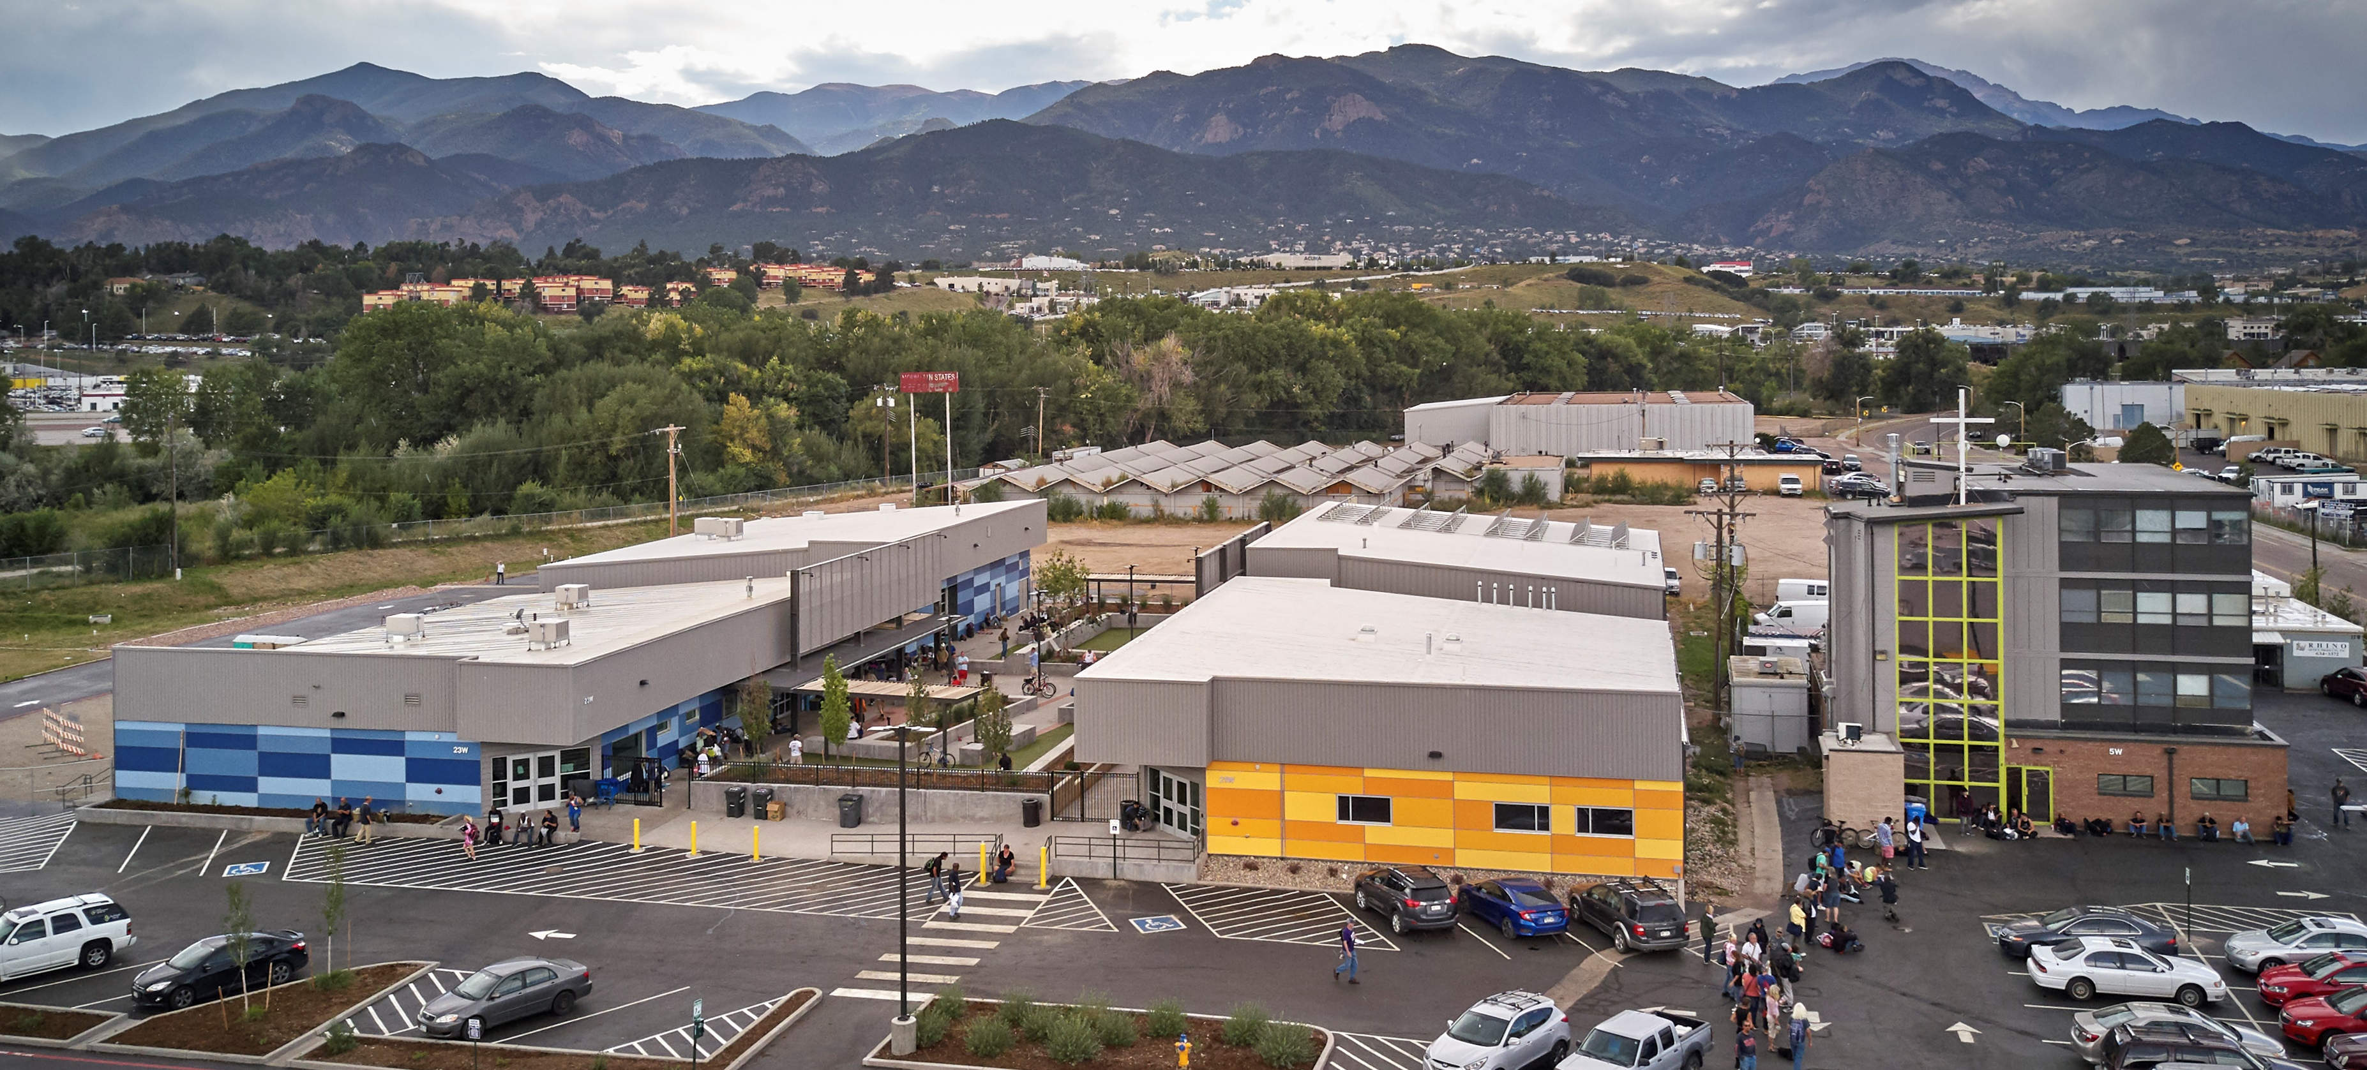
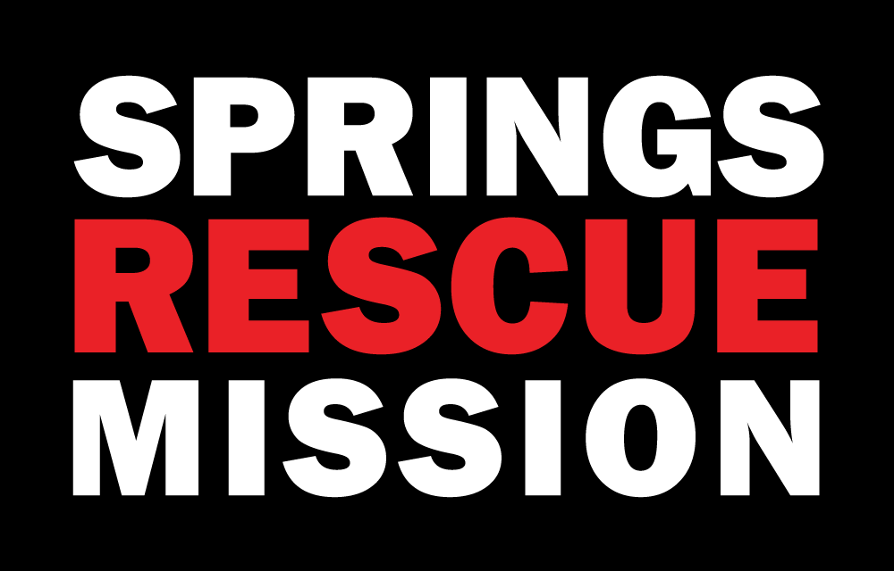
Staff Development

Slide 2
Staff Development
Staff Retention
Program Development
Main Points

Slide 3
Staff Development
What is Staff Development?
Encompasses any professional training or continuing education that an employer facilitates in order to support workers in furthering their career.
It is what we are doing here at City Gate Network.

Slide 4
Why is Staff Development important?
Improves employee engagement – After starting a development program I would hear staff discussing what they learned and how it was relevant to their work
Increases retention – Our turnover is nearly nonexistent now for those who have taken advantage of this opportunity
Attracts top job candidates – We also pay for case management oversight and other development which has garnered us some great employees
Enhances productivity – our staff already worked hard but now they work together as they are on the same page
Helps employees reach their full potential – almost every employee has received a promotion through this process. Others have done it to move to another area of the organization
Staff Development

Slide 5
Springs Rescue Mission growth Since 2013 was Exponential
Grew from a couple acres to 15
Had a few buildings - Now around 20
40 employees in August 2013; Currently – 110
Largest low-barrier shelter in Southern Colorado
In other words, growth was a part of the organization.
However, turnover of staff was just as fast.
Is growth good for organization?

Slide 6
Costs money to hire new staff
Burnout staff to cover shifts
Hire a warm body
Less capable staff
Perpetuates the situation
Other issues?
What happens when you lose staff?
We needed something to change.

Slide 7
What happens when you lose staff?
Costs money to hire new staff
Burnout staff to cover shifts
Hire a warm body
Less capable staff
Perpetuates the situation
We needed something to change.

Slide 8
Create an Employee Development Process:
Employee
Retention
Certificate Programs
Manager/Leadership
Case Management
Meet weekly as a group with a senior leader
Discuss work relevance

Slide 9
Turnover:
Supervisors to higher management - nearly non-existent
Current employees:
Many have been promoted. Would not have had the qualifications prior
Culture
Team and collaboration
Staff is Engaged

Slide 10
Unintended Benefits
Innovating/creating a new program as a team
Understanding program development processes
Collaborating at levels I have never seen before
Team Development

