Slide 1
Can Unity and Diversity Co-exist in Your Organization?
Andrew Sears, President
City Vision University
Citygate Network Conference
Notes:
Who has tried significant diversity efforts in your organization? How did they go?
8:45-10:00. With an open heart and the right strategy, you can cultivate unity and expand ministry by increasing diversity. This workshop will outline a path toward nurturing staff cultural intelligence, identifying barriers, and implementing an effective change process. We’ll also discuss demographic trends, cross-cultural leadership lessons, the role of diversity in measuring outcomes, and assessing organizational culture across various dimensions.

Slide 2
Biblical Reflection on Why Diversity Efforts Fail
Luke 14: 28-32. For which of you, desiring to build a tower, does not first sit down and count the cost, whether he has enough to complete it? Otherwise, when he has laid a foundation and is not able to finish, all who see it begin to mock him, saying, ‘This man began to build and was not able to finish.’
Or what king, going out to encounter another king in war, will not sit down first and deliberate whether he is able with ten thousand to meet him who comes against him with twenty thousand? And if not, while the other is yet a great way off, he sends a delegation and asks for terms of peace.
Ephesians 6:12. For we wrestle not against flesh and blood, but against principalities, against powers, against the rulers of the darkness of this world, against spiritual wickedness in high places.
Notes:
My history on this verse.
Because of our lack of cultural intelligence, we do not recognize how much of a challenge we are taking on.
TechMission history
Systemic injustice = principalities
https://www.dts.edu/about/policies-procedures/statement-on-unity-diversity-community/

Slide 3
What is Cultural Intelligence (CQ)
CQ is a cultural analog to IQ and EQ (combining head, heart and hands)
CQ measures ways of assessing and improving effectiveness for culturally diverse situations
CQ Drive
CQ knowledge
CQ Strategy
CQ Action
CQ: Cultural
Intelligence
Adapted from Dr. David Livermore’s Model
https://culturalq.com/about-cultural-intelligence/

Slide 4
Why Initial Diversity Efforts Often Fail
CQ Drive
CQ knowledge
CQ Strategy
CQ Action
“We need to do something about diversity”
Take on more than you can handle
resulting in conflict & failure:
“I’m never doing that again”
X
Do not know enough to assess
how significant of a cross-cultural
challenge you are taking on
Learn just enough to be dangerous:
Learn about the need, but not the “how”.

Slide 5
Part 1. CQ Drive: Recognize the Need for Increased Diversity in Your Organization
Andrew Sears, President
City Vision University
Citygate Network Conference
Notes:
CQ Drive

Slide 6
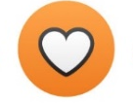

Part 1. CQ Drive
CQ Drive
CQ Knowledge
CQ Strategy
CQ Action
Part 1. Biblical repentance of head and heart
prioritizing growth cross-cultural fluency & diversity
+

Slide 7
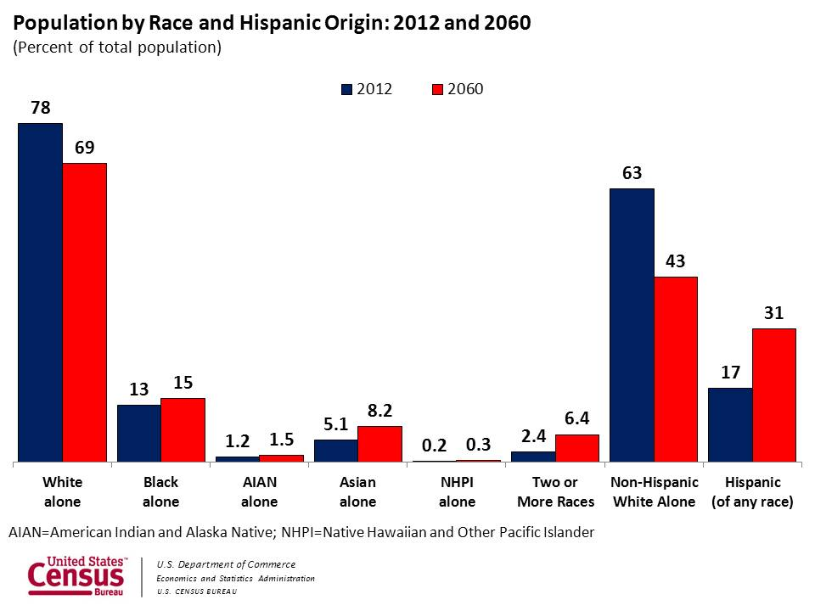
US Demographic Trends
Notes:
What is changing generationally?

Slide 8
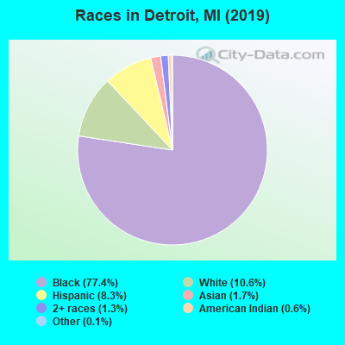
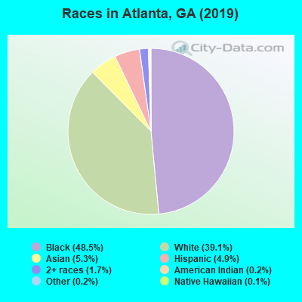
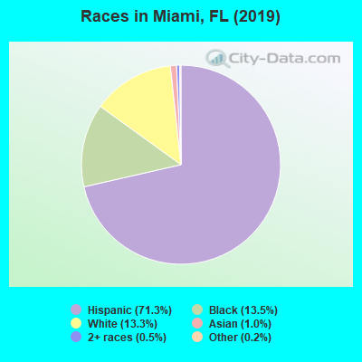
Demographics of Most Cities Are Decades Ahead of National Demographic Trends
Notes:
What is it like growing up in a different racial context?
My story: Grew up attending white evangelical churches and schools and Black churches.
Grew up in racially mixed neighborhood
My spiritual formation in ministry came partly through mentorship of rescue missions and partly from CCDA and the black church
For most of our history about 2/3rds of our staff and board have been Black and Latino. Seasons where I was the only white person. That just felt normal to me.
The past few years, I feel like have two divorced parents that won’t talk to each other
I remember the good days when John Perkins was a keynote speaker at Promise keeper events and racial reconciliation was “cool”
Now you say the words “racial reconciliation” and far right accuses you of imposing critical race theory on them, the far left say it’s a term that’s too slanted toward white people
The reality is that many more people in younger generations are growing up in a context with more racial diversity than in previous generations.
To help address this, one of our top strengths at City Vision has been in helping others grow in their own cultural intelligence.

Slide 9
Nonprofit Leadership Does Not Reflect Racial Community It Serves
Source: http://www.aecf.org/upload/publicationfiles/executive_transition_survey_report2004.pdf
Notes:
1.4 million registered nonprofits in USA
1,169,000 White-led nonprofits
138,600 Black-led nonprofits
50,400 Latino-led nonprofits
12,600 nonprofits led by other races
Source: Number of nonprofits from Independent Sector; racial breakdown extrapolated based on survey results at:
http://www.aecf.org/upload/publicationfiles/executive_transition_survey_report2004.pdf

Slide 10
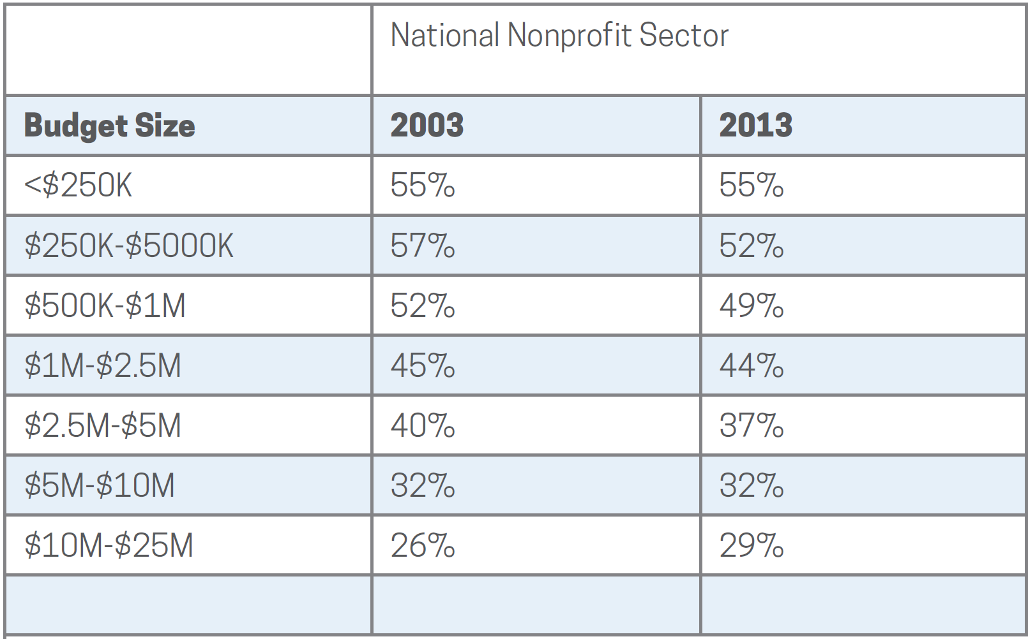
Percentage of Nonprofit Female CEOs
Source: Guidestar Compensation Survey 2015

Slide 11
Women in Leadership Evangelical Organizations vs. All Nonprofits
In Evangelical Organizations Women hold:
21% of board position
16% of CEOs
19% of top-paid leadership positions
Across All Nonprofits Women
hold:
43% of board position
40% of CEOs
Source: Women in Leadership National Study, Amy Reynolds, Wheaton College

Slide 12
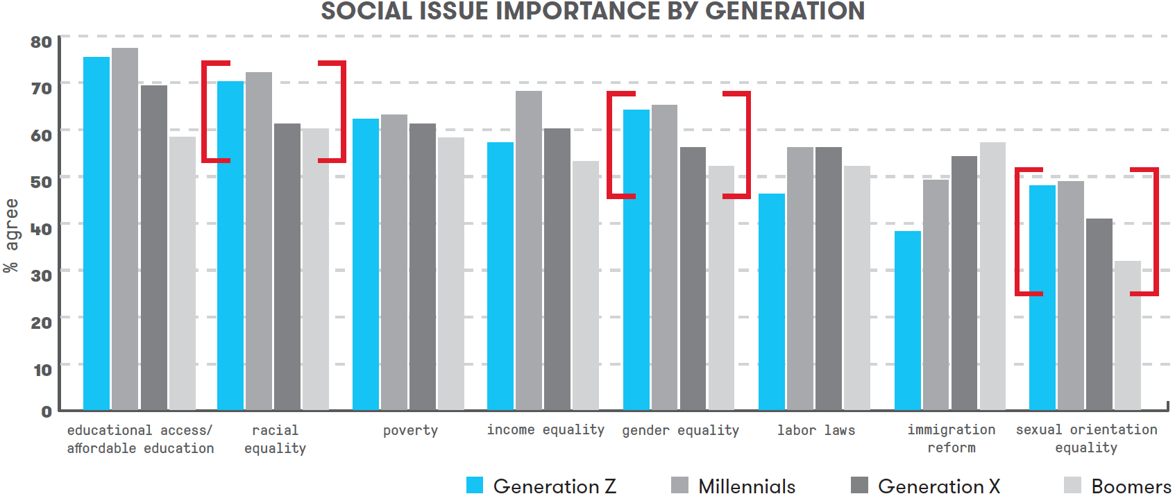
Generational Trends on Social Issues and Diversity
Source: https://www.marketingprofs.com/charts/2018/33740/getting-to-know-gen-z-beliefs-preferences-and-behaviors
Notes:
Probably the most significant slide of the presentation
The top three generational differences on social issues are: race, gender and sexual orientation.
For organizations that uphold the traditional Biblical view on marriage and sexuality, it will be increasingly important to improve the racial and gender diversity of leadership to appeal to Gen X, Millennials & Gen Z donors. Donations today are still primarily driven by Boomers, so the real pressure will happen when donations are driven by younger generations.
Concept of Deferred Maintenance, Technological Debt & being a generation or two behind on where you should be cross-culturally

Slide 13

Case Study: InterVarsity
Context
  Serves largely on secular college campuses that are racially diverse
  and are more left-leaning
Strategic choices
  Strongly promote gender equality and racial equality
  Developed policies to clearly affirm traditional view on marriage and sexuality
Implications
  InterVarsity Press became global leader on evangelical racial dialog
  Was banned from meeting on several leftist campuses creating social stigma and limited recruitment
  Some InterVarsity chapters at leftist campuses left InterVarsity
Notes:
So how to address these changes? InterVarsity serves as a good case study

Slide 14
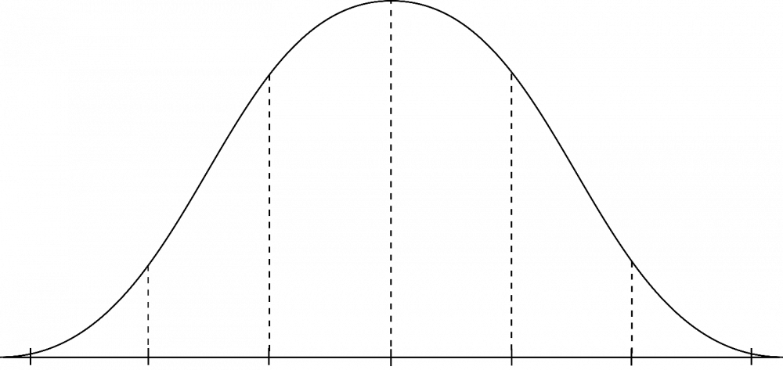
How Significant Are External Pressures for Change?
Great Need for Change
Less Immediate Need
Examples: Atlanta, Miami, Detroit, San Francisco, South Africa, etc.
Majority of constituents are of different race/ethnicity of leadership
Extended community/city is different racial/ethnic group than leadership
Younger donors (including evangelicals) in your region strongly value diversity in leadership
Examples: ministries serving regions with predominantly white community
Limited differences in leadership and constituents
Extended community/city is White and conservative
Donors in your region do not place significant value on diversity
Notes:
Part of what makes talking to a group like this difficult is the wide range of organizations and contexts you serve in.
What of your organizations are more on the left side vs right site?

Slide 15
Part 2: How to Grow in CQ Knowledge
Andrew Sears, President
City Vision University
Citygate Network Conference

Slide 16
Part 2. CQ Knowledge
CQ Drive
CQ Knowledge
CQ Strategy
CQ Action
Biblical repentance of head and heart prioritizing
growth cross-cultural fluency & diversity
+
Part 2: develop cross-cultural fluency
needed to lead bridge-building efforts

Slide 17
1. Develop a plan to grow your cultural intelligence individually & organizationally
Individually
  Head/Cognitive: Reading, taking a course, watching videos, learning a language
  Heart/Affective: Cross-cultural friendships, attending cross-cultural church as a minority, immersion in cross-cultural community as a minority, being supervised cross-culturally
  Hands/Psychomotor: Managing cross-culturally, working cross-culturally (peers), serving cross-culturally (clients)
Organizationally
  Develop a cross-cultural assessment plan
  Conduct interviews, analyze data & diagnose problems
  Develop a plan with develop goals & outcomes that stretch organization but not beyond its limit
  Staffing & training strategy

Slide 18
2. Know Where You Want to Go
Use Appropriate Training & Leaders to Expand Cultural Intelligence
Identify Training & Leaders
Appropriate for Your Goals
White Fundamentalist (or near) Churches & Ministries
White Evangelical Churches & Ministries
Highly Multiethnic
Bible-Based
Churches & Ministries
Working Class Black, first generation Hispanic & Asian American
Bible-Based
Churches
Upper Middle Class
Black, 2nd+ gen Latinx, Asian American Bible- Based Churches
Radical or Secular
Identity
Political
Movements
Nearly all-White
Nearly all non-White
Brian Fikkert
Bob Lupton
Ray Bakke
Tim Keller
Intervarsity Press
John Perkins
Brenda Salter McNeil
Miles McPherson
CCDA 1.0
Intervarsity Press
Sheila Wise Rowe
Robert Chao Romero
Carl Ellis
CCDA 2.0
Notes:
Bob Jones Network
Dallas Statement on Social Justice
Renegade fear-mongers on social media
https://www.openbible.info/topics/fear_mongers
Overton_window

Slide 19
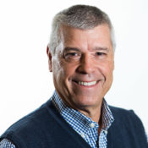
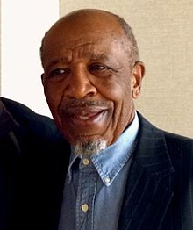

Most Effective Cross-Cultural Partnerships Utilize Two Bridge Builders: CCDA
Wayne Gordon
John Perkins
Culturally fluent in bridging to
African American culture
Black “missionary” to White
evangelicals on issue of race

Slide 20
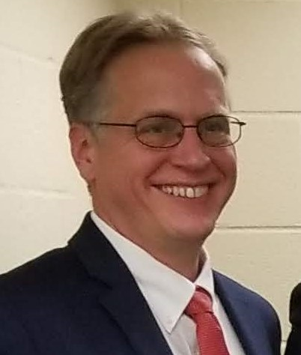
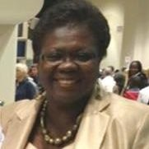
Most Effective Cross-Cultural Partnerships Utilize Two Bridge Builders
Culturally fluent in bridging to
African American culture
Culturally fluent in bridging
to White culture

Slide 21
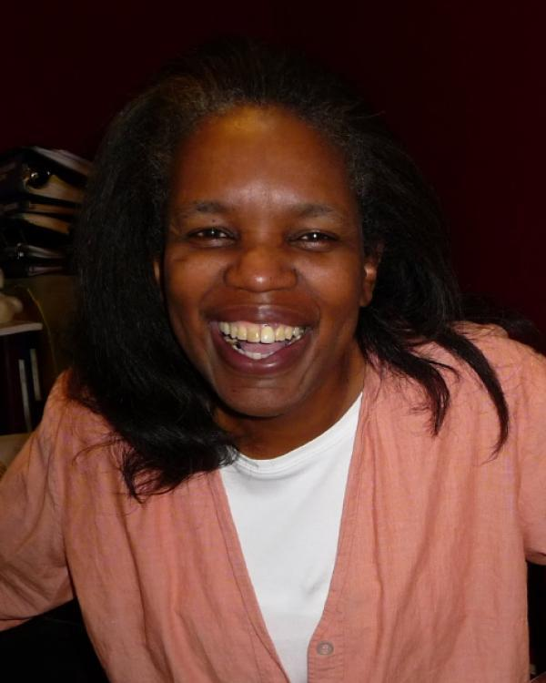
Most Effective Cross-Cultural Partnerships Utilize Two Bridge Builders
Culturally fluent in bridging to
African American culture
Culturally fluent in bridging
to White culture

Slide 22
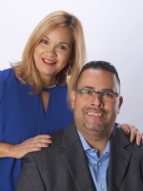
Most Effective Cross-Cultural Partnerships Utilize Two Bridge Builders
Growing in fluency bridging
to Latino/a culture
Latino pastor culturally fluent
in bridging to White culture

Slide 23
How Cross-Cultural Partnerships Fail
Primary leader has limited
cross-cultural fluency
(not a core competency)
Hires minority in ministry
who is not called to be a
bridge builder

Slide 24
Part 3: Six Lessons to Inform
Your CQ Strategy
Andrew Sears, President
City Vision University
Citygate Network Conference
Notes:
CQ Drive Part 2

Slide 25
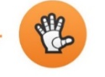
Part 3. CQ Strategy
CQ Drive
CQ Knowledge
CQ Strategy
CQ Action
Part 1. Biblical repentance of head and heart
prioritizing growth cross-cultural fluency & diversity
+
Part 3. Identify strategic steps based on
an accurate cultural assessment of where
you are and where you want to go
Part 2. Develop cross-cultural fluency
needed to lead bridge-building efforts
+

Slide 26
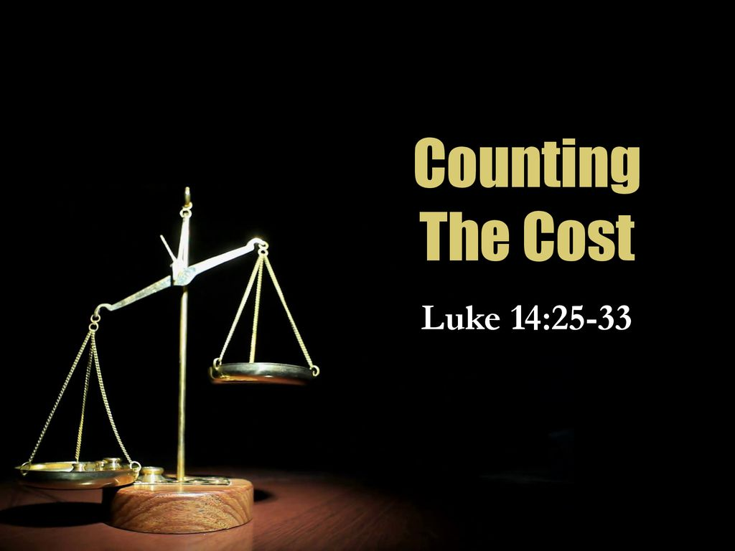
Most Cross-Cultural and Diversity Efforts Fail from Inability to Accurately Count the Cost
How do you count the cost
in diversity & cross-cultural efforts?
Image Source: https://slideplayer.com/slide/16754144/ and Wikipedia

Slide 27
Lesson 1: Understand Cultural Degrees of Separation to Assess Cultural Distance
Ralph Winter represents cultural degrees of separation as E0 (same culture), E1 (one degree removed), E2 (2 degrees removed)
Key dimensions that may influence degrees of separation or distance
  Race/Ethnicity
  Social class: poor, working, middle, upper
  Gender
  Language
  Immigrant generation (first, second)
  Country of origin
  Christian vs. non-Christian (and various denominations)
  Organizational values alignment
You learn how these dimensions affect your cultural distance based on your knowledge of yourself, other cultures and experience
Notes:
The field of missions has had concepts similar to that of intersectionality, but have presented them within a Christian worldview.

Slide 28
Lesson 2: Assess Your Personal Cross-Cultural Sphere of Influence
Tier 3
International Middle Class
(other language)
Everyone Else
Tier 2
Tier 1
White
Upper
Middle
Class
Women
Black
Poor or
Middle
Class
White & Black
Working Class
White
Middle
Class
Poor
White
2+ Gen Latino/a &
Asian Working Class
First Generation, Poor or Middle
Class Latino/a or Asian

Slide 29
Lesson 3. Assess Your Organizational Cross-Cultural Sphere of Influence
Tier 3
Non-Christians Seeking
Affordable Nonprofit Degrees
(largely adult White & Black working class)
Everyone Else
Tier 2
Christians
in Nonprofit Professions
(largely Adult White & Black Working Class)
Tier 1
Asian &
Latino
Christians
In Nonprofit
Professions
Or Program
Participants
Bible-Centered
Christians
Serving the Poor
(largely Adult
White & Black
Working Class)
International
Students
in NGOs or
Parachurch
Ministries
Participants from Evangelical
Programs Serving The Poor
(largely Adult White & Black
Working Class)
Christians Seeking
Affordable Degrees
(largely adult White &
Black working class)
Closer to center means that we
typically serve them most effectively
Notes:
Recognize that much of systemic injustice is Caused by Cross-Cultural Limits of Dominant Groups

Slide 30

Lesson 4. Your Sphere of Influence is Determined by Cross-Cultural Law of the Lid
In Cross Cultural Contexts: Your leadership ability will vary across different cross-cultural groups
Image Source: https://sajigroup.com/the-21-irrefutable-laws-of-leadership-the-law-of-the-lid/
Notes:
John Maxwell’s Law of the Lid: “If your leadership rates an 8, then your effectiveness can never be greater than a 7.” This is because you can only effectively lead those at a 7 or below.
i.e. someone who is a level 8 leader with White middle-class men, might be a 5 with Black upper-middle-class womenEach person will have a different cross-cultural sphere of influence (or leadership levels) across various groups given their cultural background, identity and personality

Slide 31
Lesson 4. How Cross-Cultural Law of the Lid Plays Out Organizationally
White Male, Middle Class Leader
(Levels: White 8, Asian 7, Black 6, Latino/a 6,
Female or Class Reduce 1)
White Male
Middle Class
Level 7 Leader
White Female Working Class Level 5 Leader
Black Male Middle Class
Level 5 Leader
Latina
Level 4 Leader
15 largely white staff
Black Male Working Class Level 3 Leader
Black Male Working Class
Level 3 Leader
Notes:
Conflict.

Slide 32
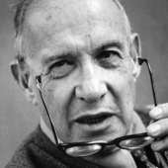
Lesson 5. Conduct Evaluation to Get Honest Measure of Organization’s Cultural Sphere of Influence
“What you don’t measure,
you can’t improve.”
- Peter Drucker
Assess demographics of participants (not showing up is a big indicator)
Assess success rates and complaints of constituents across key cultural dimensions
Do you have adequate staffing that is culturally close to be able to meet their needs?
What is the difference in success rates of clients across Race/Ethnicity? Other Factors?
Diagnose: If the success rates are much lower for key target groups, then you are not focused enough on meeting the cultural needs of your clients.
See Sample Diversity Data Form at:
https://docs.google.com/spreadsheets/d/1VRKq-xh7mAZxW-0Bzcg0Gjn3bJBKiYaETc3R8DcK5sM/edit#gid=1447133305

Slide 33
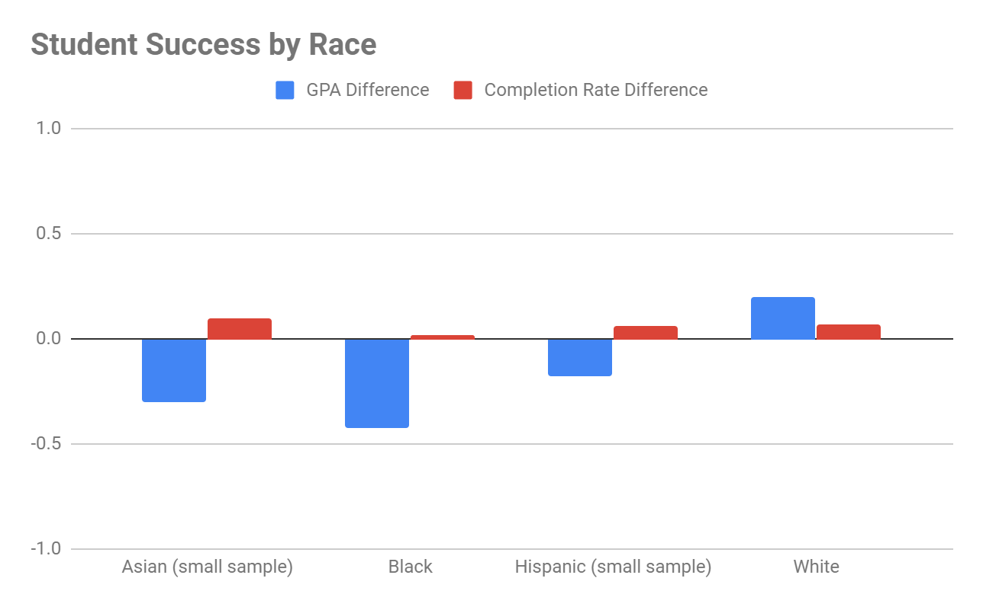
Lesson 5. Example of Measuring Cross-Cultural Effectiveness (City Vision example)

Slide 34
Lesson 6. Develop a Leadership Pipeline Strategy to Increase Diversity
1. Diversity Measurements
& Intentionality
At Every Level
Board
Senior Management
Middle Management
Hiring & Entry Level Positions
2. Diversity At Every
Level Needed for
Leadership Pipeline
3. Recognize That Values & Culture Will Be Set
By Those With Power In The Organization
4. Recognize that leadership diversity priorities will be in tension with
other priorities. Focus on maximizing mission in the long-term.
Notes:
Military as a good example
Peter Drucker: If you don’t measure it, you can’t manage it.
World Vision

Slide 35



As Budget Grows the Cultural Center Can Move too Far from Clients
Limiting Effectiveness For Ministries Serving Under-resourced Communities
Clients
New Organization’s
Cultural Center
Large Organization’s
Cultural Center
Resources
Funders

Slide 36
Part 4: CQ Action & Next Steps
Andrew Sears, President
City Vision University
Citygate Network Conference
Notes:
CQ Drive Part 2

Slide 37
Part 4. CQ Action
CQ Drive
CQ knowledge
CQ Strategy
CQ Action
Part 1. Biblical repentance of head and heart
prioritizing growth cross-cultural fluency & diversity
Part 4. Apply principles of change management to implement steps of change. Learn & repeat whole process.
+
Part 3. Identify strategic steps based on
an accurate cultural assessment of where
you are and where you want to go
Part 2. Develop cross-cultural fluency
needed to lead bridge-building efforts
+

Slide 38
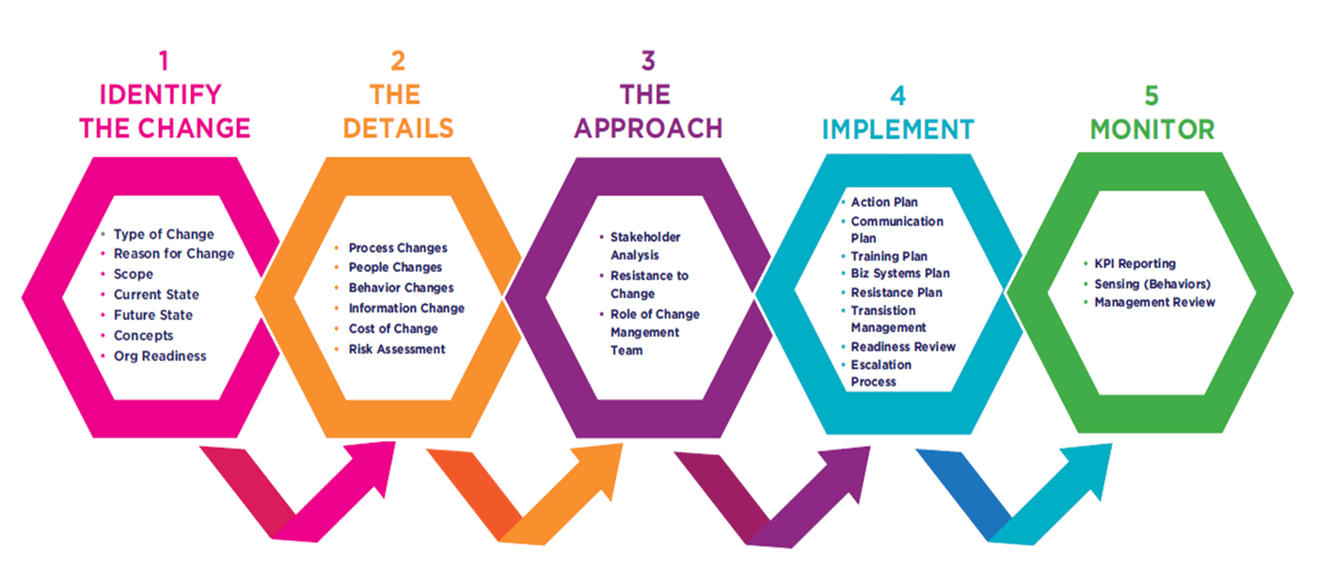
Change Management Process

Slide 39
Change Management Process

Slide 40
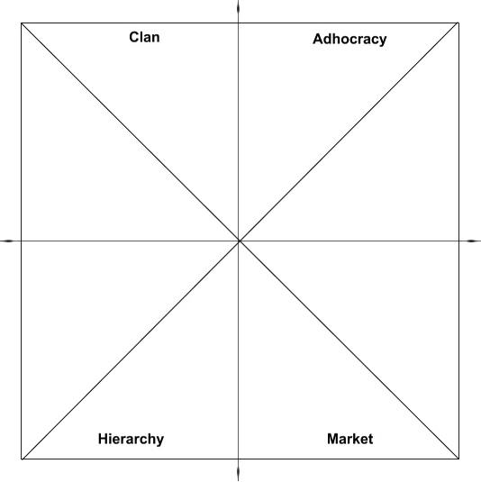
Culture Wars at Christian Nonprofit Organizations of Previous Generations
Vision: “Ministry as family”
Who: Ministry & Counselors (FP)
Often indigenous leaders raised within ministry
Risks
Nepotism and/or ”Holy Huddle”
Financial decline
Christian tribalism
Staff with Ministry Mindset
Solution 2: Train ministry staff in
business skills
Solution 3: Recruit bi-vocational ministers
& promote those who are “bilingual”
Solution 1: Provide cross-cultural ministry
training to staff from business background
Staff with Business Mindset
Vision: “Best practices of business world”
Who: Business Background (TJ)
Often “outside hires”
Risks
Culture of “it’s just business”
Gentrification of ministry
Dilution of culture from growth
1. Entrepreneurship
2. Balanced Social Change
Notes:
The challenge is that over the past 20 years, I’ve seen wars of organizational culture between two different mindsets
I’ve seen students from a business background judging the ministry side as “soft”
Those from the ministry side just the other side as “it’s just business”
One of the main things we do at City Vision is to help bridge this divide

Slide 41

Directing Staff Training to Improve Cross-Cultural Fluency
Ministry & Relational Competencies
• Cross-Cultural Management & Ministry
• Leadership in Under-Resourced Communities
• Christian Community Development
• Urban Youth Ministry
• Organizational Behavior & Health
• Vocation, Calling & Purpose of Work
• Technology, Life Balance & Addiction
• Bible & Theology Courses
• Counseling Courses
Cross-cultural
Competencies
Innovation Competencies
Social Entrepreneurship
Intro to Entrepreneurship
Educational Program Development
Transformational Change Leadership
(Collaborate)
(Create)
Spiritual
Formation
Ministry Competencies
Entrepreneurial Competencies
Introduction
& Capstone
Courses
• Introduction to Nonprofit & Ministry Management
• Strategic Management
Operations
Competencies
Business & Funding
Competencies
Operations & Governance Competencies
Nonprofit Human Resources
Nonprofit Financial Accounting
Executive Leadership & Board Development
Nonprofit Program Planning
Project Management
Business & Funding Competencies
Marketing
Grant Writing
Nonprofit Fundraising
Major Gifts & Planned Giving
Introduction to Business
(Control)
(Compete)
Notes:
Innovation
Demographic Change
Change through Education
Organizational Change

Slide 42
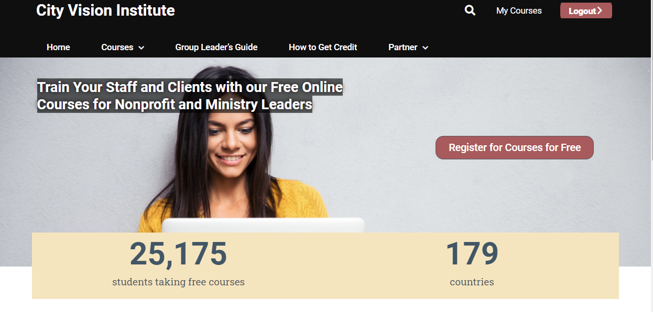


Courses
Available
for Free or
For Credit

Slide 43
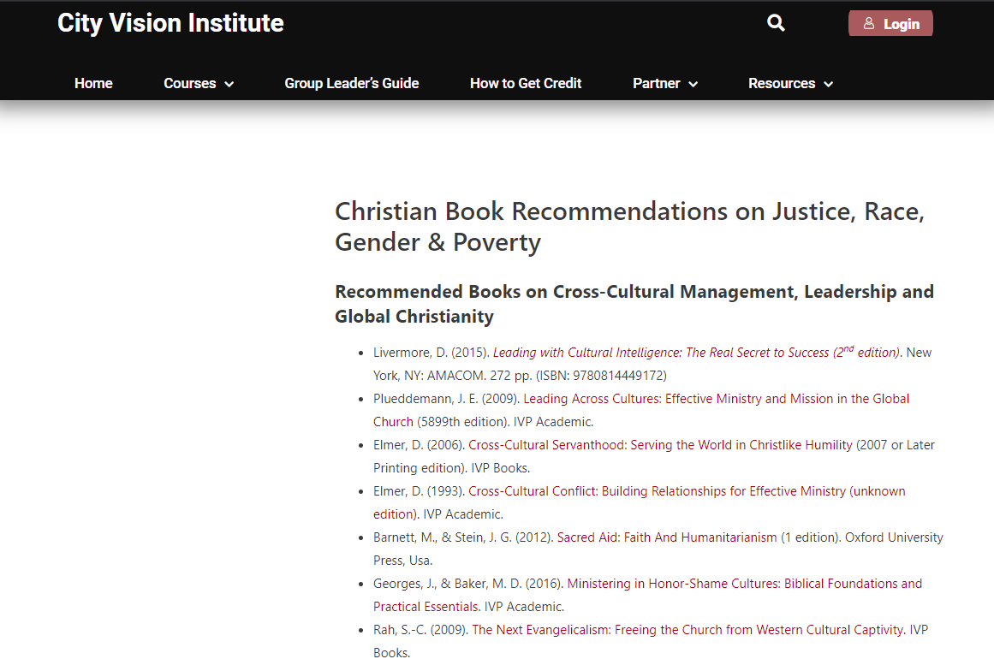
Notes:
Recording of this talk

Slide 44
Not Used or Appendix
Andrew Sears, President
City Vision University
Citygate Network Conference

Slide 45
Navigating Critical Race Theory: Big Picture and Origins
Social Sciences
Psychology
Sociology
Critical Theory
Clinical Psychology & Counseling
Critical
Race
Theory
Notes:
Critical Theory largely originated in Germany academic circles initially as a critique of Hitler’s Nazism.
CRT largely emerged in US academic circles in the 1980’s as “a collection of critical stances against the existing legal order from a race-based point of view”

Slide 46
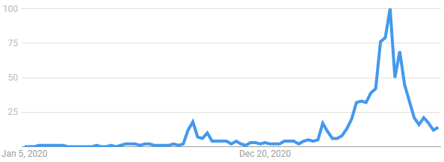
How Did “Critical Race Theory” become a Major Issue
Google Searches on Critical Race Theory
State Battles over
CRT in Education
Trump Releases
White House
Memo on CRT
Notes:
Was around since the 1980s, and similar theories with different names since the 1960’s, but was not a major issue
September 2020, Trump
Before that, the Manhatten Institute funded an initiative to focus on rebranding all “cultural insanities” under CRT

Slide 47
Critical Race Theory: The Big Picture
Critical Race Theory (CRT) is one of hundreds of frameworks
for understanding race (popular in secular academic circles)
The controversy around CRT is driven by polarization from social media and politics
Framing the race discussion primary through controversy around CRT largely shuts down the race discussion
Most Christian criticisms and controversies around CRT largely apply to other social sciences - i.e., debate over counseling/psychology

Slide 48
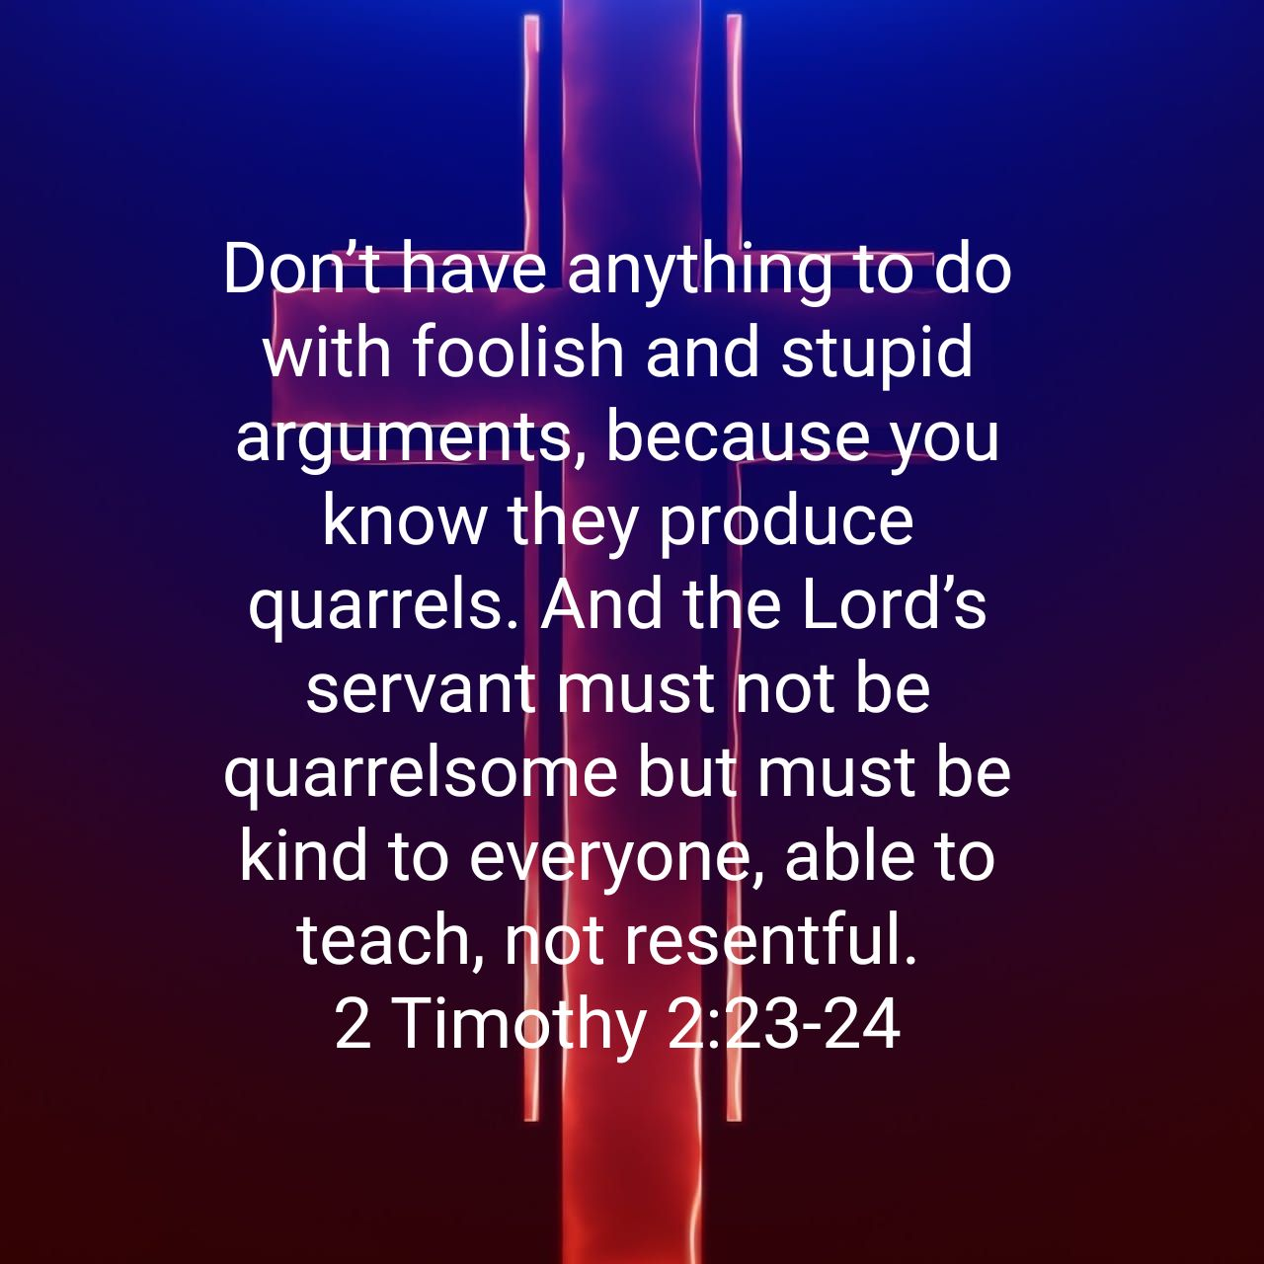

Slide 49
Translating Social Sciences Through a Christian Worldview
New Cross-Cultural Competencies Needed
to Manage Demographic Transition in Society
Christian Worldview
Translation of Social Sciences
Secular Social Sciences
Church
Scattered
(sent into
the world)
Church
Gathered
(not of
the world)
City Vision Courses
Christian Community Dev’t
Cross-Cultural Ministry
Leadership in Under
Resourced Environments
Inadequate Translations
Levels of Explanation in Counseling
Weak Integration Christian Counseling
Social Gospel
Christians with Secular Worldview in their field
Political Science
History
Economics
Sociology
Critical Race Theory
Anthropology
Cultural Studies & Gender Studies
Social Identity Development
Notes:
Should we have Christians in Hollywood? In academia?

Slide 50
Dualism Heresy: Secular-Sacred Divide
Sacred
Personal beliefs
Church/religion
Sunday
Secular
Counseling/Psychology/Sociology
Science
The other 6 days
“The sacred-secular dualism is the worst heresy of the Christian church worldwide” – R. Paul Stevens
The whole world is sacred and under God. Ephesians 4:6, Isaiah 6:3, Psalm 139:8
Notes:
“[There is] one God and Father of all, who is over all and through all and in all.” (Ephesians 4:6)
“And one called to another and said: ‘Holy, holy, holy is the Lord of hosts; the whole earth is full of his glory!’” (Isaiah 6:3)
“If I ascend to heaven, you are there! If I make my bed in Sheol, you are there!” (Psalm 139:8)

Slide 51
Christian vs. Secular Social Science Worldview
Christian Worldview Dominant Secular Social Science Worldview
Base Worldview Christian Worldview Secular Scientific Naturalism
Fundamental Problem? Sin Social/Psychological Problem: i.e. Unequal Power
Solution? Salvation Social/Counseling Solution (Power)
Who are we? In God’s Image but fallen Thinking animals/Collection of atoms
Identity in Christ Primary Identity is social/group identity
Where we came from? God Accidental Cosmic Chance
Philosophy? Spiritual, wholistic Materialistic, postmodern
What is truth? Biblical+ general revelation Entirely socially constructed
Values Bible-based Pretends (falsely) to be value-free
How should I live? Love God, Love Others Individual Pleasure Maximizing
and/or Social Activism
Sources: The Universe Next Door, Hidden Worldviews

Slide 52
Individual Development, Community Development & Reform
Relief/Charity give a man a fish
Individual Development teach a man to fish
Community Development microloan program for fishing equipment
loan to buy a lake
raise up indigenous leaders to train others
Advocacy/Reform teach on global structures of fishing industry
just laws to provide fair access to fishing
just macroeconomic policies to maximize
national revenue of fishing industry

Slide 53
Assess Organizational Demographics with a Diversity Data Form

Slide 54
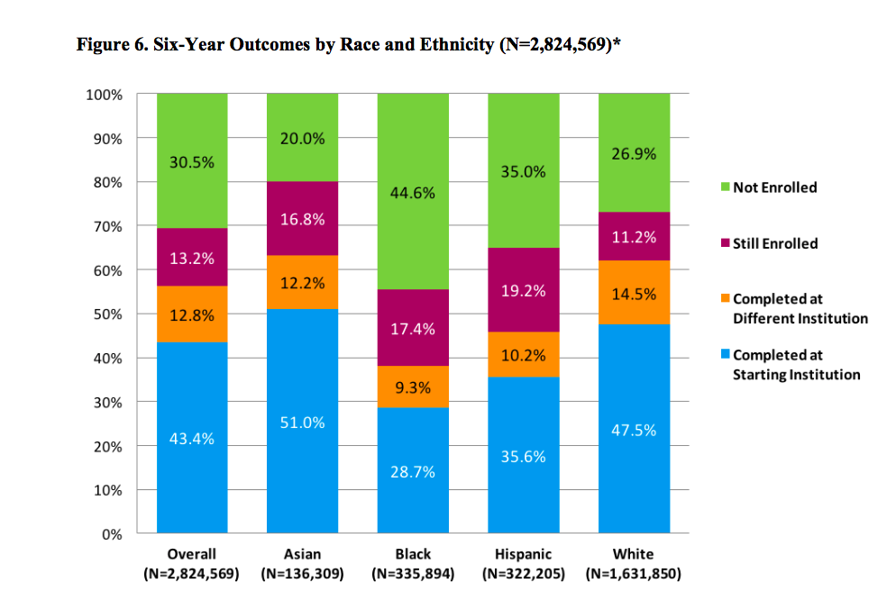
Lesson 1. Benchmarking Success Rates across Demographics to Industry
3. Diversity
2. Balanced Social Change
1. Entrepreneurship
Source: https://www.insidehighered.com/news/2017/04/26/college-completion-rates-vary-race-and-ethnicity-report-finds

Slide 55
Goal: Stretch organization’s cross-cultural limits to maximize long-term mission effectiveness
Our Clients
Resources
Funders
Dominant Culture

Slide 56
Lesson 5. Understand Types of Injustice
Bigotry
Selfishness
Bullying & abusive management
Not understanding culture & perspective
Unintended offense
Unconscious individual bias
Individual
2
3 4
Need to Grow Your Cross-Cultural
Sphere of Influence
Unjust laws, policies & exploitation creating an unequal playing field
Resources & leadership tend to be concentrated in
White, Western, Middle/Upper Class and Male
Creates cultural encroachment & assimilation
Collective
Intentional
Unintentional
Notes:
Applying systemic theology to a current problem like addiction helps explain how systemic theology can be helpful.
Most problems like addiction have multiple inter-related causes.
Using the four quadrants and the different fields in each quadrant helps to understand different potential causes.
We often try to simplify things into one cause, and we have big debates over which item is the only cause.
These debates often can be summarized as “I believe Quadrant x is the most important (because of my predisposition) vs. I believe Quadrant y is the most important (based on my predisposition).”
If we understand multifaceted systemic causes, we can come up with a multifaceted solution.

Slide 57

Critical Race Theory
is a secular intellectual
response to a perceived
unequal playing field

Slide 58
Critical Race Theory is an attempt to create a
intellectual framework to offset the
unequal playing field

Slide 59
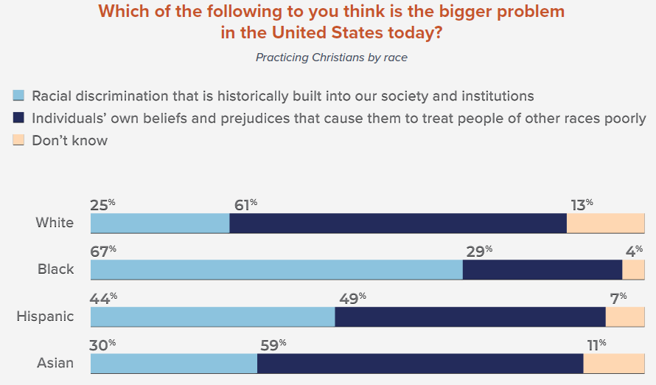
Different Christian Perspectives on Whether Institutions Create an Uneven Playing Field
Institutional Racism
Personal Racism
Gap Between White & Black Christian
Perspectives on Institutional Racism
Barna Beyond Diversity Study, 2019

Slide 60

Understanding Biblical Justice (Tim Keller)
Community: Others have a claim on my wealth, so I must give voluntarily.
  Deuteronomy 24:17-22
Equity: Everyone must be treated equally and with dignity.
  Leviticus 19:13; 24:22, Isaiah 33:15, Deuteronomy 24:14-15, Deuteronomy 24:14-15
Corporate responsibility: I am sometimes responsible for and involved in other people’s sins.
  Daniel 9, 2 Samuel 21, Joshua 7, Numbers 16, 1 Samuel 15:2, Deuteronomy 23:3-8, Exodus 20:5, Leviticus 19:15, Exodus 22:25-27; Jeremiah 22:13, James 5:4, Deuteronomy 24:14-15
Individual responsibility: I am finally responsible for all my sins, but not for all my outcomes.
  Proverbs 6:6-7; 13:23; 23:21, Exodus 22:21-27, Ezekiel 18, Deuteronomy 24:16
Advocacy: We must have special concern for the poor and the marginalized.
  Leviticus 19:15, Isaiah 1:17, Psalm 41:1, Proverbs 31:8-9, Jeremiah 22:3, Zechariah 7:9-10
Source: Tim Keller https://quarterly.gospelinlife.com/a-biblical-critique-of-secular-justice-and-critical-theory/

Slide 61
What Changes and Remains the Same Across Generations for Ministry?
What to Believe
How to See
What to Do
Doctrinal Foundation
Theological Vision
Ministry Expression
Timeless truths from the Bible
about God, our relationship to Him,
and His purposes in the world
Theological tradition
Organizational statement of faith
Systematic & biblical theology
A faithful restatement of the gospel with rich
implications for life, ministry, and mission
in a particular culture at a moment in history
Vision and values
Ministry “DNA”
Philosophy of ministry
Emphases
How the gospel is expressed
in a particular ministry in one
community at a point in time
Local cultural adaptation
Programs & processes
Organizational structure
Program Outcomes
1. Bible & Theology
2. Applied Theology
3. Vocation
4. Healthy Leadership
5. Cross-Cultural Ministry
6. Organizational skills
Adapted from Tim Keller’s Center Church
Notes:
Before slides: I like to think that part of our role as a university that grew out of the rescue mission movement is as an innovation hub similar to the relationship with Stanford and Silicon valley.
The problem is that as soon as you use the word innovation in ministry people get worried that you might change things that shouldn’t change.
So what can change and what remains the same across generations for ministry?
The best book I’ve read it Tim Keller’s Center Church

Slide 62

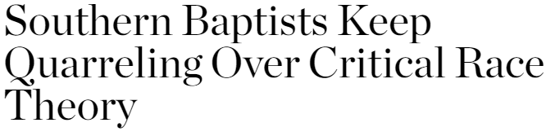

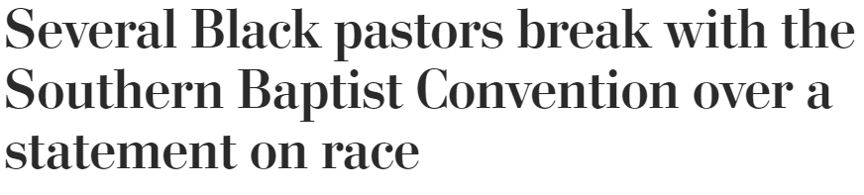
Case Study: Southern Baptists
Southern Baptists’ Seminary Presidents issue statement on CRT
Black Southern Baptist pastors
push back
Southern Baptist Convention elects bridge-builder Ed Litton as President
Image Source: https://www.pngegg.com/en/png-krljh

