Slide 1
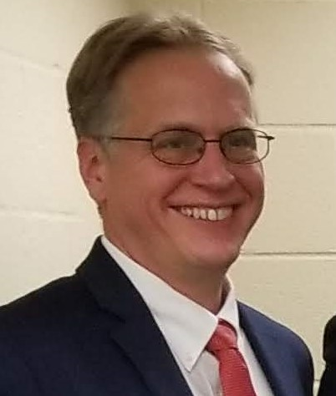
Using Curriculum, Internships and College Partnerships in Rescue Mission Programs
Andrew Sears President, City Vision University Gospel Rescue Mission Fellowship Conference
Notes:
My start with City Union Mission in Kansas City in 1992. Rescue College history
Meet with 50 to 100 rescue missions each year. Have had 35 faculty from rescue missions. Students from 110 rescue missions. If rescue missions were a denomination, we like to think of ourselves as the denominational school.

Slide 2
Education & Employment in Program Models
Residential Program
External Job (70-100%)
Vo-Tech Training (20-40%)
Mission Intern (0-10%)
College (5-20%)
Long Term Outcomes
Educational Components
Bible/Recovery Classes (144 hours)
Education & Vocational Courses (200)
Spiritual Devotions (72)
Other Program Components
Work Therapy (1,000)
Biblical 12-Step Program (36)
Physical Fitness: 200 hours (200)
Sunday Church Attendance (36 weeks)
Individual Counseling (18)
Active in local church
Employment
Sobriety
Stable housing
The hours listed above were modeled on: https://urm.org/services/ministry/

Slide 3
Education & Employment in Program Models
Residential Program
External Job (70-100%)
Vo-Tech Training (20-40%)
Mission Intern (0-10%)
College (5-20%)
Long Term Outcomes
Part 1
Educational Components
Bible/Recovery Classes (144 hours)
Education & Vocational Courses (200)
Spiritual Devotions (72)
Active in local church
Employment
Sobriety
Stable housing
Other Program Components
Work Therapy (1,000)
Biblical 12-Step Program (36)
Physical Fitness: 200 hours (200)
Sunday Church Attendance (36 weeks)
Individual Counseling (18)
Part 2
Part 3
Main Message of This Talk: Don’t Do It All Yourself
The hours listed above were modeled on: https://urm.org/services/ministry/

Slide 4
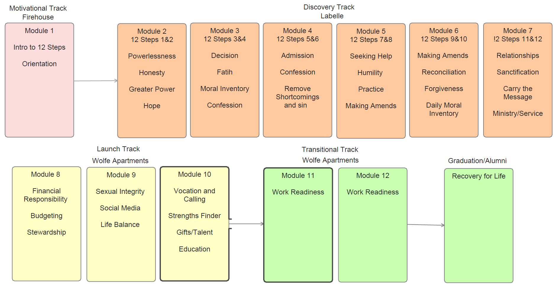
Sample Curriculum Plan for 12 Month Residential Recovery Ministry
Source: St. Matthew’s House

Slide 5
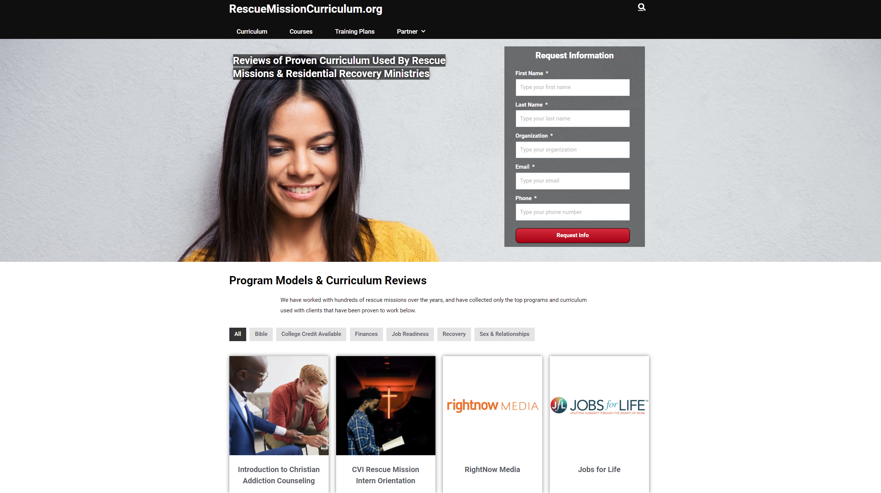

Slide 6
Build vs Buy: Curriculum Development
CO-DEVELOP
DEVELOP IN HOUSE
UNIQUE
Q1. HOW UNIQUE IS THE CONTENT TO THE ORGANIZATION?
GENERIC
BUY
BUY
LIMITED
MANY
Q2. WHAT RESOURCES DO WE HAVE IN HOUSE?
Chart Source: https://pd.hotshotlegal.com/buy-or-build-a-framework-for-deciding-when-to-create-or-outsource-training-content

Slide 7
Build vs. Buy Questions
How closely aligned does the outside curriculum align with your values?
Does it cost more to build it yourself than buy it?
How soon does the course need to be delivered?
Does build or buy significantly improve the quality of the offering and better address needs?
Can you buy a license for unlimited use, or do you have to continue to pay for each learner as you add them?
How hard is it to build and do you have the resources internally to build it?
Is there a relational advantage to developing or delivering the curriculum yourself?
Some questions adapted from https://www.caveolearning.com/blog/6-questions-for-learning-leaders-to-solve-build-vs.-buy-scenario

Slide 8
Expanded version of
this workshop

Slide 9
Using Myers-Briggs to Discern Potential Career Options
Image Source: https://www.pinterest.com/pin/381820874648771710/

Slide 10
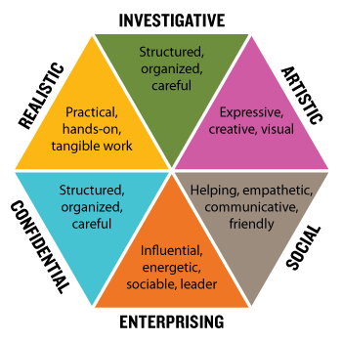
Holland Codes
Thinking
Building
Creating
Helping
CONVENTIONAL
Organizing
Image source: https://parentalalienation-pas.com/2018/08/26/holland-codes/
Persuading
Notes:
BUILDING: REALISTIC: Building jobs involve the use of tools, machines, or physical skill. Builders like working with their hands and bodies, working with plants and animals, and working outdoors.
THINKING: INVESTIGATIVE Thinking jobs involve theory, research, and intellectual inquiry. Thinkers like working with ideas and concepts, and enjoy science, technology, and academia.
CREATING
ARTISTIC: Creating jobs involve art, design, language, and self-expression. Creators like working in unstructured environments and producing something unique.
HELPING: SOCIAL: Helping jobs involve assisting, teaching, coaching, and serving other people. Helpers like working in cooperative environments to improve the lives of others.
PERSUADING
ENTERPRISING: Persuading jobs involve leading, motivating, and influencing others. Persuaders like working in positions of power to make decisions and carry out projects.
ORGANIZING
CONVENTIONAL: Organizing jobs involve managing data, information, and processes. Organizers like to work in structured environments to complete tasks with precision and accuracy.

Slide 11
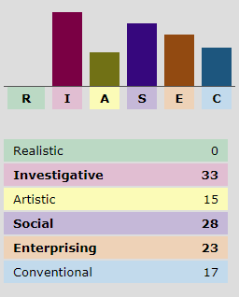
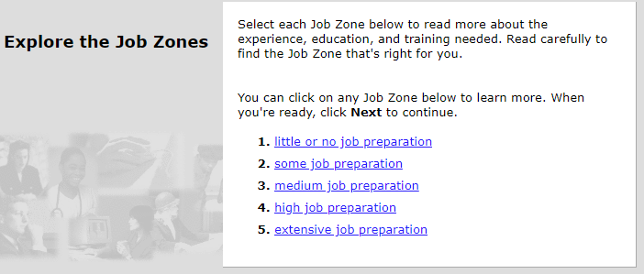
O*NET Career Interest Profiler
Maps Holland Codes to Careers
https://www.mynextmove.org/explore/ip
High School Diploma
Associate’s or Vocational training
Bachelor’s
Graduate Degree

Slide 12
O*NET Career Profiles

Slide 13
Using Vocation, Calling & Purpose of Work with Clients
Available for free on www.cityvisioninstitute.org
Components
Reflecting on Your Story: Lifeline Exercise
Relating Personality Type to Career and Calling: Myers-Briggs & Holland Codes
Discovering Your S.H.A.P.E. & Abilities Assessments
Career Path Research and Planning: O*Net, Others
The Christian Worldview and Our Problems with Work: Every Good Endeavor book/video
The Christian Worldview and Redeeming Our Work
Personal SWOT Analysis and Personal Branding (template)
Developing Your Life Plan (template)
Options for implementation
Have clients do self-study of whole course with live discussions
Can use individual lessons, templates or components in your program
Can outsource and have clients take City Vision’s online course (paid by Pell grant)

Slide 14
S.H.A.P.E Profile Template
https://bit.ly/3m1bdz6

Slide 15
Best Practices for Internship Programs
Andrew Sears President, City Vision University Gospel Rescue Mission Fellowship Conference
Notes:
I have personally supervised hundreds of interns. We have partnered with organizations and worked intimately with hundreds of other interns.

Slide 16
Types of “Interns”
Trainee Intern
Academic intern
For credit at academic institution
Stipended volunteer
For work typically done by volunteers at 20% of employee rate
Apprentice
Involve in skilled trade in registered aprientice program

Slide 17
Definition of a Trainee (Intern)
According to the DOL a trainee is NOT an employee if:
Receives training, though it includes actual operation of the employer facilities, is similar to that which would be given in a vocational school
Training is for the benefit of the trainee
Can’t displace a paid employee, must work under close supervision
Employer that provides training derives no immediate advantage from the activities of the trainees, and on occasion, employer’s operations may actually be impeded.
Trainee is not entitled to a job at conclusion of training period.
Mutual understanding that trainee is not entitled to wages for time spent in training.

Slide 18
Reason’s Why Intern Programs Fail
Ministry hires too many unprepared program graduates as interns
Ministry does not adequately compensate interns, so they get too many interns that create dysfunction
Ministry becomes co-dependent with interns where it would be better off hiring staff
Ministry does not have resources to invest in mentoring and training interns, so program devolves into a mechanism to pay below minimum wage
Ministry does not work with interns because they got burned by interns in the past (see points 1-4)

Slide 19
Balancing Indigenous Leadership Development vs Professionalization
Too many former graduates & interns
Too many highly credentialed
professionalized staff
Strengths
Indigenous leaders connect with clients
Passion and vitality from recent converts
Weaknesses
Environment becomes too chaotic
Dysfunction from codependency
Can limit quality of programs and unacceptable norms in ministry culture
Strengths
Highly competent staff
Needed to handle complexity of growth
Weaknesses
Staff can be disconnected from clients
Dysfunction from cultural disconnect
Can tend toward gentrification and secularization of ministry

Slide 20
Need to Balance Internal Leadership Development (Enlisted) with External Hires (Officers)
Internally developed leaders
Program graduates
External hires
Highly professional staff
Enlisted
Officers

Slide 21
Best Practices for Internship Programs
Invest heavily in recruitment to have a large pool of candidates so you can select only those who are most qualified.
Provide competitive compensation
Invest significantly in mentoring, training & education so an internship is sought after.
Have effective pipeline of interns to staff (but not guaranteed)
Have balanced leadership development pipeline of various types of interns & outside hires

Slide 22
How CVU Helps You Build a Leadership Pipeline
Values Aligned Senior Leaders
Program Graduate Interns (needs: maturing & basic skills)
External Hires (Needs: contextual skills + values alignment)
College Graduate Interns (Needs: specific skills + values alignment)
Complete Program (3)
CVU Certificates & Undergrad Degrees
CVU Graduate Certificates
& Degrees
Internally developed leaders helps increase values alignment Externally hires helps increase professional capacity

Slide 23
Best Practices for Educational Partnerships
Andrew Sears President, City Vision University Gospel Rescue Mission Fellowship Conference

Slide 24
When to Partner with Christian vs. Secular Colleges: Worldview Distortion Depends on Subjects
Less Worldview Distortion
More Worldview Distortion
Examples
Adult Basic Education & High School Equivalency
Vocational training
Options
Internally developed
Community college
Vocational/technical school
Examples
Addiction Counseling Training
Nonprofit Management
Options
Internally developed
State or community college training in addiction counseling
City Vision University

Slide 25
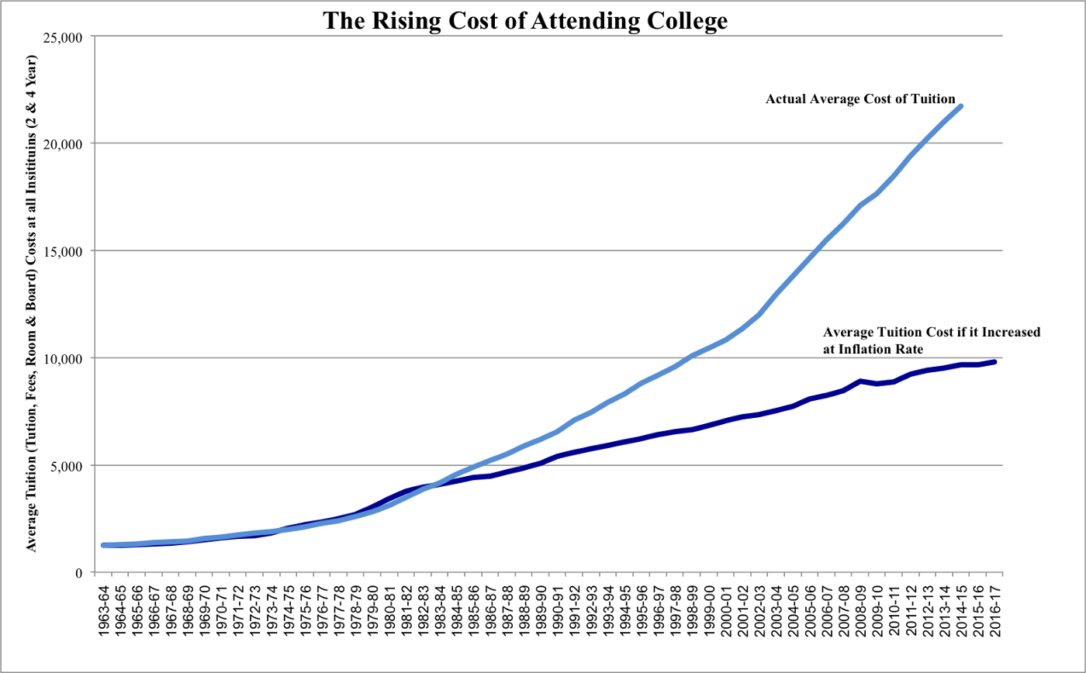
The Need for New Wineskins in Higher Education
“Thirty years from now
the big university campuses
will be relics.” (1997)
Peter Drucker (most quoted business guru)
2.5 times inflation
“In 15 years from now
half of US universities
may be in bankruptcy.” (2013)
Clayton Christenson
(2nd most quoted business guru)
Image Source: Wikimedia
Notes:
My history at MIT. Doctoral work.

Slide 26
Transforming Organizations Stories
26
01
40+ Students with City Vision
Provided two faculty members
"The partnership with City Vision has been one of the most important factors to equip our team to minister to the needs of the poor. Without this partnership, we wouldn’t be nearly as effective serving our most vulnerable neighbors.“ - Vann Ellison, Executive Director, St. Matthew’s House
02
Co-designed certificate program cohorts for new Program Managers & Case Managers
18+ Students
03
City Vision Student, Michelle Porter Founded 2 rescue missions
20+ Student & Interns
Notes:
Disruptive innovation allows for tenfold increase in access. Our history with rescue missions.

Slide 27
City Vision as an Educational Training Outsourcing Partner
All Educational Staff & Client Educational Programs
MBA Program (5)
Credit Recognition of Ministry Developed Courses & Third-Party Curriculum (i.e. Wheeler, TUMI, Genesis, Thirdmill)
CityVisionInstitute.org
Use free versions of CVU courses
lessons in staff & client Training
20 staff & 30 clients
from an organization
Addiction Counseling
Program
Ministry & Management
Programs
Nonprofit Management
Ministry
Business
MBA & MSOL
Example: 10 students
from an organization

Slide 28
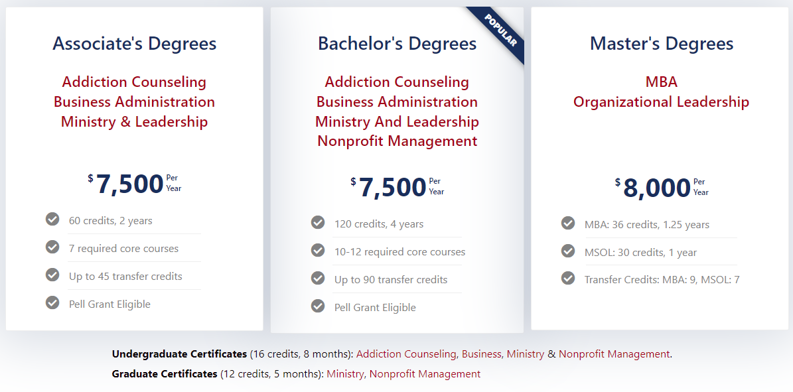
City Vision Degrees and Certificates

Slide 29
Tuition & Financial Aid
Partner Discount Tuition: $500/course = $2,500/year half time
Maximum Pell Grant: $812/course = $312 back after tuition
Currently about 75% of CVU students who apply for a Pell grant get one

Slide 30
How CVU Helps You Build a Leadership Pipeline
Values Aligned Senior Leaders
Program Graduate Interns (needs: maturing & basic skills)
External Hires (Needs: contextual skills + values alignment)
College Graduate Interns (Needs: specific skills + values alignment)
Complete Program (3)
CVU Certificates & Undergrad Degrees
CVU Graduate Certificates
& Degrees
Internally developed leaders helps increase values alignment Externally hires helps increase professional capacity

Slide 31
Appendix
Andrew Sears President, City Vision University Gospel Rescue Mission Fellowship Conference

Slide 32
Importance of Christian Worldview Values Alignment Across Subjects
Values Alignment Less Important
Addiction Counseling &
Nonprofit Management
Business
GED, ABE &
Vocational Training
Values Alignment More Important
Notes:
Gangel, Kenneth o. 1978. Christian higher education at the end of the twentieth century, Part 2: Integrating faith and learning: Principles and process, Bibliotheca sacra 135.0538, 99-108. Available from ATLA Serials 2002. Retrieved 7 November 2003 from http://66.77.30.29/pls/elil pshow?lcookie=915583&pid=1000474&lmode=ME&lfirstp=99.

Slide 33
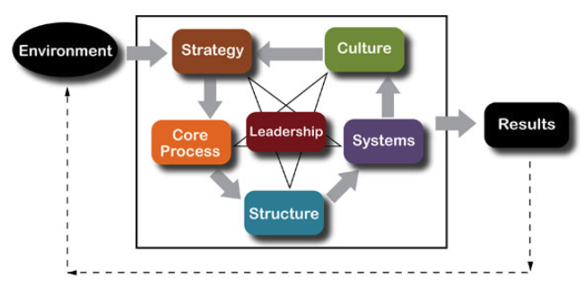
Does Your Organizational Design Fit Your Market?
OR
There is a tendency of ministry ED’s to design strategy based around their personal culture without adequate recognition to the environment.
Model Source: Center for Organizational Design’s Transformation Model http://www.centerod.com/framework/ . Logos from Wikipedia

Slide 34
As Budget Grows the Cultural Center Can Move too Far from Clients Limiting Effectiveness
Clients
New Organization’s
Cultural Center
Large Organization’s
Cultural Center
Resources
Funders

Slide 35
Interns: Types & Paths
I. Academic Intern:
Student at an accredited college or university
Receives academic credit from school (benefit to intern)
Ask for requirements from school to fulfill internship
Draft Academic Intern Agreement
Define length of internship and number of hours to be completed
Define what the intern will learn and what their responsibilities/participation will be
Define Site Supervisor
Complete student evaluations and have intern complete Site Evaluation
State no expectation of employment at conclusion or pay

Slide 36
Additional Legal Guidelines on Interns
Not required to pay interns minimum wage
Must still withhold FICA
Check with own accountants and state authorities on tax guidelines, unemployment insurance
Have your legal counsel check with your state to see if it requires health insurance for more 30 hours/week if they are paid.

Slide 37
Stipended Volunteers
The law acknowledges the fact that many nonprofits want to give volunteers stipends, reimbursements for out-of-pocket expenses, or other tokens of appreciation. For this reason, the law allows a volunteer to be paid expenses, reasonable benefits, and/or a nominal fee to perform services. A fee is likely to be considered nominal if it’s not a substitute for compensation or tied to productivity and does not exceed twenty percent (20%) of what an employer would pay to hire a full-time employee for the same services.
If your nonprofit organization decides to offer stipends to volunteers:
Do not offer volunteers the same benefits that paid employees receive.
Do not exceed 20% of what you would pay an employee
https://www.dol.gov/sites/dolgov/files/WHD/legacy/files/2006_08_07_28_FLSA.pdf

Slide 38
Guidelines for Stipended Volunteers
Is the work they are doing really volunteer work? They will consider
Nature of the entity receiving the services (nonprofit, for instance)
Services should be of the kind typically associated with volunteer work.
Compensation of any sort (such as money, room & board, perks, etc.) should be just to cover basic expenses
Should not displace regular employees
Should not have expectations of benefits in the future
Whether the activity is less than a full-time occupation
Services are offered freely without pressure or coercion, or expectation of employment
Should not be involved in commercial or for fee activity (thrift store, business, etc.)
Typically should not involve volunteer supervising staff
[Reference: DOL Opinion Letters FLSA 2001-18 and FLSA 2006-4]

Slide 39
Definition of Apprentice
Someone who undertakes a system of learning a craft or trade from one who is engaged in it and paying for the instruction by a given number of years of work. The terms of apprenticeship are regulated by many labor agreements as well as by law.
Apprentice means a worker, at least sixteen years of age unless a higher minimum age standard is otherwise fixed by law, who is employed to learn a skilled trade through a registered apprenticeship program. Training is provided through structured on-the-job training combined with supplemental related theoretical and technical instruction.
*DOL PART 520—EMPLOYMENT UNDER SPECIAL CERTIFICATE OF MESSENGERS, LEARNERS (INCLUDING STUDENT-LEARNERS), AND APPRENTICES
DOL Apprentice Definition*

Slide 40
Linking Educational Plan to Program Outcomes & Mission
Program Outcomes (Logic Model & Theory of Change)
Educational Program Learning Outcomes (PLO)
Course Learning Outcomes (CLO) Course A
Course Learning Outcomes (CLO) Course B
Organizational Mission
Lesson Learning Outcomes (LLO)
Lesson Plan
Other Program Activities
Nonprofit Program Outcome
Model
Each Level Needs to:
Fit within the scope of the level above it
Have Outcome Measures that Provide evidence the Outcomes Above it Were Achieved
Evidence
Educational Program Outcome
Model
Outcomes = Objectives
Educational Program Plan

