Slide 1
How to Avoiding Secularization and Increase Organizational Health
Andrew Sears President, City Vision University Gospel Rescue Mission Fellowship Conference
Notes:
My personal interest in this topic
Grew up in KC
MIT: Warning from parents, got assimilated, came back to God
Became fascinated with the drivers of secularization
War wounds

Slide 2
Biblical Pattern
God redeems & blesses Israel
Israel becomes complacent under blessing
Israel turns to other gods (Love God, Love Others)
Israel turns to God for help
Israel goes into bondage
Notes:
My expertise is more lessons from history and as an expert on parachurch ministries

Slide 3
Understanding Our Place in History
There are more challenges to religious freedom than any other point in US history
Two countries politically
There are more major denominational splits than at any point in US history except for around the Civil War
There is likely to be a wave of secularization of Christian institutions not seen since the wave of secularization of Christian colleges
Western Christianity
American Christianity
US Parachurch Ministries
Your Ministry
Notes:
CVU is focused on creating healthy parachurch ministries

Slide 4
Biblical Pattern In Recent History: Redemption & Lift
God redeems & blesses the movement
The movement experiences blessing (and becomes complacent)
The organization turns to other gods (secularizing) (Love God, Love Others)
God initiates a new movement
The organization goes into bondage
Notes:
Donald Mcgavern: used it for countries or people groups

Slide 5



Case Study: Christian Colleges Secularizing
Leadership
Almost all secularization was led by leaders who did not think they were secularizing
Leaders identified with mainstream culture rather than providing a prophetic criticism of it
Funding
Some major foundations (Carnegie Endowment) only funded nonsectarian institutions
Government funding only to secular organizations & dramatically increased
Professionalization
Religious criteria for hiring were abandoned to get “best candidates”.
Pragmatic response to Societal Cultural Shifts
Dramatic cultural shifts created intense pressure to secularize
Religious schools in small towns faced decision for most of the town to lose their job and wreck the local economy or to capitulate
Sources: The Soul of the American University: from Protestant Establishment to Established Nonbelief
Fundamentalist U and The Secularization of the Modern American University
Notes:
Truth (Veritas) for Christ (Christo) and the Church (Ecclesiae),
Princeton was founded because Harvard and Yale resisted the Great Awakening: Jonathan Edwards who helped lead the great awakening became President of Princeton

Slide 6
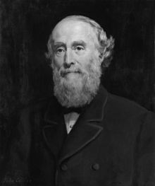
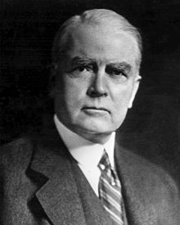



Case Study: YMCA
1844: YMCA Founded by Sir George Williams and largely remains faithful to evangelical roots until 1950’s
1910-1950: John Mott leads YMCA to tremendous growth ultimately winning a Nobel Peace Prize
1950-1970: YMCA under financial pressure from growth and cultural changes faces choice to either secularize or shrink
Sources: John R. Mott, 1865-1955, Wikipedia
Notes:
“The evangelization of the world in this generation”
Led World Student Christian Federation, an international organization that grew under his leadership to include societies in some 3,000 school. Bill Bright of his day.
Northeastern University was founded by the YMCA in 1898, exactly 100 years before City Vision. It’s mission when founding was very similar to City Vision. Now is entirely secular. Great school. The only part of its initial core values that live on are is practical orientation.

Slide 7
Christian Radio: Mainline vs Evangelicals
1920’s
First pioneers in Christian radio emerge
1930-1970
Mainline denominations lobby for free airtime for religious broadcasts allowing them to early domination of airtime based on government subsidy
Evangelical message is incompatible with free airtime requirements, so they develop self-supporting business models (Moody, Fuller, McPherson)
1970-Now
Government subsidy of religious broadcast ends leaving most mainline denominations radio programs without sustainable revenue
Evangelical groups dominate radio because they had developed self-sustaining models and achieve scale

Slide 8
What Are the Key Lessons from Case Studies?
Christian Colleges
When social norms change so that 95% of funding was allocated toward secular institutions, they faced a choice to: 1) fail financially, 2) shrink or 3) secularize
YMCA
Rapid growth created financial pressures, so only choice to enable continued growth was to secularize
Mainline vs. Evangelical Christian Radio
Mainline chose government funding streams that caused them to not develop competencies and scale needed for market-driven funding model
Across all models
Secularization process was almost always led by strong Bible-based Christians who never intended to lead a secularization process
They underestimated how funding sources and board/leadership composition might drive secularization in the long term
Notes:
Mott: “Evangelism of the world in this generation”

Slide 9
Principles to Avoid Secularization from Recent Case Studies
Andrew Sears President City Vision University

Slide 10
Biblical Pattern Today: Redemption & Lift
God redeems & blesses the movement
The movement becomes a complacent organization under blessing
The organization turns to other gods (secularizing) (Love God, Love Others)
God Initiates a new movement
The organization goes into bondage
What are the
biggest risks here?
Notes:
Donald Mcgavern

Slide 11


Slide 12


Slide 13
Case Study: Rescue Mission
Executive Director brought in board of Christian businesspeople that all have had a lifetime of success
Local government offered Mission major grant that would enable tremendous growth if it would become low barrier shelter and secularize in hiring practices
Board removed Executive Director to accommodate local government and continue financial growth largely secularizing

Slide 14

Case Study TechMission (parent of City Vision University)
Context
AmeriCorps National Grantee until 2013
Targeted by Obama administration for defending religious hiring rights of evangelical AmeriCorps sites
Strategic Choices
Walked away from 75% of funding rather than compromise religious hiring rights
Stopped taking direct government grants
Pivoted funding model from 80% donor income to 80% earned income dropping all programs except for City Vision University
Experienced a decade of significant suffering
Now have strong growth with funding sources with much less risk of secularization
Notes:
Should not have ignored cautions about taking government funds

Slide 15

The Greatest Secularization Threat? God of Success & Respectability
Most Significant Risk Factor: Composition of Board & Executive Leadership
Budget

Slide 16
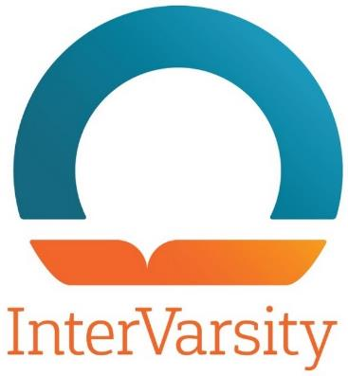
Case Study: InterVarsity
Context
Serves largely on secular college campuses that are racially diverse and are more left-leaning
Strategic choices
Developed policies to clearly affirm traditional view on marriage and sexuality
Strongly promote gender equality and racial equality
Implications
Was banned from meeting on several leftist campuses creating social stigma and limited recruitment
Some InterVarsity chapters at leftist campuses left InterVarsity
InterVarsity Press became global leader on evangelical racial dialog

Slide 17
Acculturation, Assimilation & Evangelicals
Assimilation (secularization)
Biblical Engagement (“in the world, but not of the world”)
Marginalization (cultural “evangelicals” who do not attend church)
Separation (fundamentalism)
Yes
Is it important to
develop relationships
with larger society?
No
No
Yes
Is it important to maintain one’s Christian identity & community?
Source: Adapted from Berry’s Acculturation Model

Slide 18
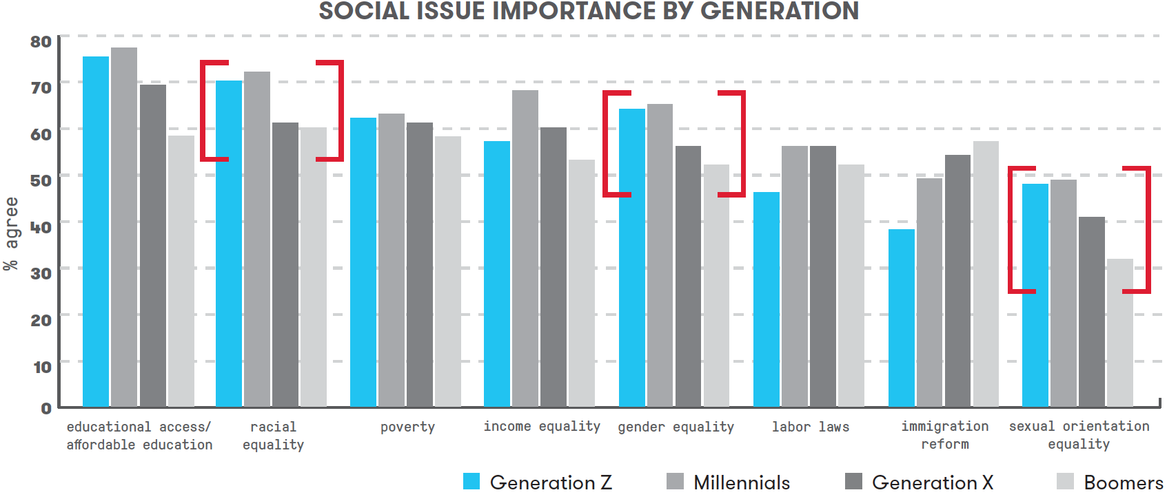
Generational Trends on Social Issues
Source: https://www.marketingprofs.com/charts/2018/33740/getting-to-know-gen-z-beliefs-preferences-and-behaviors
Notes:
The top three generational differences on social issues are: race, gender and sexual orientation.
Donations today are still primarily driven by Boomers, so the real pressure will happen when donations are driven by younger generations.
For organizations that uphold the traditional Biblical view on marriage and sexuality, it will be increasingly important to improve the racial and gender diversity of leadership to appeal to Gen X, Millennials & Gen Z donors.

Slide 19
Case Study: Christian Colleges (CCCU)
Council for Christian Colleges and Universities
180 evangelical members
How it has managed cultural changes
CCCU has two tiers of membership: Full voting members and affiliate members
Stricter requirements for full voting members
CCCU has programs to support
Women in leadership
Improving racial diversity of leadership
Immigration reform
Notes:
Some colleges that were more gay-affirming voluntarily left CCCU to avoid creating division

Slide 20
Seattle’s Union Gospel Mission
Bisexual lawyer volunteered with UGM and later applied for a staff position
UGM lost in Washington’s supreme court
US Supreme Court refused to hear case, allowing ruling to stand

Slide 21
Specific Actions to Take to Limit Risk of Secularization
Andrew Sears President City Vision University

Slide 22
An Alternative Pattern
God redeems & blesses the movement
The movement becomes a complacent organization under blessing
The organization turns to other gods (secularizing) (Love God, Love Others)
Organization repents & depends on God
The organization goes into bondage
Notes:
Donald Mcgavern

Slide 23
Steps to Take to Avoid Secularization
Biblical repentance & faithful dependence on God
Evaluate composition of board & leadership
Does having success-driven board & leadership lead to secularization?
Diversify funding streams to less risky sources
Tighten policies and legal basis for religious hiring
Religious hiring of staff and board is critical to avoiding secularization
Invest in values aligned training of staff

Slide 24
Risk of Various Funding & Support Streams
High Risk
Government funding
Secular foundation & corporate grants
Positive PR with local news agencies
Non-Christian donors not familiar with depth of religious nature of mission
Local zoning cooperation with city
Wealthy & upper-middle class Christian donors
Middle-class and below Christian donors
Loss of tax exempt (501(c)(3)) status
Earned income
Church-based donations (evangelical)
Tithe (for churches)
Being legally allowed to exist
Low Risk
Notes:
Will vary based on where you are located

Slide 25
Alliance Defending Freedom Recommendations
Free guide & membership information at www.adfministryalliance.org
Have the following statements
Statement of Faith
Statement on Marriage and Sexuality
Statement on the Sanctity of Human Life
Statement of Final Authority for Matters of Faith and Conduct
Religious Mission Statement
Code of Christian Conduct
Use the following policies & procedures
Religious Employment Criteria
Signed Statement of Faith
Religious Job Description
Facility Use Policy
Emphasize Religious Character throughout organization

Slide 26
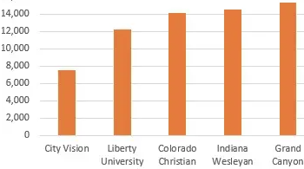
How CVU Can Help Increase Value Alignment to Avoid Secularization
Extremely targeted practical education for Christians serving the poor, addicted and underserved
Much more relevant than generic Christian ministry, business, nonprofit or counseling degrees
Deep Christian integration
We help translate tools into a Christian context
We help you professionalize without compromising your values
Our focus on partnerships with Christian nonprofits
We help you drive growth in your organization without compromising your values
Affordability & Convenience
Cost less than half of most other online Christian degrees
Prior learning credit for up to 25% of degree + credit partners
Convenience of online education

Slide 27
Competing Values, Cultural Imbalance and Christian Organizations
Cultural Relevance
Risks
Insular Church or ”Holy Huddle”
Inaccessible to those with business culture Lack of Funding/Burnout from Lack of Resources
Over-programmed church members
Example: Church that only serves its members
Risks
Fraud or financial mismanagement
Sexual abuse or misconduct
Lawsuits & Government Investigations
Secularization from the “New”
Example: Emerging church that secularizes
Flexible
Ministry Mindset (Clan)
Entrepreneurial Mindset (Adhocracy)
Church Gathered
(not of the world)
External
Church Scattered (sent into the world)
Internal
Control Mindset (Hierarchy)
Business Mindset (Market)
Risks
Legalism & judgmentalism
Isolated fundamentalism
Slow Death from Cultural Irrelevance & Decline
Inaccessibility to “flexible” cultures
Example: isolationist, fundamentalist church
Risks
Drivenness creates burnout or church splits
Secularization from “Professionalization” or the need for continuous financial growth
Culture of “It’s just business”
Inaccessibility to relational cultures
Example: “Business” of Christian social services
Stable
Faithful to Scripture
Notes:
In the world, but not of it
John Piper has said we should say, “not of the world, but sent into the world”

Slide 28
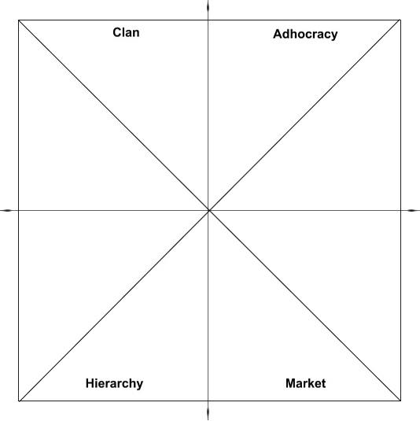
Balancing “Business culture” with “Ministry Culture”
Ministry Mindset Staff and Business Mindset Staff Can’t Communicate
Well, and then Judge Each Other and the Non-dominant Group Leaves
Staff with Ministry Mindset
Too Much Cultural Distance
Lack of Common Language
Staff with Business Mindset
Need to Develop “Bi-lingual” fluency between Business & Ministry Cultures

Slide 29

City Vision Management and Ministry Competencies and Courses
Cross-cultural
Competencies
Ministry & Relational Competencies
• Cross-Cultural Management & Ministry
• Christian Community Development
• Urban Youth Ministry
• Organizational Behavior
• Vocation, Calling & Purpose of Work
• Technology, Life Balance & Addiction
• Bible & Theology Courses
• Counseling Courses
Innovation Competencies
Social Entrepreneurship
Intro to Entrepreneurship
Leadership in Under-Resourced Communities
Educational Program Development
Transformational Change Leadership
(Collaborate)
(Create)
Ministry Competencies
Entrepreneurial Competencies
Spiritual Formation
Introduction & Capstone Courses
• Introduction to Nonprofit & Ministry Management
• Strategic Management
Operations Competencies
Business & Funding Competencies
Operations & Governance Competencies
Nonprofit Human Resources
Executive Leadership & Board Development
Nonprofit Financial Accounting
Project Management
Nonprofit Program Planning
Business & Funding Competencies
Marketing
Grant Writing
Nonprofit Fundraising
Nonprofit Managerial Accounting
Introduction to Business
(Control)
(Compete)
Notes:
Innovation
Demographic Change
Change through Education
Organizational Change

Slide 30
Appendix
Andrew Sears President City Vision University

Slide 31
Case Study: World Vision
Improved policies to affirm traditional view on marriage and sexuality
Fought federal court case to defend religious hiring rights
Fired three employees who denied Jesus’ divinity
Strongly promote gender equality and racial equality

Slide 32

Case Study: Cape Town City Mission
Context
Leadership was White as apartheid was ending
Radical change of cultural norms in post-apartheid South Africa
Dominant culture viewed white-led missions as a colonial mentality and decided to stop supporting organizations that were disproportionately white in their leadership
Strategic Choices
Transitioned from white leadership
Many programs either were ended or became independent
Dramatically increased focus on systemic change
Charity Focus vs. Systemic Focus
10,000 street children in Cape Town with beds for 50
Systemically-focused partnership with city that reduced number of street children to only 800 children on the street
Notes:
I spent a summer in 1993 at Cape Town City Mission while apartheid was being dismantled. Visited them about 15 years later

Slide 33
Undergraduate and Graduate Ministry Education
Change Management
Core Theology & Doctrine
Bible
Identify Organization’s Unique Values
Applied Theology
Identify Unique Personal Leadership Values
City Vision Master’s
Focus
Learn and Accept Applied Theology of Denomination or Organization
City Vision Undergrad
Focus

Slide 34
Five Approaches to Counseling & Christianity
Biblical Counseling
Transformational Counseling
Christian Psychology
Christian Integration (light)
Levels of Explanation (secular)
Church Scattered (sent into the world)
Church Gathered
(not of the world)
Primarily Christian Counselors
in Churches
Primarily Christian
Counselors in
Christian organizations
that take Insurance
Primary Christian
Counselors in
Secular Organizations

Slide 35
Translating Social Sciences Through an Evangelical Lens
New Cross-Cultural Competencies Needed to Manage Demographic Transition in Society
Evangelical Translation of Social Sciences
Secular Social Sciences
Church Scattered (sent into the world)
Church Gathered
(not of the world)
City Vision Courses
Christian Community Dev’t
Cross-Cultural Ministry
Leadership in Under Resourced Environments
Inadequate Translations
Levels of Explanation in Counseling
Weak Integration Christian Counseling
Social Gospel
Christians with Secular Worldview in their field
Political Science
History
Economics
Sociology
Critical Race Theory
Anthropology
Cultural Studies
Gender Studies
Social Identity Development
Notes:
Should we have Christians in Hollywood? In academia?

Slide 36
Spectrum of Evangelical Understanding of Race
Priority 2: As a Generational Transition, Many Evangelical Ministries Serving the Poor Will Need to Make this Transition
Priority 1: Resist Assimilative force of non-Biblical secular worldviews on race
Separatist White Fundamentalist Churches
White Evangelical Churches & Ministries
Highly Multiethnic Evangelical Churches & Ministries
Working Class Black, first generation Hispanic & Asian American Evangelical Churches
Upper Middle Class Black, 2nd+ gen Latinx, Asian American Evangelical Churches
Radical or Secular Identity Political Movements
Nearly all-White
Nearly all non-White
Christian Community Dev’t
Intervarsity
Lausanne Statement on Holistic Mission of the Church (Billy Graham, 95% of evangelicals globally): Evangelism, relief, development and advocacy are all important with emphasis on evangelism
Notes:
Bob Jones Network
Dallas Statement on Social Justice
Renegade fear-mongers on social media
https://www.openbible.info/topics/fear_mongers

Slide 37
Dualism Heresy: Secular-Sacred Divide
Sacred
Personal beliefs
Church/religion
Sunday
Secular
Counseling/Psychology/Sociology
Science
The other 6 days
“The sacred-secular dualism is the worst heresy of the Christian church worldwide” – R. Paul Stevens
The whole world is sacred and under God. Ephesians 4:6, Isaiah 6:3, Psalm 139:8
Notes:
“[There is] one God and Father of all, who is over all and through all and in all.” (Ephesians 4:6)
“And one called to another and said: ‘Holy, holy, holy is the Lord of hosts; the whole earth is full of his glory!’” (Isaiah 6:3)
“If I ascend to heaven, you are there! If I make my bed in Sheol, you are there!” (Psalm 139:8)

Slide 38
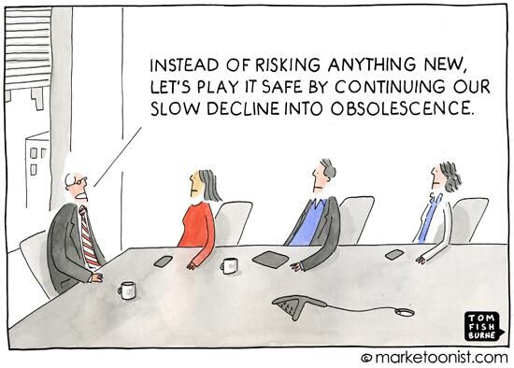
Naïve Thinking 2: We Can Avoid Secularizing by Avoiding Change

Slide 39
Typology of Faith-Based Organizations & Risk Profiles
Faith
-
Filled/Permeated
Faith
-
Based/Centered
Faith
-
Linked/Background
Religious Participation of
Required for All Clients
Encouraged, not required except
Little connection
Clients
in some programs
Staff/Board Requirements
Significant Faith Commitment
Significant Faith Commitment
No or minimal religious
May have tiers w/o requirement
requirements
Examples
Rescue Missions & Churches,
Salvation Army, World Vision,
Jewish Services, YMCA,
Bible Schools, Evangelicals
CCDA, CCCU, Evangelicals
Georgetown
LGBT/Traditional Marriage
Traditional Marriage
Traditional Marriage for
Often support LGBT rights
evangelical organizations
Funding Sources
Individuals, churches and
Individuals, churches,
Individuals, government and
foundations
government and foundations
foundations
Risk of Secularization
Small
Moderate
High or already secularized
Risk of Legal Ostracism
High in Northeast and West
Moderate
Low
Moderate in Midwest & South
Risk: Cultural Irrelevance/
High: often male, white
Moderate
Moderate
Cross
-
Cultural Ineffectiveness
evangelical leadership
Risk:
Government Investigation
Low
Grants: High, Vouchers: Medium
Lowest
Risk: Legalism
High: conservative legalism
Low
High: liberal legalism

Slide 40
Typology of Faith-Based Organizations & Risks
 | Faith-Filled/Permeated | Faith-Based/Centered | Faith-Linked/Background
Religious Participation of Clients | Required for All Clients | Encouraged, not required except in some programs | Little connection
Staff/Board Requirements | Significant Faith Commitment | Significant Faith Commitment May have tiers w/o requirement | No or minimal religious requirements
Examples | Rescue Missions & Churches, Bible Schools, Evangelicals | Salvation Army, World Vision, CCDA, CCCU, Evangelicals | Jewish Services, YMCA, Georgetown
LGBT/Traditional Marriage | Traditional Marriage | Traditional Marriage for evangelical organizations | Often support LGBT rights
Funding Sources | Individuals, churches and foundations | Individuals, churches, government and foundations | Individuals, government and foundations
Risk of Secularizations | Small | Moderate | High or already secularized
Risk of Legal Ostracism | High in Northeast and West Moderate in Midwest & South | Moderate | Low
Risk: Cultural Irrelevance/ Cross-Cultural Ineffectiveness | High: often male, white evangelical leadership | Moderate | Moderate
Risk: Government Investigation | Low | Grants: High, Vouchers: Medium | Lowest
Risk: Legalism | High: conservative legalism | Low | High: liberal legalism

Slide 41
Benne Typology of Church-Related Colleges and Universities
 | Orthodox (often denominational) | Critical-Mass | Intentionally Pluralist | Accidentally Pluralist
Major Divide: | the Christian vision as the organizing paradigm |  | secular sources as the organizing paradigm
Public relevance of Christian vision: | Pervasive from a shared point of view | Privileged voice in an ongoing conversation | Assured voice in an ongoing conversation | Random or absent in an ongoing conversation
Public rhetoric: | Unabashed invitation for fellow believers to an intentionally Christian enterprise | Straightforward presentation as a Christian school but inclusive of others | Presentation as a liberal arts school with a Christian heritage | Presentation as a secular school with little or no allusion to Christian heritage
Membership requirements: | Near 100%, with orthodoxy tests | Critical mass in all facets | Intentional representation | Haphazard sprinkling
Religion/theology department | Large, with theology privileged | Large, with theology as flagship | Small, mixed department, some theology, but mostly religious studies | Small, exclusively religious studies
Religion/Theology Required Courses | All courses affected by shared religious perspective | Two or three, with dialogical effort in many other courses | One course in general education | Choice in distribution or an elective
Chapel: | Required in large church a protected time daily | Voluntary at high quality service in large nave or protected time daily | Voluntary at unprotected times with low attendance | For few, on special occasions
Ethos: | Overt piety of sponsoring tradition | Dominant atmosphere of sponsoring tradition-rituals and habits | Open minority from sponsoring tradition finding private niche | Reclusive and unorganized minority from sponsoring tradition
Support by church: | Indispensable financial support and majority of students from sponsoring tradition | Important direct and crucial indirect financial support; at least 50% of students | Important focused, indirect support; small minority of students | Token indirect support; student numbers no longer recorded
Governance: | Owned and governed by church or its official representatives | Majority of board from tradition, some official representatives | Minority of board from tradition by unofficial agreement | Token membership from tradition
Examples: (not by Benne) | Bible Schools, Denominational Schools, ABHE | Christian Liberal Arts schools, CCCU, City Vision | Georgetown, Notre Dame | Duke, Most Secular Liberal Arts Schools
Source: Ringenberg, W. C. (2006). Christian College, The: A History of Protestant Higher Education in America (2nd ed.). Baker Academic.

Slide 42
Wesleyan Quadrilateral: Ways of Knowing God’s Direction
Scripture
Tradition
Experience
Reason
Knowledge

Slide 43
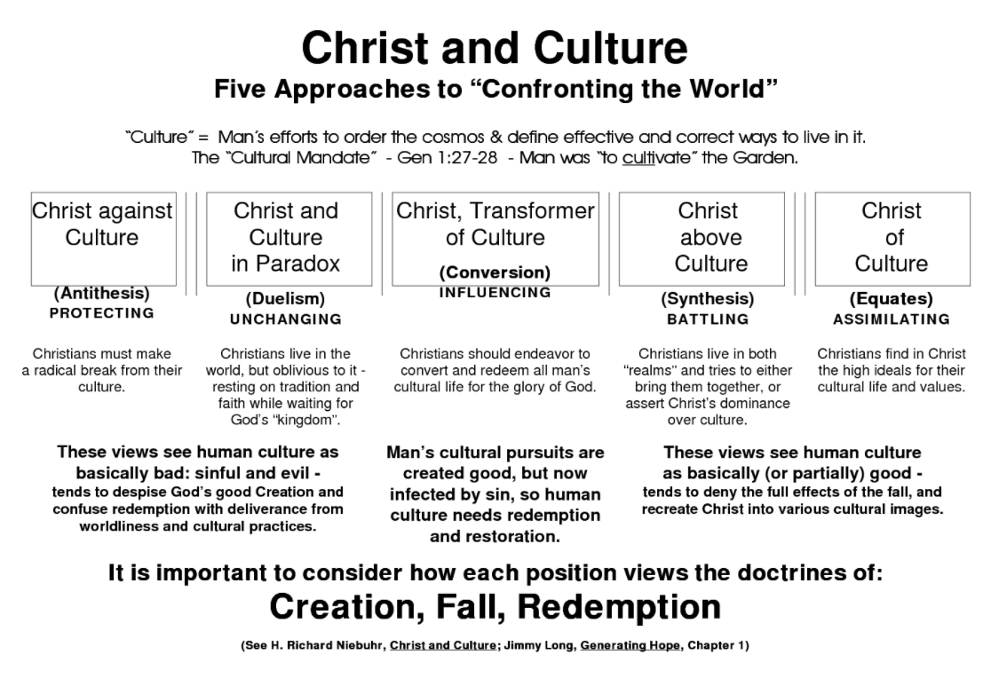
http://christianculturecenter.com/wp-content/uploads/2011/11/christ-and-culture.png

Slide 44
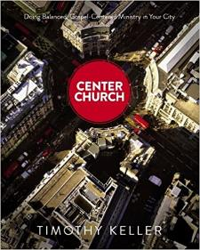
What Changes and Remains the Same Across Generations for Ministry?
What to Believe
How to See
What to Do
Doctrinal Foundation
Theological Vision
Ministry Expression
Timeless truths from the Bible
about God, our relationship to Him,
and His purposes in the world
Theological tradition
Organizational statement of faith
Systematic & biblical theology
A faithful restatement of the gospel with rich
implications for life, ministry, and mission
in a particular culture at a moment in history
Vision and values
Ministry “DNA”
Philosophy of ministry
Emphases
How the gospel is expressed
in a particular ministry in one
community at a point in time
Local cultural adaptation
Programs & processes
Organizational structure
Adapted from Tim Keller’s Center Church
Notes:
Before slides: I like to think that part of our role as a university that grew out of the rescue mission movement is as an innovation hub similar to the relationship with Stanford and Silicon valley.
The problem is that as soon as you use the word innovation in ministry people get worried that you might change things that shouldn’t change.
So what can change and what remains the same across generations for ministry?
The best book I’ve read it Tim Keller’s Center Church

Slide 45
Center Church Balance Vision

Slide 46
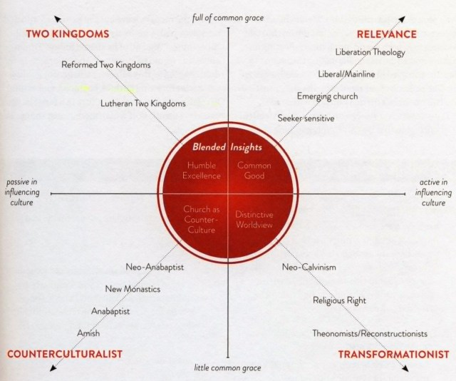

Slide 47

Understanding Biblical Justice (Tim Keller)
Community: Others have a claim on my wealth, so I must give voluntarily.
Deuteronomy 24:17-22
Equity: Everyone must be treated equally and with dignity.
Leviticus 19:13; 24:22, Isaiah 33:15, Deuteronomy 24:14-15, Deuteronomy 24:14-15
Corporate responsibility: I am sometimes responsible for and involved in other people’s sins.
Daniel 9, 2 Samuel 21, Joshua 7, Numbers 16, 1 Samuel 15:2, Deuteronomy 23:3-8, Exodus 20:5, Leviticus 19:15, Exodus 22:25-27; Jeremiah 22:13, James 5:4, Deuteronomy 24:14-15
Individual responsibility: I am finally responsible for all my sins, but not for all my outcomes.
Proverbs 6:6-7; 13:23; 23:21, Exodus 22:21-27, Ezekiel 18, Deuteronomy 24:16
Advocacy: We must have special concern for the poor and the marginalized.
Leviticus 19:15, Isaiah 1:17, Psalm 41:1, Proverbs 31:8-9, Jeremiah 22:3, Zechariah 7:9-10
Source: Tim Keller https://quarterly.gospelinlife.com/a-biblical-critique-of-secular-justice-and-critical-theory/

