Slide 1
Reconciliation Across Social Class
Dr. Andrew Sears
President
City Vision University
www.cityvision.edu
Notes:
My story

Slide 2
Outline
My story of reconciliation across social class
Defining Social Class
Understanding Class as Culture and Bias
The Intersection of Race, Class and Gender

Slide 3
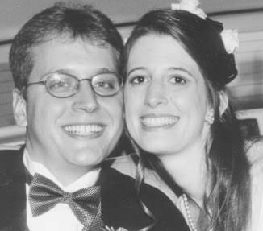




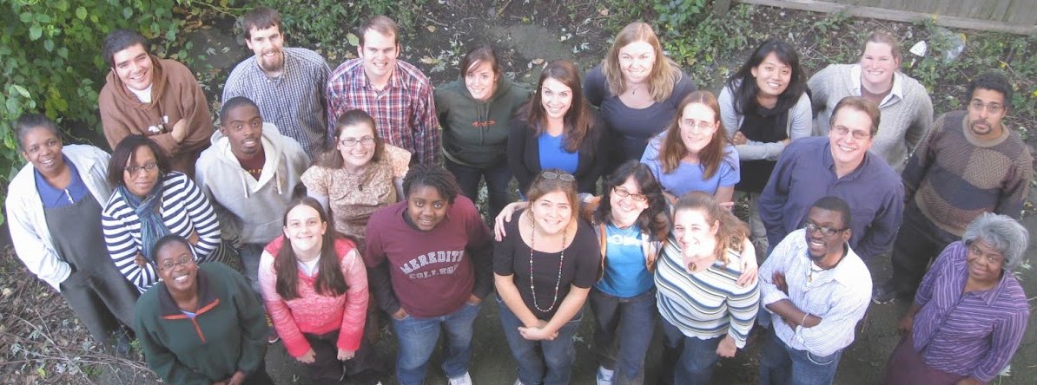
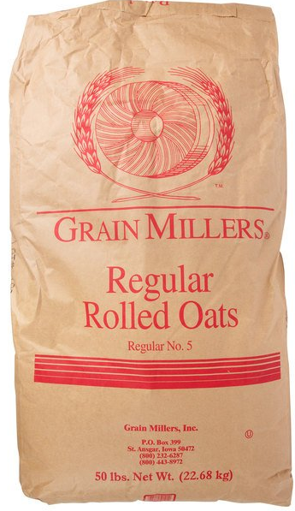
Stage: 1. Unaware 2. Awareness 3. Immersion 4. Holiness
My Journey
Across
Social Class
Burnout
Balanced Bi-cultural
Bridge Building
Class Assimilation
Immersed & Unassimilated
Class Reconciliation
Burnout
Notes:
Grew up poor: oatmeal, neighborhood police were afraid to go
Then I moved to the Hickman mill’s neighborhood in Kansas City: I remember in second grade feeling like I was the oddball because I wasn’t sexually active or using drugs. Friends
High School: Burger King, drug house,
Workaholism, College, talking like I was black, MIT
Access: parents educated Tri-city, Blue Springs
Cambridge Vineyard, class assimilated.
burnout, trauma caught up with me, Heather
counseling, Angel: class identity
Started a CCD ministry called TechMission, $2 million, AmeriCorps, black and Latino
Revolution will not be funded, bridge to nowhere, Became too culturally distant from funders
Balanced, bi-cultural, Walked away from donor dependent model to earned income model
Moved to suburbs in San Diego

Slide 4
Defining Social Class
Social Class is a combination of:
  Objective Definition
    (Almost all writing & teaching on social class will use the objective definition)
    Family income, assets, education and job type
  Subjective Definition
    Level of exposure to group trauma and oppression
    Culture (lifestyle, language, dress, food, values, etc.)
    Status level in community and society
    Class identity of those closest to you that you identify with (friends, neighborhood, community, family)
It is important to recognize that many people will have very complex class backgrounds and avoid oversimplifying class into objective definitions
Notes:
Problems with Secular Academic Perspectives of Class
Definitions of class were constructed primarily to define class in objective measurable terms
Creates an overemphasis on perspectives of more objective fields like economics and sociology
Deemphasizes the subjective and practical
Do not agree with oversimplification: Low-income = low class
blue collar, white collar, etc.
Allows rich secular academics to monopolize authority on “truth”
Higher education becomes primary mechanism of class assimilation

Slide 5
Defining Class: Four Factors of Class Identity
Class upbringing: childhood friends, family, school,
neighborhood, class culture, trauma exposure
Goal: personal understanding
Class
Background
(past)
Class
Access
(current)
Class
Identification
Class
Consciousness
Ability to perceive and understand
systems of classism, your own
class identity, class as culture
and cultural class conflicts
your class role, culturally and
in the systems.
Goal: learning
Access to power & social capital based on: income/assets, job type, education, appearance, speech, relationships/network & cultural fluency in dominant class culture
Goal: upwardly mobile
Class
Identity
  Class Culture of: 1. Your Community (family, friends, church)
  2. Work environment (which class groups your work primarily serves)
  3. Your role in addressing (or perpetuating) classism. Goal: downwardly mobile
Notes:
Background Godly Goal: to understand class background and unique role in bringing class reconciliation
Class Access: increase Class Access/Social Capital to all groups to be able to bring class reconciliation
Identification: Godly goal: to identify with the lower classes (“the least of these”) as much as possible within your own calling
Consciousness: Godly goal: to increase class consciousness

Slide 6
Four Quadrant Definition of Social Class
Q1 Personal: Nurture (Humanities)
(Relational)
Q2: Physical: (individual objective measures)
(physical needs)
Exposure to personal trauma
Class background
Family income, assets
Job type
Education
Health
Individual
Objectivist
Definition of
Social Class
(assimilation)
Socioeconomic Status
Q3: Cultural
(we)
Q4: Societal (Social Sciences)
(Systems)
Exposure to group class trauma & oppression
Class Culture (lifestyle, language, dress,
food, values, etc.)
Social Capital (network of relationships)
Class identification (those closest to you)
Status level in community & society
Structural class analysis: economics, law, sociology,
history, etc.
Collective
Primary Quadrant Priority of
the Nondominant Class
Internal (subjective)
External (objective)

Slide 7
Understanding Class as Culture and Class Bias
Dr. Andrew Sears
President
City Vision University

Slide 8
Dominant & Non-Dominant Class
For simplification, we will use terms “dominant class” and “non-dominant class”
  Dominant Class: Upper-middle class and above
  Non-dominant Class: Lower-middle class, working class and below
Why only two categories?
  Avoid the tendency toward the “imperial middle class”
  One of the primary ways to avoid discussions on class is for almost everyone to say they are middle class
  Some studies show that more than 90% of Americans identify as middle class
Let people self-identify based on four aspects of class identity
Notes:
Calling everyone middle class is like saying you are color-blind.

Slide 9
Understanding Class as Culture Quiz for Organizational Culture
Cost
Non-Dominant Class Value Dominant Class Value
Low Cost vs. High Quality
Low Cost vs. Speed
Relational vs. Structured/Orderly
Relational vs. Efficient
Spontaneous vs. Detached/Objective
Subjective vs. Objective
Emotionally Intense vs. Emotionally Reserved
Hierarchical vs. Egalitarian Appearance
Trauma is Common vs. Trauma is Avoided
Many small organizations vs. Big organizations
Many Volunteers/Time’s Cheap vs. Staff time is expensive
Organization model: family vs. Organization model: business
Speed
Quality
Notes:
Questions on this?

Slide 10
How Social Class of Organization Affects Ministry Focus in Maslow's Hierarchy of Needs
Ministry Areas
Finding Calling
Leadership Development
Personal Identity Development
Social Activities
Small Groups
Youth Groups
Counseling
Educational/Job Programs
After School Programs
Medical Ministries
Housing Ministry
Food Ministry
Global Relief
Self
Actualization
Self-Esteem
(recognition, status, projects)
Belongingness & Love
Safety/Security
(protection from violence & trauma)
Physiological
(food, water, shelter)
Dominant
Class Needs/
Ministries
Non-Dominant
Class Needs &
Ministries

Slide 11
How Fundraising Drives Organizational Cultural Gentrification
Most resources and giving come from those in the dominant class
  People tend to give to those who match their class culture and values
  Objectivist standards create the same bias in organizations as they do in individuals
  (i.e. overemphasis on quantitive outcomes creates a bias similar to that of of the SAT)
Individualistic fundraising
  Many Christian missionary organizations rely on individuals doing fundraising for themselves in ministry though personal relationships because it is highly scalable
  Those from a low-class access & background will not have much access to social capital
  Will result in almost exclusively only funding individuals with high-class access and background
  Creates strong incentive to upwardly class identify/assimilate to improve funding potential
  This classism has strong racial implications (class-based racism)
Result is gentrification of organizational culture
  Those who rise in leadership often must match the class-culture of donors
  For organizations serving the poor, this creates cultural distance from clients limiting effectiveness and class-based indigenous leadership development
Notes:
James 2: 1-5: My brothers, as believers in our glorious Lord Jesus Christ, don't show favoritism. Suppose a man comes into your meeting wearing a gold ring and fine clothes, and a poor man in shabby clothes also comes in. If you show special attention to the man wearing fine clothes and say, "Here's a good seat for you," but say to the poor man, "You stand there" or "Sit on the floor by my feet," have you not discriminated among yourselves and become judges with evil thoughts? Listen, my dear brothers: Has not God chosen those who are poor in the eyes of the world to be rich in faith and to inherit the kingdom he promised those who love him?

Slide 12

Where is the cultural center across social class of your organization? (for CCD ministries)
Our Clients
Organizations culturally close to clients
Organizations with cultures between clients & funders
Organizations culturally close to funders
Resources
Funders
Dominant Culture

Slide 13
The Intersection of Race, Class and Gender
Dr. Andrew Sears
President
City Vision University

Slide 14
Race, Class and Gender
 | White |  | Black |  | Latino |  | Asian
 | M | F | M | F | M | F | M | F
Upper
Middle
Lower
Dominant
Class
Upper Middle
Class
Non-Dominant
Class
Lower Middle &
Working Class

Slide 15
Kingdom Principles
We are called to identify with the oppressed
  Understanding oppression in terms of life chances
  What were your life chances given your race, class, gender and other environmental factors?
  We are called to sacrifice for the oppressed. The last shall be first and the first shall be last.
We are all sinners: we must all acknowledge our roles in oppression and have the humility and mercy that comes with that
  Recognize the limitation of “identity” frameworks is that our natural tendency is to emphasize the characteristics of our identity where we were oppressed
  Recognize that all frameworks & perspectives are “fallen” and have limitations (including justice frameworks) and need to be combined with others for better understanding
  Our “fallenness” is both individual and collective and often the collective becomes much more significant to disadvantaged groups
We are called to be reconciled to God, ourselves and others.
Notes:
Could be good discussion slide

Slide 16
Race-Centric Culture
 | White | Black | Latino | Asian
Upper
Middle
Lower
Example: Black, Latino, Asian & Other Ethnic Churches

Slide 17
Gender Based Cultures
 | Men | Women
Upper
Middle
Lower
Example: Mainline denominations, Christian Feminist

Slide 18
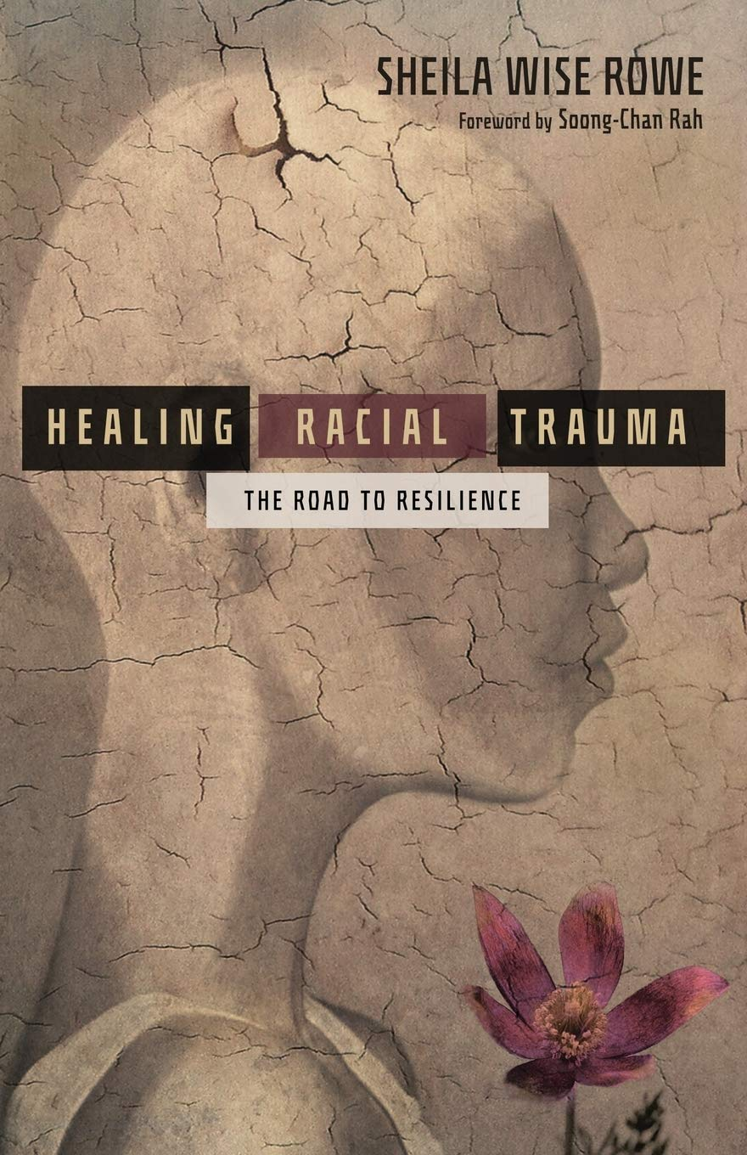
Developing a Trauma Informed Understanding on Race, Class & Gender
Important to recognize significance of group trauma
  Racial trauma, gender-based trauma, social class-based trauma
Group trauma is best healed in a group with people recovering
from similar trauma without major risk of invalidation
  Many ministries have separate men’s and women’s residential recovery programs to increase safety
  Ethnic churches
Much of conflict that happens is from group trauma being invalidated
  A woman with trauma from men in a co-ed group where it is not safe to discuss her trauma
  Someone with racial trauma in a white culture dominant group with mixed races where some group members deny the legitimacy of their trauma
  A white male experiencing social class-based trauma being told it is not valid, because only racial and gender-based trauma are legitimate group trauma

Slide 19
Christian Organizations Specialize in Processing Different Types of Group Trauma
Racial Trauma
Dominant Culture
Organizations
Ethnic Churches
& Organizations
Good for Healing
Personal Trauma
Lower/working Class
White Churches
& Organizations
Gender Specific Groups
Class-Based
Trauma
Gender-Based
Trauma
Group dynamics make it difficult to process all three in the same group
Interpreting racial ideologies through a trauma-informed perspective
helps avoid some unhelpful intellectual and political bickering
Notes:
Discuss

Slide 20
Class-Centric, Multiracial Culture
 | White | Black | Latino | Asian
Upper
Middle
Lower
Multiethnic Majority
Culture Churches,
Campus Ministries,
Christian Colleges
& Global Relief
Dominant
Class
Non-
Dominant
Class
Salvation Army
Rescue Missions
Pentecostals
12-Step Programs
Liberation Theology
Key Differences in Non-Dominant Class Models
Are they a charity or funded by those they serve?
Are they class conscious?

Slide 21
City Vision Cultural Target: Building a School for Christians Serving At-Risk Commmunities
 | White | Asian | Black | Latino/a | Other
Upper
Middle
Lower
CCCU Schools
Upper Middle
Class
Lower Middle &
Working Class
Community
Colleges
Notes:
Address class as well as race – focus on lower middle and working class needs & values

Slide 22
Strengths of Class-Centered Traditions in Serving the Poor
Can serve the poorest the best
  Most effective at meeting both spiritual needs and immediate physical needs of the poor
  Indigenous leadership development of those formerly homeless, addicted, etc.
  Charity helps transfer resources to those who need it the most
  Effective in addiction recovery and rehabilitation
Organizational
  Rich history and deep ties in churches and social capital of many cities
  Outstanding at fundraising to individuals
  Often have very strong administrative and bureaucratic systems
Unique culture
  Often create strong community of multiracial staff and clients from working class and the poor
  Can be particularly effective at addressing White poverty
  “Love people into God’s Kingdom”
Notes:
Focused on the poor.

Slide 23
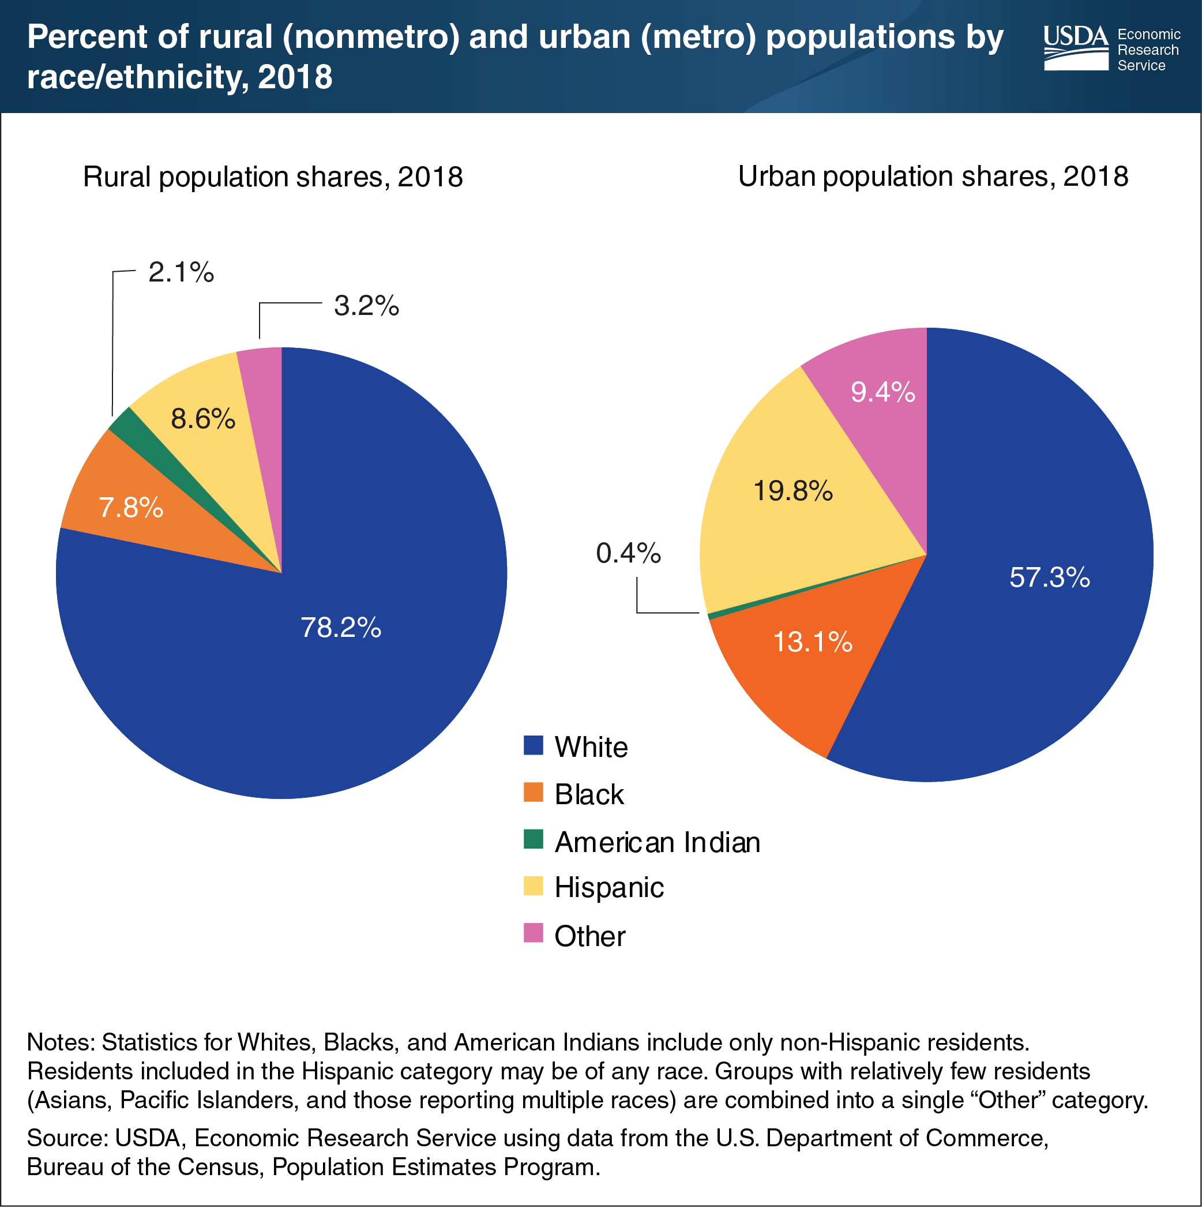
Majority of Urban Poverty is White
Source: https://www.ers.usda.gov/data-products/chart-gallery/gallery/chart-detail/?chartId=99538
Notes:
White poverty rate is less
White poverty is less concentrated

Slide 24
The Invisibility of White Poverty and Assumptions on Poor White Anger
Class oppression and white poverty are invisible, so anger and pain has no identifiable source
  The primary feeling of oppression from white poverty is anger and pain that has no identifiable source
  Much of poor white music (heavy metal, punk, etc.) is expressions of deep anger and pain with no identifiable source
  Anger of experiencing classism often gets displaced into racism because the actual source cannot be identified because it suppressed by society

Slide 25
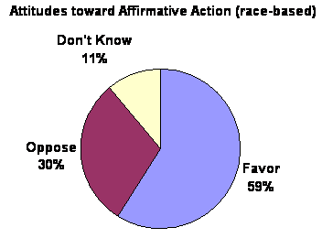
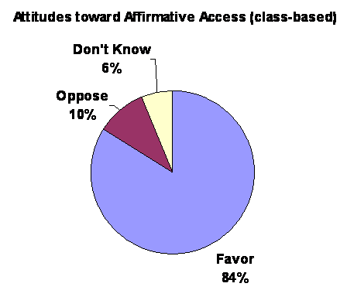
Tendency to Play Race and Class Against Each Other
Example: Current Affirmative Action & Access Debate
  Currently many conservatives have used class-based arguments as a tool to reverse affirmative action and limit policies addressing racism
  This has caused some individuals in racial groups to be hostile to discussions on class and to not address classism
  There are social reasons to consider both affirmative action (race-based) to address racism and affirmative access (class-based) to address classism

Slide 26
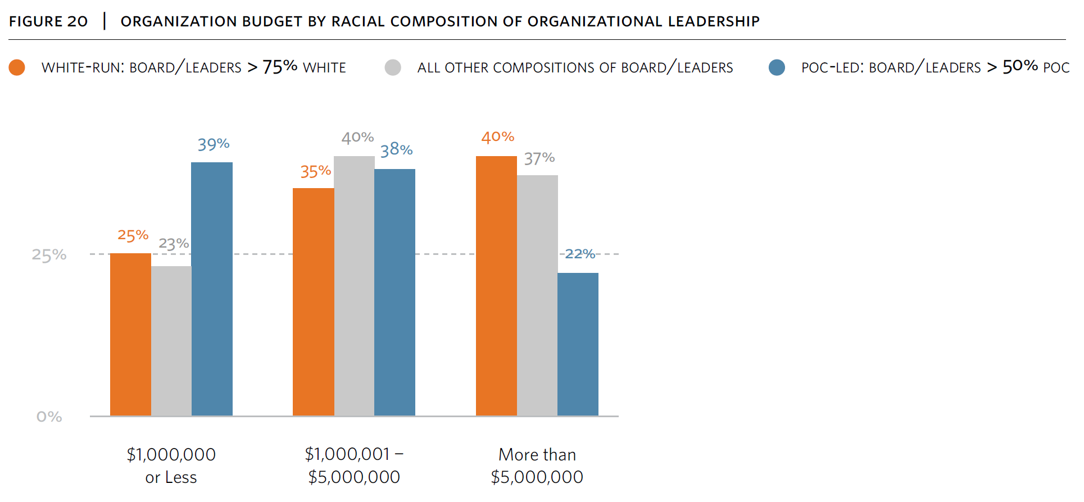
Class Bias of Funders for Large Nonprofits Creates Racial Bias
Source: https://racetolead.org/wp-content/uploads/2020/07/RTL_Revisited_National-Report_Final.pdf

Slide 27
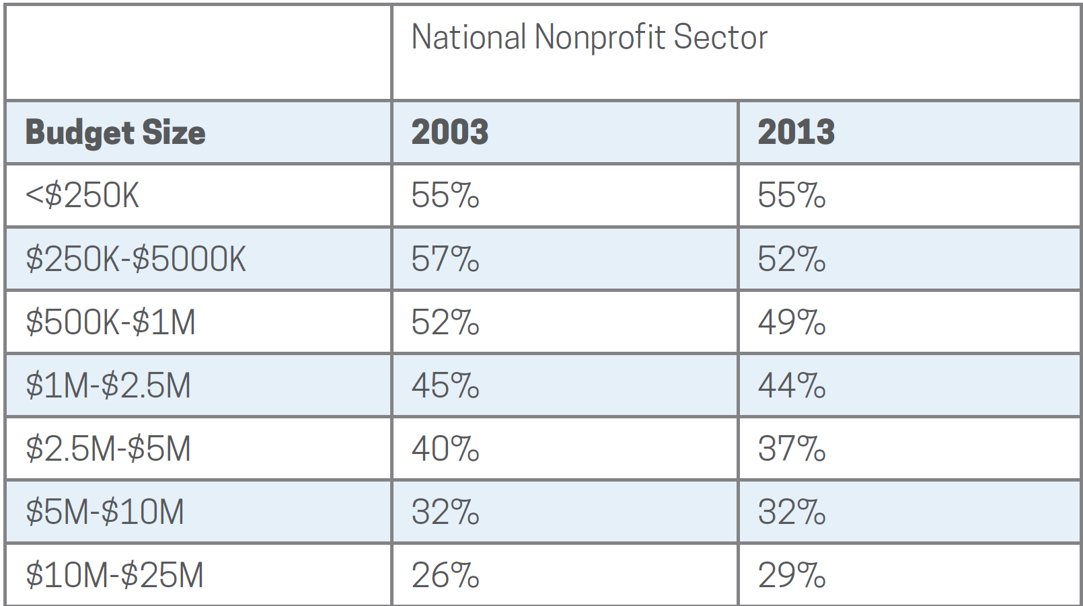
Class Bias of Funders for Large Nonprofits Creates Gender Bias
Percentage of Nonprofit Female CEOs vs. Organizational Size
Bias of funders for large nonprofits creates gender bias
Source: Guidestar Compensation Survey 2015

Slide 28
What to Do
Dr. Andrew Sears
President
City Vision University

Slide 29
1. Grow in Your Social Identity Development Process Across Race, Class and Gender
 | Description | Goal
Stage 1. Unawareness | Unaware of racial and social identity & make decision to pursue awareness | Become aware of racial/social identity & make decision to pursue awareness
Stage 2. Awareness (head learning) | Growing awareness of culture and racism, classism and sexism but most processing is on a head-level | Become aware of racism, classism and sexism and other forms of social injustice to provide basis for entering immersion
Stage 3. Immersion (heart & hand learning) | Immersion and identification with minority culture | Process on an emotional level and heal the effects of racism, classism and sexism and social brokenness through action, relationships and forgiveness
Stage 4. Holiness (head, heart & hand mastery) | Secure, consistent racial/ social identity while integrating strengths from other cultures | Continue reconciliation by addressing social injustice, bringing social healing and addressing personal cultural brokenness

Slide 30



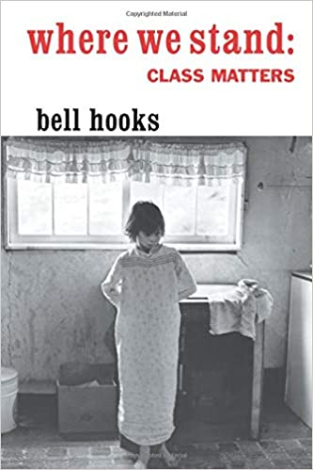
Secular Books On Social Class
Notes:
I don’t necessarily agree with all they say in these books, but they can provide helpful understanding.

Slide 31
2. Know Your Personal Cross-Cultural Sphere of Influence
Tier 3
International Middle Class
(other language)
Everyone Else
Tier 2
Tier 1
White
Upper
Middle
Class
Women
Black
Poor or
Middle
Class
White & Black
Working Class
White
Middle
Class
Poor
White
2+ Gen Latino/a &
Asian Working Class
First Generation, Poor or Middle
Class Latino/a or Asian

Slide 32
3. Understand How Maxwell’s Law of the Lid Can Apply Cross-Culturally
John Maxwell’s Law of the Lid: “If your leadership rates an 8, then your effectiveness can never be greater than a 7.” This is because you can only effectively lead those at a 7 or below.
Your leadership level will vary across different cross-cultural groups
  i.e., someone who is a level 8 leader with White middle-class men, might be a 5 with Black upper-middle class women
  Each person will have a different cross-cultural sphere of influence (or leadership levels) across various groups given their cultural background, identity and personality

Slide 33
How Cross-Cultural Law of the Lid Plays Out Organizationally (for social class)
White Male, Upper Middle Class Leader
(Levels: White 8, Asian 7, Black 6, Latino/a 4,
Female or Class Reduce 1)
White Male
Upper Middle Class
Level 7 Leader
White Female Upper Middle Class Level 5 Leader
Black Male Upper Middle Class
Level 5 Leader
15 largely upper middle class staff
Black Male Working Class Level 3 Leader
Black Male Middle Class
Level 3 Leader
Staff: 90% dominant class culture
Clients: 95% non-dominant class culture
(30% White, 40% Black, 30% Latino/a)
Clients do not have as strong a success rate from cultural disconnect

Slide 34
4. Know Your Organizational Cross-Cultural Sphere of Influence
Tier 3
Non-Christians Seeking
Affordable Nonprofit Degrees
(largely adult White & Black working class)
Everyone Else
Tier 2
Christians
in Nonprofit Professions
(largely Adult White & Black Working Class)
Tier 1
Asian &
Latino
Christians
In Nonprofit
Professions
Or Program
Participants
International
Students
in NGOs or
Parachurch
Ministries
Evangelicals & Bible-
Centered Christians
Serving the Poor
(largely Adult
White & Black
Working Class)
Participants from Evangelical
Programs Serving The Poor
(largely Adult White & Black
Working Class)
Christians Seeking
Affordable Degrees
(largely adult White &
Black working class)
Notes:
Recognize that much of systemic injustice is Caused by Cross-Cultural Limits of Dominant Groups

Slide 35
5. Social Class and the Poor: Recognize Strengths of Different Traditions & Partner
Q1 Personal: Nurture (Humanities)
(Relational)
Q2: Physical: Nature (Science & Technology)
(physical needs)
Strength of Evangelical tradition
Change brought by Personal Salvation is
very accessible to the poor
Strength of Charity Tradition
The poor need physical needs met while spiritual need
are being met
Individual
Q3: Cultural
(we)
Q4: Societal (Social Sciences)
(Systems)
Strength of the Charismatic tradition
The poor often chose “heart” over “head”
and value churches and worship styles that
fit their culture over cognitive ideological or
political stances
Strength of the Social Justice Tradition
The poor are deeply affected by unjust systems, but
often are not able to affect political change as much as those with resources
A key role for Christians in the dominant class is advocacy and societal change
Collective
Internal (subjective)
External (objective)

Slide 36
6. Resist Macro-Trends Distorting Culture of CCD Ministries
Macro Trends
Political polarization
Wealth concentration & decline of middle class
Christ-Centered
Ministries Serving the Disadvantaged
(Large, Affluent & Left-Leaning)
Christ-Centered
Ministries Serving the Disadvantaged
(Large, Affluent & Right-Leaning)
Affluent/Elite
Goal: Grow bigger & professionalize,
without compromising culture
40-60% will secularize
(i.e. YMCA) or culturally
gentrify
Balanced Christian Community Development Ministries
(cultural center: middle-class, mid-sized & moderate)
20-30% will become ineffective become increasingly conservative, racially and socially isolated as well as cultural gentrification
Social Class
50% of Donor-Dependent Grassroots
Ministries will close due to lack of capacity
Grassroots
Left
Political Alignment
Right
Notes:
Cultural gentrification is where your organization’s cultural sphere of influence decreases with those in non-dominant classes

Slide 37
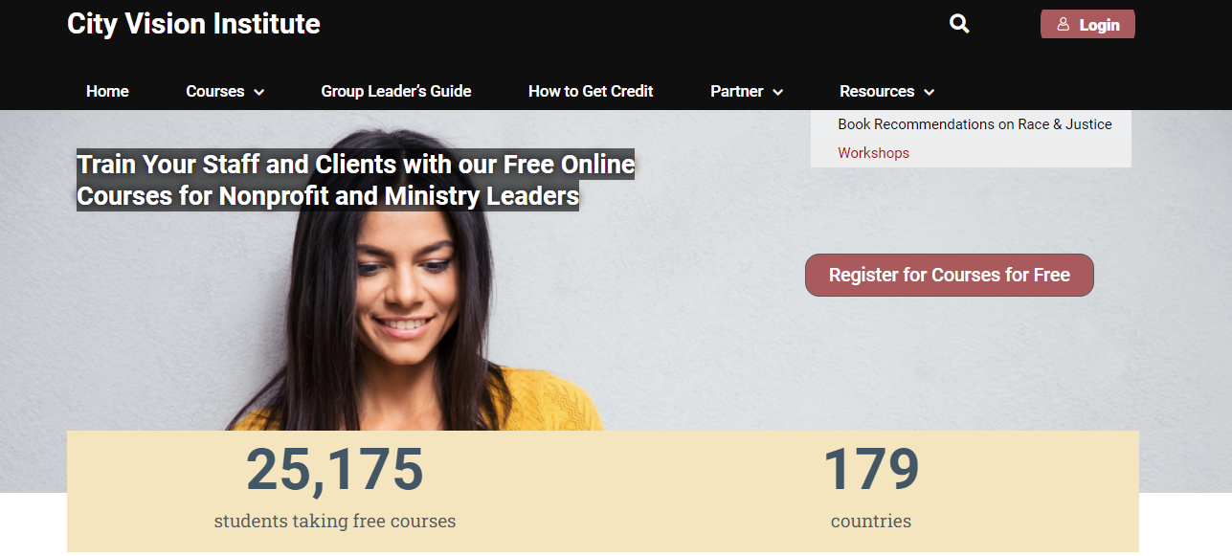
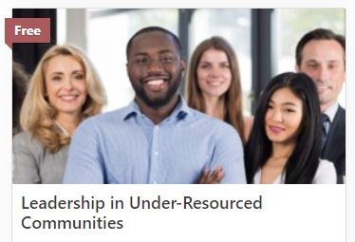

Recording, Slides &
Links from this Talk

Slide 38
Appendix

Slide 39
Note on Language and “The Poor”
All language used to describe the disadvantaged will have downsides
  i.e. at-risk, minority, oppressed, underserved, poor, lower-class, homeless, non-dominant class
  Nonprofit marketing that equates “the poor” with racial minorities perpetuates stereotypes
Organizations working in different cultural spaces often have good reasons for using the terms they use
  Effective charities typically need to be bi-cultural in their language using terms their funders will understand (i.e. “the poor, the addicted & underserved”) while using other terms with clients
There is a tendency of those who are in the dominant class who are educated on social justice to impose their preferred term on others
  This can become a form of classism when doing that to those who are identified with non-dominant classes
Ultimately it is up to individuals & groups to identify their preferred term
  i.e. Hispanic, Latino/a, Latinx, Brown
Why I use the term “the poor” in some context
  I identify with the poor. It is my personal preference to use that term in some contexts.
  “The poor” lends a social class framing, while other terms may not.
  Avoidance of using “the poor” in all contexts can be the class equivalent of saying “I’m colorblind”
  “The Poor” is used extensively in the Bible and has a very important specific definition

Slide 40
Biblical Framework for Sin and Poverty
1. Sin is when we cause
these to be out of order
Original Sin
Personal Sin
Suffering
2. Weakness or poverty (astheneia) is damage to God’s creation not due to personal sin
Biological damage
Psychological damage
Social damage
Source: Eric Johnson https://www.youtube.com/watch?v=90Z2DsXT8O8
Notes:
Eric Johnson
Three aspects of sin: https://www.youtube.com/watch?v=90Z2DsXT8O8 (43 min)
Original Sin
Personal Sin
Suffering (some your fault and some not your fault)
Sin is the worst type of psychopathology
Bio, Psycho, Social Damage: Astheneia
https://www.blueletterbible.org/lang/lexicon/lexicon.cfm?t=kjv&strongs=g769
https://www.bibletools.org/index.cfm/fuseaction/Lexicon.show/ID/G769/astheneia.htm
Weakness. Most common work for physical illness and also used for being poor.
Any type of physical, psychological or spiritual limitation
Examples:
Night Jesus betrayed: Spirit is willing but the flesh is weak
Paul don’t know how to pray as we ought because of our weakness (cognitive)
Some believers are weak because they are legalistic
Best summary is 2 Corinthians: thorn in flesh, brags about his weakness, shows power belongs to God
Implications: autism, severe mental impairment (not caused by self), hallucination, paranoia (in schizophrenia), depression from child abuse
Uses word fault (sin and weakness together) some our fault and some others fault

Slide 41
White Poverty and Class Blindness
Class blindness is the inability to see or discuss class or classism
  Not recognizing the class dimension of cultural/interpersonal conflict
  Not recognizing class power structures at play in conflict
  Making wrong assumptions about class or a person’s class identity
  Not recognizing class privilege
Class-blind examples
  Not recognizing the validity of group trauma based on social class
  Assuming one set of rules or language for social justice applies in all social class contexts
  Not recognizing the social class implications of key value stances
  Judging non-dominant class-centric movements without understand their unique role
  Avoiding talking about class or avoiding using terms like “poor”
  “Race and Class are the same thing in the US”
  Only using “class” in combination with race and/or gender without giving it the weight it is due
  Inability to recognize social class identification of individuals (particularly White individuals)
Poor whites most commonly feel the effects of the class blindness of others
  Because people tend to assume all whites are middle/upper class
Notes:
People often assume that you shouldn’t discuss race and ignore it, but the problem is that people don’t know how to talk about it so they offend people.
We should talk about class, but know how to talk about it.

Slide 42
Class Privilege
Class privilege is similar to “White privilege” but for social class
The assumption that you class-based cultural standards are correct and are naturally reinforced by social structures
  Movie critic example
  Language norms on social justice established largely in higher education (dominated by upper middle class)
  Expectations of nonprofit best practices by donors & foundations rooted in the culture of the upper-middle class or rich
Jobs in dominant class culture institutions
  i.e. Universities Christian colleges, large nonprofits, foundations vs. grass roots nonprofits, community colleges
  Higher pay, nicer facilities, adequate resources, appearance of success vs.
  constantly judged as dysfunctional, inadequate resources, pay, faculties & higher stress/trauma
  The assumption that you have all these things because you have the “right” or “healthy” model rather than a result of the upper middle-class context
  Failure to recognize that many institutions focus more on race or gender even as the become more classist and class assimilating (i.e. higher ed & student loan exploitation)

Slide 43
Understanding White Poverty: Geographic Poverty Concentration
Source: NARPAC http://www.narpac.org/RCA.HTM

Slide 44
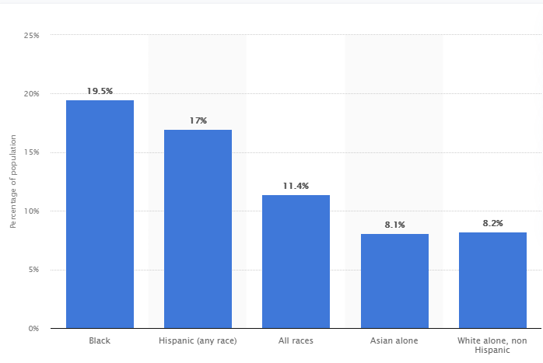
Poverty Rates 2020 by Ethnic Group
Source: https://www.statista.com/statistics/200476/us-poverty-rate-by-ethnic-group/

Slide 45
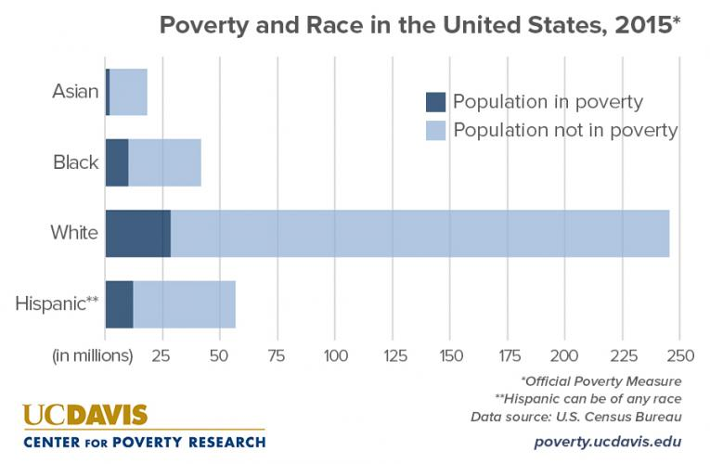
US Population by Poverty Status
Source: https://poverty.ucdavis.edu/faq/how-do-race-and-hispanic-origin-relate-poverty

Slide 46
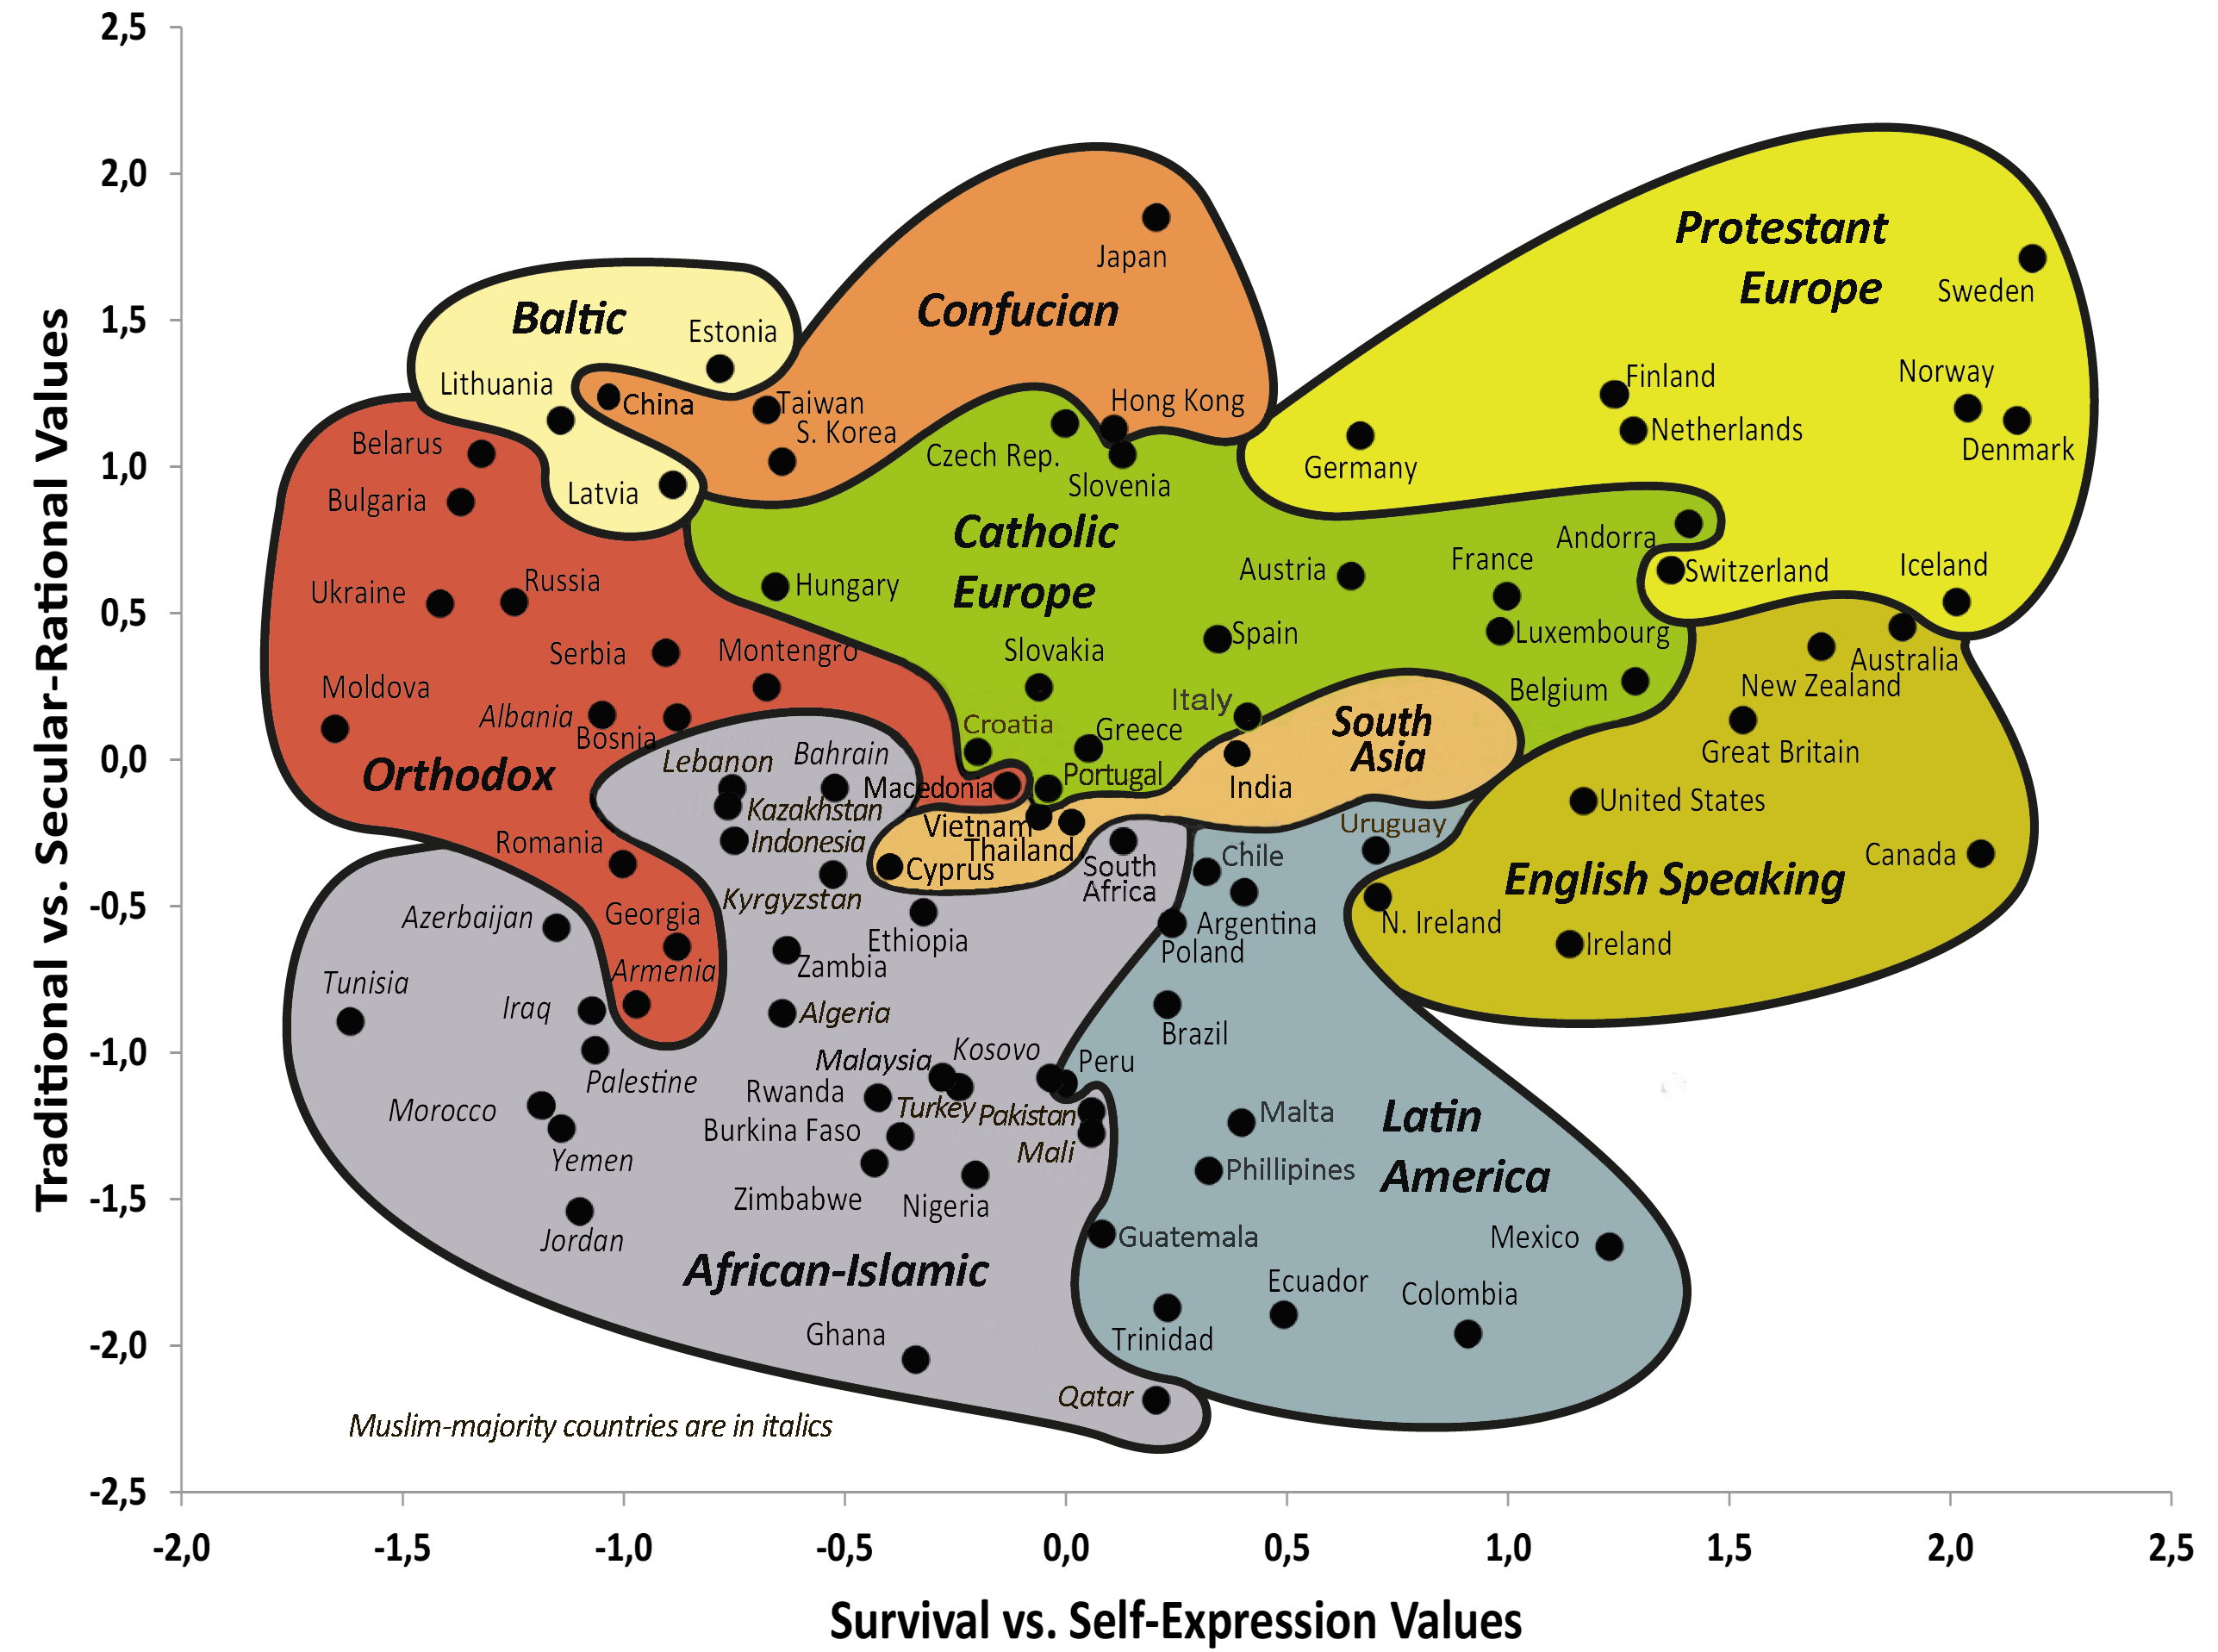
Social Class and Global Values Survey
Non-dominant Class
Dominant Class
Chart Source: http://www.worldvaluessurvey.org/WVSContents.jsp?CMSID=Findings

Slide 47
Holistic Ministry Across Four Quadrants
Q1 Personal: Nurture (Humanities)
(Relational)
Q2: Physical: Nature (Science & Technology)
(physical needs)
Vertical reconciliation with God
Horizontal reconciliation between individuals
Healing racial & class trauma
Addressing bigotry and prejudice
Deep relationships across race & class
Long-term cross-cultural immersion (relocation)
Being supervised where you are the “minority”
Food and clean water programs
Homeless shelters & housing programs
Christian Community Health programs
Relief
Individual
Q3: Cultural (we)
Q4: Societal (Social Sciences) (Systems)
Micro (healthy organizational cultures)
Community to support positive class
identity development (Relocation)
Leadership development of cultural minorities
Develop affinity groups & mentoring programs
for cultural minorities in organizations
Macro (reconciliation between people groups)
Removal of bias and stereotypes in media
Addressing cultural oppression & assimilation
Micro (development)
Nonprofit community development organizations
Micro-economic development
Remove classist structural barriers in leadership
Macro (advocacy & structural change)
Just laws & policies
Healthy social structures
Just teaching of history (Black history, etc.)
Macro-economic development
Collective
Internal (subjective)
External (objective)

Slide 48
The Bible and Classism in the Church
James 2: 1-5
My brothers, as believers in our glorious Lord Jesus Christ, don't show favoritism. Suppose a man comes into your meeting wearing a gold ring and fine clothes, and a poor man in shabby clothes also comes in. If you show special attention to the man wearing fine clothes and say, "Here's a good seat for you," but say to the poor man, "You stand there" or "Sit on the floor by my feet," have you not discriminated among yourselves and become judges with evil thoughts? Listen, my dear brothers: Has not God chosen those who are poor in the eyes of the world to be rich in faith and to inherit the kingdom he promised those who love him?

Slide 49
Christian vs. Secular Social Science Worldview
Christian Worldview Dominant Secular Social Science Worldview
Base Worldview Christian Worldview Secular Scientific Naturalism
Fundamental Problem? Sin Social/Psychological Problem: i.e. Unequal Power
Solution? Salvation Social/Counseling Solution (Power)
Who are we? In God’s Image but fallen Thinking animals/Collection of atoms
Identity in Christ Primary Identity is social/group identity
Where we came from? God Accidental Cosmic Chance
Philosophy? Spiritual, wholistic Materialistic, postmodern
What is truth? Biblical+ general revelation Entirely socially constructed
Values Bible-based Pretends (falsely) to be value-free
How should I live? Love God, Love Others Individual Pleasure Maximizing
and/or Social Activism
Sources: The Universe Next Door, Hidden Worldviews

Slide 50

Understanding Biblical Justice (Tim Keller)
Community: Others have a claim on my wealth, so I must give voluntarily.
  Deuteronomy 24:17-22
Equity: Everyone must be treated equally and with dignity.
  Leviticus 19:13; 24:22, Isaiah 33:15, Deuteronomy 24:14-15, Deuteronomy 24:14-15
Corporate responsibility: I am sometimes responsible for and involved in other people’s sins.
  Daniel 9, 2 Samuel 21, Joshua 7, Numbers 16, 1 Samuel 15:2, Deuteronomy 23:3-8, Exodus 20:5, Leviticus 19:15, Exodus 22:25-27; Jeremiah 22:13, James 5:4, Deuteronomy 24:14-15
Individual responsibility: I am finally responsible for all my sins, but not for all my outcomes.
  Proverbs 6:6-7; 13:23; 23:21, Exodus 22:21-27, Ezekiel 18, Deuteronomy 24:16
Advocacy: We must have special concern for the poor and the marginalized.
  Leviticus 19:15, Isaiah 1:17, Psalm 41:1, Proverbs 31:8-9, Jeremiah 22:3, Zechariah 7:9-10
Source: Tim Keller https://quarterly.gospelinlife.com/a-biblical-critique-of-secular-justice-and-critical-theory/

Slide 51
A Systems Perspective: Wholistic Biblical Social Justice
Q1 Personal
(Relational)
Q2: Physical
(physical needs)
Vertical reconciliation with God
Horizontal reconciliation between individuals
Just caring for individual physical needs
Individual
Tzadeqah in Hebrew
“being righteous and just”
Tzadeqah & Mishpat
= Social Justice
Mishpat is the Hebrew word for justice
“giving people what they are due, whether punishment or protection or care”
Q3: Cultural
Q4: Societal (Social Sciences) (Systems)
Horizontal relationships between groups
Just laws & social structures
Collective
Internal (subjective)
External (objective)
Notes:
Mishpat in bible 200 times
Sedaka
In the Bible these two words are tied together over three dozen times

