Slide 1
Developing Healthy Organizations to Avoid Staff Burnout
Dr. Andrew Sears
President, City Vision University
CCDA Conference, 2021
Notes:
Ask questions
Short version of my story of burnout

Slide 2
Outline
Why those in CCD ministry often experience burnout
Addressing Burnout on a Personal Level
Toolkit to Diagnose and Change Organizational Culture to Increase Health

Slide 3
A Systems Perspective: Wholistic Biblical Social Justice
Q1 Personal
(Relational)
Q2: Physical (physical needs)
Vertical reconciliation with God
Horizontal reconciliation between individuals
Just caring for individual physical needs
Individual
Tzadeqah in Hebrew
“being righteous and just”
Tzadeqah & Mishpat
= Social Justice
Mishpat is the Hebrew word for justice “giving people what they are due, whether punishment or protection or care”
Q3: Cultural
Q4: Societal (Social Sciences) (Systems)
Horizontal relationships between groups
Just laws & social structures
Collective
Internal (subjective)
External (objective)
Notes:
Mishpat in bible 200 times
Sedaka
In the Bible these two words are tied together over three dozen times

Slide 4
A Systems Perspective: Reconciliation & Redistribution
Q1 Personal
(Relational)
Q2: Physical (physical needs)
Vertical reconciliation with God
Horizontal reconciliation between individuals
Just caring for individual physical needs
Individual
Cultural & Theological Imperialism
Tzadeqah & Mishpat
= Social Justice
Reconciliation & Redistribution
CCDA is Prophetic Response to
Individualistic “Gospel”
Collective
Q3: Cultural
Q4: Societal (Social Sciences) (Systems)
Horizontal reconciliation between groups
Just laws & social structures
Internal (reconciliation)
External (redistribution)
Notes:
katallagḗ

Slide 5
Why we get stuck? The Law of the Instrument
Most Christian Community Development
leaders have tools for the Community
Development Quadrant (Q4), but need tools
from other quadrants to avoid burnout.
Image Source: https://www.pinterest.com/pin/215821007131374920/
Notes:
Glasses vs. Tools.

Slide 6
My Story of Recovering from Burnout
Q1 Personal
Q2: Physical
2000
Career change to focus on my calling
Went to counseling: trauma & codependency
Limited work to 40 hours/week to avoid burnout
Invested in small group & friendships
Worship & prayer to center & address PTSD
Accountability
2013
Started taking breaks (Tony Schwartz)
2000
Played basketball regularly
Took SSRI to treat PTSD symptoms
2013-Now
Treated adrenal fatigue (Integrative/Functional Medicine)
Radical shift to healthier diet
Switched to moderate exercise regularly
Take vitamins & supplements under doctor’s guidance
Individual
Q3: Cultural
Q4: Social
2000
Immersed in lower-class community to re-form own cultural identity
Healed from group trauma
Maintained media diet on healthy media
2018
Shifted to bi-cultural identity across social class
Moderated trauma exposure to avoid PTSD triggers
Moved to San Diego suburbs & megachurch to increase balance & access to social capital
2006
Invested in training staff in emotional intelligence & set expectations where seeking counseling is the norm
Brought in staff who were older and wiser
2018
Recognized need to balance access to resources with “keeping it real” from being close to the community
Invested in learning about healthy organizations from a structural perspective
Collective
Internal
External

Slide 7
Why Do We Get Stuck? 4 Quadrant Approach to Avoiding Burnout
Q1 Personal: Nurture (Humanities)
Q2: Physical: Nature (Science & Technology)
Secure a job in a healthy work environment
Go to counseling or life coaching
Develop healthy friendships
Deepen your personality identity
Establish physical & emotional safety
Pursue spiritual fulfillment
Get healing from wounds of abuse
Get connected to God
Avoid behavioral addictions
Eat healthy
Exercise regularly
Treat adrenal fatigue (Integrative/Functional Medicine)
Address health conditions related to chronic stress
Take healthy vitamins, supplements and medication under guidance of a doctor
Individual
Q3: Cultural
Q4: Societal (Social Sciences)
Work in a culturally convergent context
Find a cultural space that balances your needs with the needs of “the cause”
Find healthy church & small group that values emotion, spiritual, relationships, etc.
Participate in health recovery or counseling groups (to receive)
For cultural minorities, find positive groups where you can be in your own culture
Avoid triggering tech & media use
Micro
Develop healthy organizations
Macro
Work towards developing more just systems and laws without burning yourself out personally
Collective
Internal
External

Slide 8
Addressing Burnout on a Personal Level (Q1 & Q2)
Dr. Andrew Sears
President City Vision University
www.cityvision.edu
Notes:
I started working full time in community development in 1998. I knew a few hundred leaders who got started around the same time. Over half that have stayed with it have had a major burnout.

Slide 9
Burnout & Compassion Fatigue Quiz
Pick 1-5: Not At All (1), Rarely (2), Sometimes (3), Often (4), Very Often (5)
I feel run down and drained of physical or emotional energy.
I have negative thoughts about my job.
I am harder and less sympathetic with people than perhaps they deserve.
I am easily irritated by small problems, or by my co-workers.
I feel misunderstood or unappreciated by my co-workers.
I feel that I have no one to talk to.
I feel that I am achieving less than I should.
I feel under an unpleasant level of pressure to succeed.
I feel that I am not getting what I want out of my job.
I feel that I am in the wrong organization or profession.
I am frustrated with parts of my job.
I feel that organizational politics or bureaucracy frustrate my ability to do a good job.
I feel that there is more work to do than I practically have the ability to do.
I feel that I do not have time to do many of the things that are important to doing a good quality job.
I find that I do not have time to plan as much as I want to.
Score Interpretation: 15-18: No sign of burnout. 19-32: Little sign of burnout. 33-49: At risk of burnout. 50-59: Severe risk of burnout. 60-75: Very severe risk of burnout
Source: https://www.mindtools.com/pages/article/newTCS_08.htm

Slide 10
Discussion
What personal practices have you done to help avoid burnout?

Slide 11
Important Concepts to Understand to Avoid Burnout
Codependency with work/ministry
Compassion Fatigue
Emotional Labor
Secondary/Vicarious Trauma
Dual roles & role conflict
Health Issues
Adrenal Fatigue (HPA Axis Dysfunction)
Other health conditions related to chronic stress

Slide 12
Emotional Labor, Burnout & Chronic Trauma
Emotional labor is where work requires you to manage your emotions in order to serve customers/clients or fellow employees
Emotional labor is often higher for
Those in caring professions: ministry, social work, nursing, etc.
Those in organizations serving the at-risk communities and/or cross-culturally
Women and those not in the dominant culture in an organization
Those serving in high-trauma environments
Causes of burnout
Because emotional labor is hard to quantify, it can be easy to burn out
If an organization is unbalanced, it can cause staff to be in chronic traumatic state
It is common for ministry & nonprofit staff to be co-dependent with their job
Behavioral addictions like workaholism are often socially acceptable
Lack of boundaries

Slide 13
Know Your Personal Cross-Cultural Spheres of Influence & Limits
Unsustainable Emotional Labor
High Emotional Labor
Tier 3
International Middle Class (other language)
Everyone Else
Moderate Emotional Labor
Tier 2
Low Emotional Labor
Tier 1
White Upper Middle Class Women
Black Low Income or Middle Class
White & Black Working Class
White Middle Class
Low Income White
2+ Gen Latino/a & Asian Working Class
First Generation, Low Income or Middle Class Latino/a or Asian

Slide 14
Secondary/Vicarious Trauma
Secondary or Vicarious Trauma can be incurred when an individual is exposed to people who have been traumatized themselves, disturbing descriptions of traumatic events by a survivor, or others inflicting cruelty on one another.
Symptoms of secondary trauma are similar to those of PTSD.
Those involved in Christian Community Development are often exposed to secondary trauma
Those coming from a high trauma background (frequently with PTSD) often choose careers in high-trauma environments re-triggering PTSD

Slide 15
Stages of Recovery from Trauma
Establishing Safety
Remembrance & Mourning
Reconnection
What happens if your organization is so committed to serving externally that you never establish safety?

Slide 16
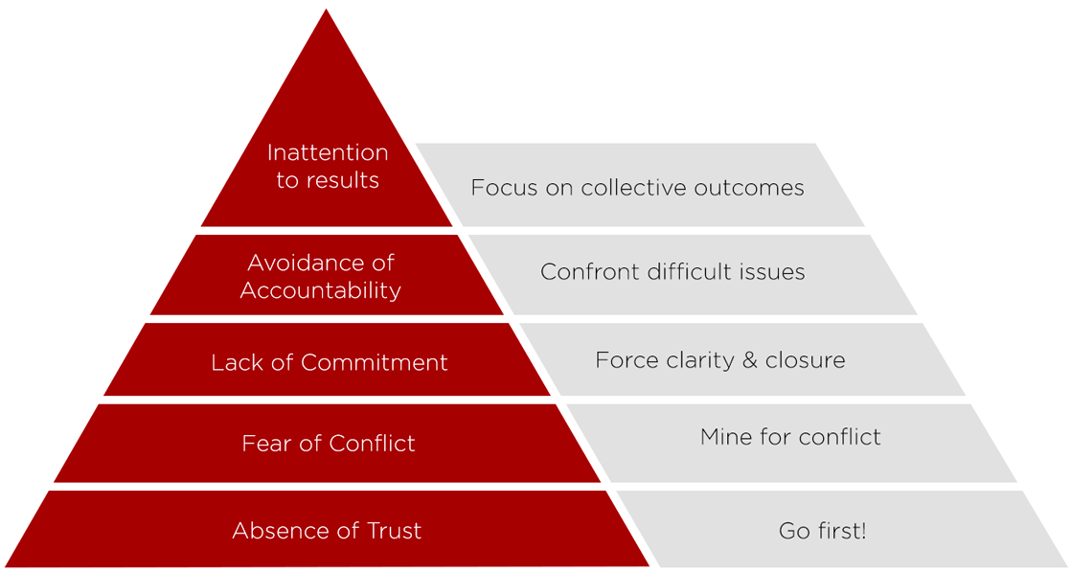
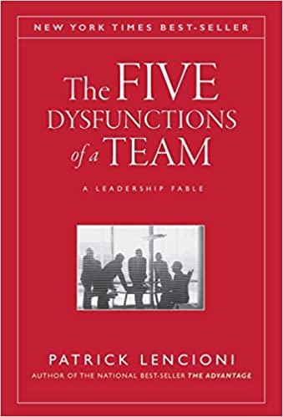
Five Dysfunctions of a Team
What if your organization’s commitment to external justice gets stuck at low trust & safety?
Image Source: https://www.intepeople.co.nz/five-dysfunctions-team/

Slide 17
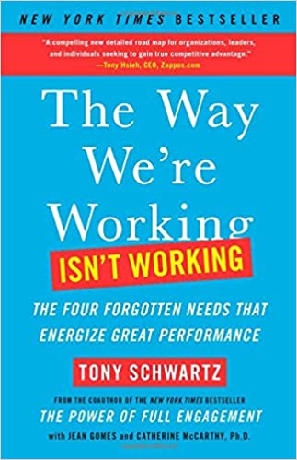
Other Book Recommendations

Slide 18
Toolkit to Diagnose and Change Organizational Culture to Increase Health (Q3 & Q4)
Dr. Andrew Sears President City Vision University www.cityvision.edu

Slide 19
Four Domains of Expertise for CCD Organizational Health
Organizational Management & Leadership Theory
Organizational Health Best Practices
Practitioner Experience
Cultural Context of Ministries Serving At Risk Communities
Notes:
Some would argue that a healthy organization is one that just follows good management & leadership practices.
Subfield of Organizational health best practices. I’ve read dozens of books on organizational health. The challenge is that nearly all of those books assume either a business context or a highly-resourced middle class nonprofit context. In other words, they were coming from a resourced and majority culture context.
I asked the question of how would these principles be translated into a CCD context. What are the most important principles to consider
Practitioner experience. I’ve been doing CCD since 1998. At TechMission and City Vision, we have worked very closely with over 500 CCD ministries. I saw the inside of their operations and I saw what happened over the long-term. From that I’ve identified a lot of principles that are particularly important for CCD organizations.

Slide 20
Discussion
What other practices have you seen organizations do to help their staff and volunteers avoid burnout?

Slide 21
Organizational Health Best Practices to Help Staff Avoid Burnout
Be generous with vacation and strongly encourage staff to take vacation
Ensure staff do not have excessive caseload or workload
Restorative meetings with staff & volunteers
Provide staff whose role is to mentor or pastor other staff (who they do not supervise when possible)
Have healthy HR practices
Sustainable pay and benefits
Conduct employee engagement surveys
Effective evaluation processes
Invest in employee training
Provide good insurance for mental health visits
Allow mental health days to count as sick days

Slide 22
Tool 1: Use Stakeholder Map for Cultural Balance for Organizational Health
Our Clients
Burnout from Lack of Resources
Culture of Balanced
Bridge Builders
Burnout from Driven Culture
Resources
Funders
Dominant Culture

Slide 23
Stakeholder Map for City Vision
Clients
Program Participants at
Orgs Serving…
Destitute, Homeless, Addicted, Reflecting Poverty Demographics in US
Staff At Organizations Serving the Poor & Other Nonprofits
Middle & Working Class Christian Bridge Builders
60% female, avg age 40, 29% Black, 41% People of Color
Student Services & Admissions
Working/Middle Class Women 50% Black, 50% White
President
Working Class Identified White Male
Faculty
Board
Christian leaders in education & serving the poor
Financial Manager
Individual Donors
Christian Foundations
Upper Middle Class White Christians
Consultants
Employers/Jobs
Largely Middle Class White
Accreditor (DEAC)
Working Class
MDHE
US Department of Education
Upper Middle class, White, Democrats
Resources

Slide 24
Initial Diagnosis for City Vision
Our Clients
Burnout from Lack of Resources
Resources
Funders
Dominant Culture

Slide 25
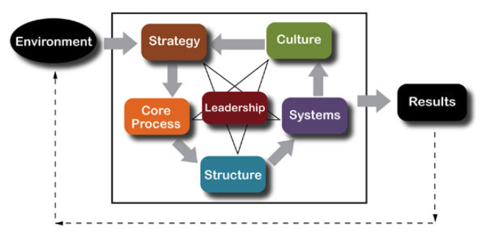
Tool 2: Organizational Structure & Design for Health
2. What if your environment
is high trauma and/or
under-resourced?
1. Organizational health and effectiveness depends on having all these aligned.
Source: Center for Organizational Design’s Transformation Model http://www.centerod.com/framework/

Slide 26
People Alignment: Jim Collins’ Good to Great Advice
Get the right people on the bus
Alignment with organization’s mission & values
Get the right people in the right seats on the bus
Alignment of skills and personality type with position (competence)

Slide 27
Adapting Jim Collins’ Advice in Under-Resourced Organizations
What if you cannot afford to pay the right people for the right position?
Get the right people on the bus
Misalignment with organization’s mission & values creates mission drift
Get the right people in the right seats on the bus
Misalignment of skills and personality type with position will result in staff who incompetent for their positions and will create conflict
Potential Solutions
Be willing to live with significant levels of dysfunction
Invest much more in recruiting
Do less to be able to pay people more

Slide 28
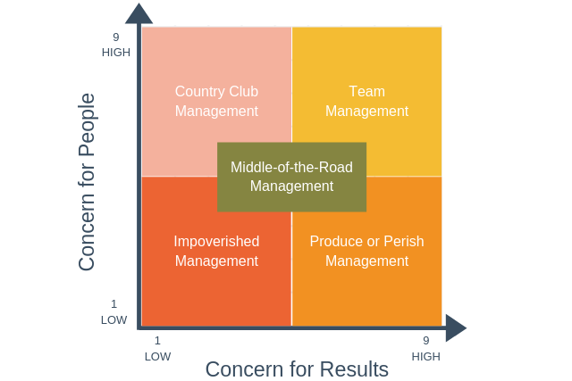
Tool 3. Balancing Concern for People and Results
Goal for effective management
Being under-resourced
and serving at-risk
communities can drive
you here
Source: Blake and Mouton Managerial Grid https://expertprogrammanagement.com/2019/05/blake-mouton-grid/

Slide 29
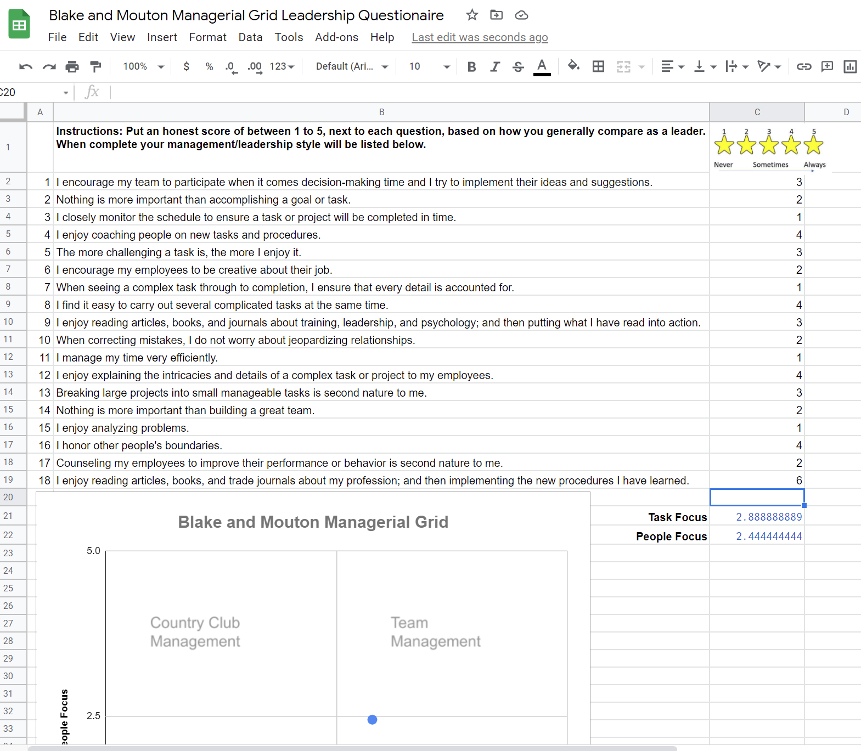
Take the Blake and Mouton Managerial Grid Quiz at: https://bit.ly/3mK4qgg
Questions Source: https://www.bumc.bu.edu/facdev-medicine/files/2010/10/Leadership-Matrix-Self-Assessment-Questionnaire.pdf

Slide 30
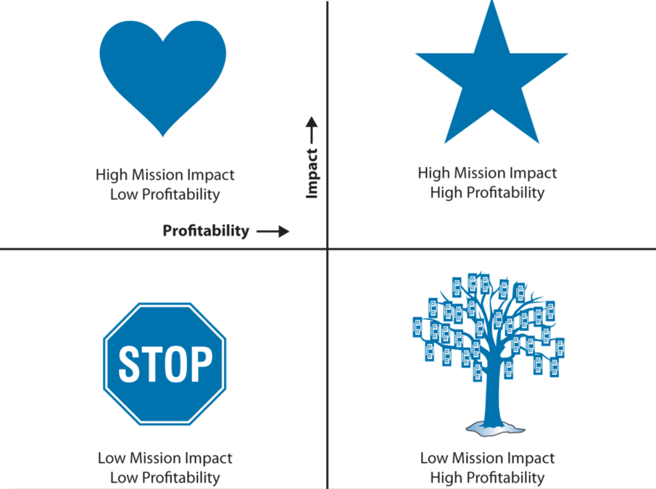
Tool 4: Use the Sustainability Matrix to Prune Activities
Source: The Sustainability Mindset

Slide 31
City Vision’s Pruning Strategy Program from Sustainability Matrix
Keep, Contain Cost
Invest & Grow
Addiction Counseling Program
Nonprofit Mgt
CHEIA
Ministry Program
Business Undergrad
GC4/ CQF
MBA
City Vision Internships
CV.Org UM.org
CIR
Kenyan Partnership
Student Loans
Foundation Grants
Individual Donors / Major Gifts
Close or Give Away
Water, Harvest, Increase Impact

Slide 32
Strategic Priorities & Pruning from Sustainability Matrix
Keep when possible, limit cost/time
Invest & Grow
3. Activity
1. Activity
2. Activity
Activity
Activity
Activity
Revenue Source
Revenue Source
Close or Give Away
Water, Harvest, Increase Impact

Slide 33
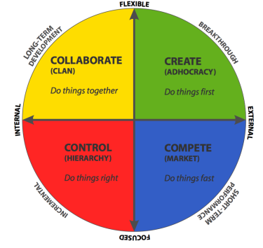
Tool 5: OCAI & Competing Values Framework to Balance Ministry Culture
Risks
Inaccessible to those with business culture Lack of Funding/Burnout from Lack of Resources
Example: CCD Ministry in Burnout
Risks
“New program of the week”
Burnout from lack of structure & too much risk
Example: Burnout from too many programs
Startup
Values
Ministry Values
Business Values
Governance Values
Risks
Stifling creativity and new ideas
Burnout from rigid bureaucracy
Example: Historic, but bureaucratic ministry
Risks
Culture of “It’s just business”
Burnout from drivenness
Example: “Business” of Christian social services

Slide 34
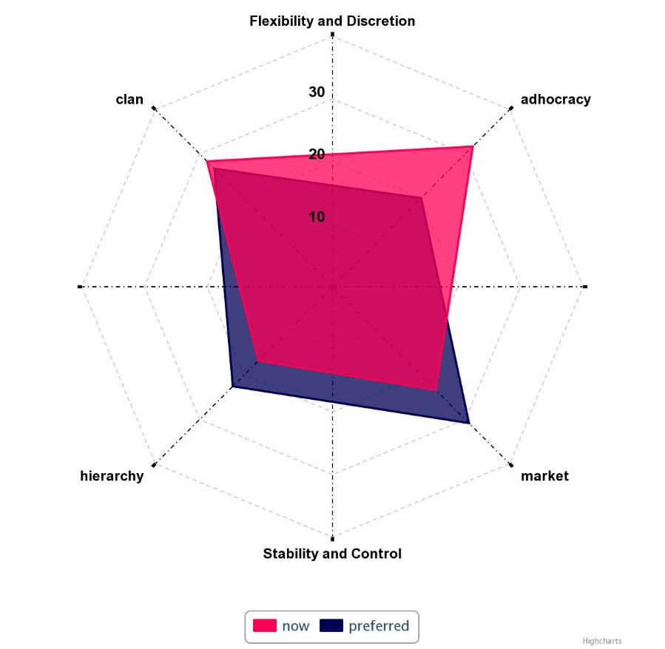
Sample Organizational Culture Assessment Instrument (OCAI) Profile
www.ocai-online.com
Ministry Competency
Entrepreneurial
Competency
Operations, Governance & Quality Assurance Competency
Business & Fundraising Competency
From the Organizational Culture Assessment Instrument and Competing Values Framework

Slide 35
Balance Planning & Competing Values Leadership
Relational Goals
Entrepreneurial/Innovation Goals
Operations & Governance Goals
Business & Funding Goals

Slide 36
City Vision 5 Year Strategic Plan Goals & Competing Values Framework
Relational Goals
Goal 3: Faculty & Staff Capacity
Entrepreneurial/Disruptive Goals
Goal 2: Radically Affordable Education
Operations & Governance Goals
Goal 1: Christian Social Service Education
Goal 4: Support Systems
Business & Funding Goals
Goal 5: Financial Growth

Slide 37
Developing Balanced Strategic Planning Goals (Competing Values Framework)
Relational Goals (%)
How will you care relationally for staff, constituents & stakeholders?
Entrepreneurial & Innovation Goals (%)
What are your new initiatives & innovations? What new core competencies do you need to develop?
How might your nonprofit business model need to change?
Operations, Governance & Risk Management Goals (%)
What policies, procedures and risk management practices do you need?
How do you protect your constituents, staff and stakeholders?
Funding & Sustainability Goals (%)
How will you ensure financial sustainability?
What are new funding opportunities that might be available?
Notes:
70% focused on the bottom half for City Vision strategic plan
What should we do MORE of?
What should we START?
What should we STOP?

Slide 38
City Vision 2020 Strategic Plan Goals & Milestones: Competing Values Framework
Faculty & Staff Capacity (10%)
Goal 3: Human Capacity
Improve capacity of staff to serve students
Specific actions not listed for privacy
Improve capacity of faculty to serve students
Specific actions not listed for privacy
Disruptive Innovation & New Programs (20%)
Goal 2: Innovation Capacity
Submit new Graduate Program to accreditor
Develop 3 new free course on CityVisionInstitute.org
Operations & Governance Goals (30%)
Continuous Innovation of Courses & Programs (Goal 1)
Specific actions not listed for privacy
Continuous Innovation of Administrative Systems (Goal 4)
Specific actions not listed for privacy
Funding Goals (40%)
Financial Capacity
Grow tuition revenue by X%
Specific actions not listed for privacy
Fundraising
Specific actions not listed for privacy

Slide 39
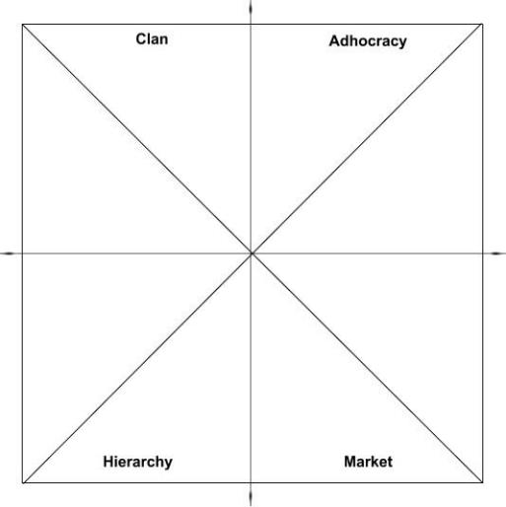
Using Competing Values to Direct Personal and Organizational Learning
Cross-cultural
Competencies
Ministry & Relational Competencies
• Cross-Cultural Management & Ministry
• Christian Community Development
• Urban Youth Ministry
• Organizational Behavior
• Vocation, Calling & Purpose of Work
• Technology, Life Balance & Addiction
• Bible & Theology Courses
• Counseling Courses
Innovation Competencies
Social Entrepreneurship
Entrepreneurship
Leadership in Under-Resourced Communities
Educational Program Development
Transformational Change Leadership
Ministry Mindset
Entrepreneurial Mindset
Spiritual Formation
Introduction & Capstone Courses
• Introduction to Nonprofit & Ministry Management
• Strategic Management
Operations Mindset
Business Mindset
Operations & Governance Competencies
Nonprofit Human Resources
Executive Leadership & Board Development
Nonprofit Financial Accounting
Project Management
Business & Funding Competencies
Marketing
Grant Writing
Nonprofit Fundraising
Nonprofit Managerial Accounting
Introduction to Business
Notes:
St. Matthew’s House

Slide 40
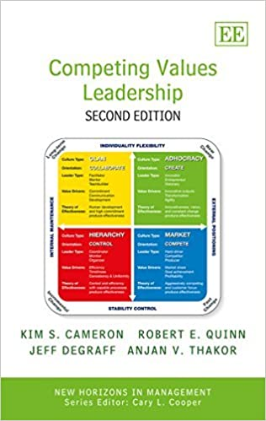
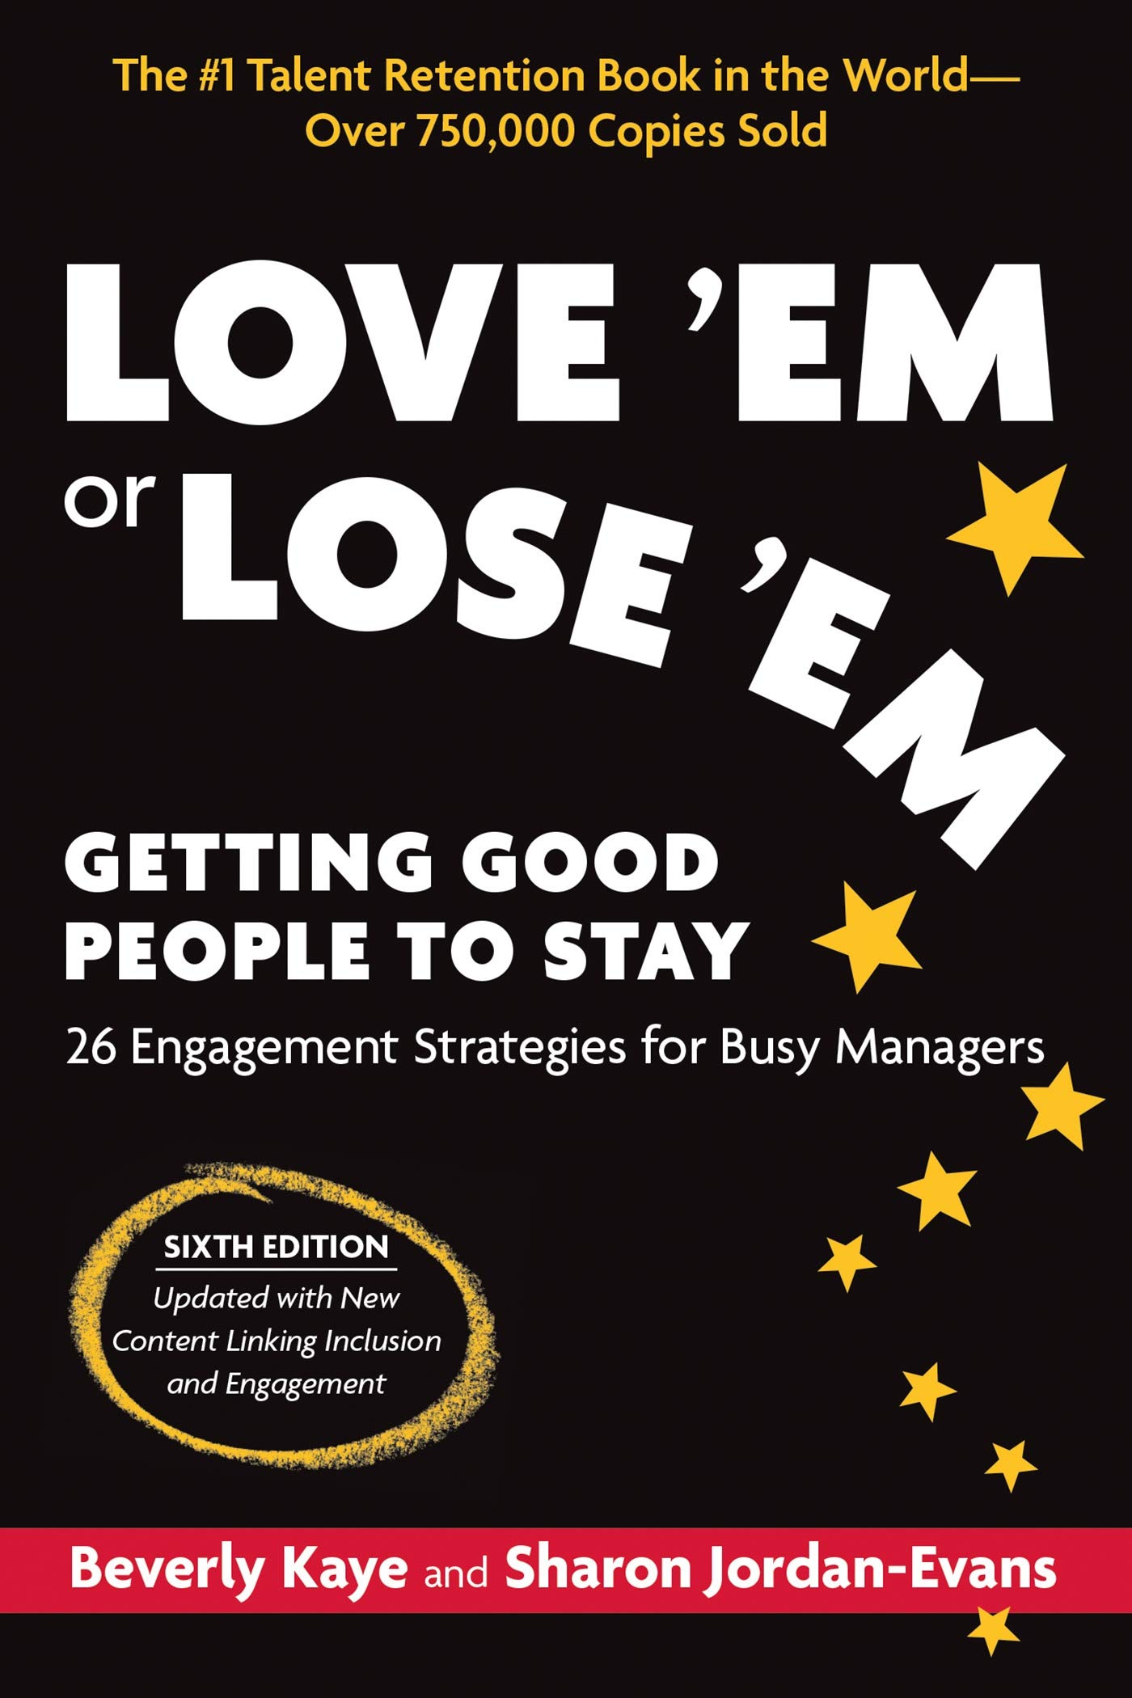
Book Recommendations

Slide 41
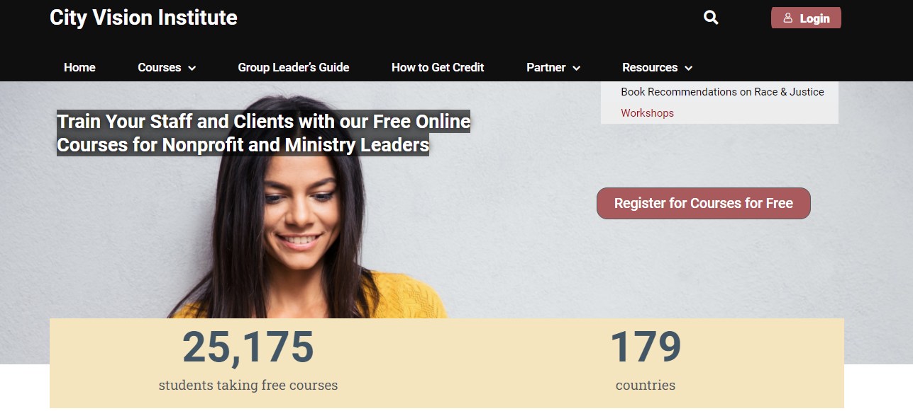
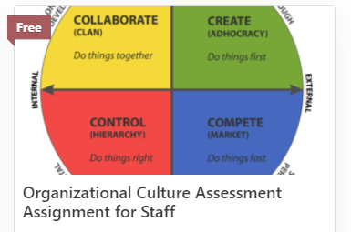
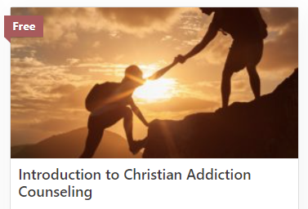
Recording, Slides &
Links from this Talk

Slide 42
Appendix
Dr. Andrew Sears President City Vision University www.cityvision.edu
Notes:
https://docs.google.com/document/d/17Oq1ie7JhIy6GcpGn8tsrsuEdthVHcEddYHmBxixY3U/edit#

Slide 43
Change Lever. Staffing and Hiring: Assessing Staffing
How Do you Shift Your Staffing Balance in Domains You Need to Grow In?
Ministry & Relational Staff
How many?
At what levels of leadership?
Innovation Staff
How many?
At what levels of leadership?
Ministry Mindset
Entrepreneurial Mindset
Operations & Governance Staff
How many?
At what levels of leadership?
Operations Mindset
Business Mindset
Business & Funding Staff
How many?
At what levels of leadership?
Notes:
What it will feel like when you take courses in your weak quadrant

Slide 44
Change Lever. Staffing and Hiring
Hire People Who Are Strong in Domains You Need to Grow In
Ministry & Relational Staff
Graduates from Bible Schools & Seminaries
Ministry Degrees
Bible Degrees
Cultural or Missions Degrees
Human Resources Degrees
People who previously worked at ministries
Innovation Staff
Entrepreneurship Majors
Entrepreneurs
Small Business Owners
Ministry Mindset
Entrepreneurial Mindset
Operations & Governance Staff
Degree Types
Accounting Majors
Business Majors with Detailed Personality
Previous Work
Project Management
Accounting
Operations & Logistics
Operations Mindset
Business Mindset
Business & Funding Staff
Business Majors
Christians from Secular Schools
Sales Background
Notes:
What it will feel like when you take courses in your weak quadrant

Slide 45
Charity, Development and Structural Change: Give a Man a Fish
Q1 Personal: Nurture (Humanities)
(Relational)
Q2: Physical: Nature
(physical needs)
Develop relationship with God and character for world-class fishing and a fulfilling life
Charity: give a man a fish
Individual development: Teach a man to fish
Individual
Q3: Cultural
(cultural transformation)
Q4: Societal (Social Sciences) (Systems)
Create a village culture of world-class fishing and cultural health
Community Development
Provide microloan for fishing equipment
Loan to buy lake
Macro (advocacy & structural change)
Teaching about global structures of fishing industry
Just laws to provide fair access to fishing
Just macroeconomic policies to maximize national revenue of fishing industry
Collective
Internal (subjective)
External (objective)

