Slide 1
How Ministries Might Respond to Critical Race Theory
Andrew Sears, President
City Vision University
Citygate 2021 Conference
Notes:
Let me start by asking a question:
How many of you live or work it neighborhoods where the stereotype in your city is that they are dangerous?
Are the neighborhoods as dangerous as the stereotype?
How many of you have been robbed or significantly hurt in those neighborhoods?
Why not?
Why are you willing to live or work in neighborhoods that many think are dangerous?

Slide 2

Image Source: https://www.josephprince.com/meditate-devo/we-are-in-this-world-but-not-of-this-world
Notes:
What would you do if God called you to work at Harvard? A place that where the stereotype is that it is intellectually and culturally dangerous?
Why is that different?
My point is that as Christians we are often willing to risk our lives in what many consider dangerous neighborhoods, but we avoid what many consider intellectually dangerous neighborhoods
One of the most intellectually dangerous neighborhoods to live in is being a Bible believing Christian discussing critical race theory
The solution isn’t to avoid it, but to learn to be street savvy in terms of ideas.

Slide 3
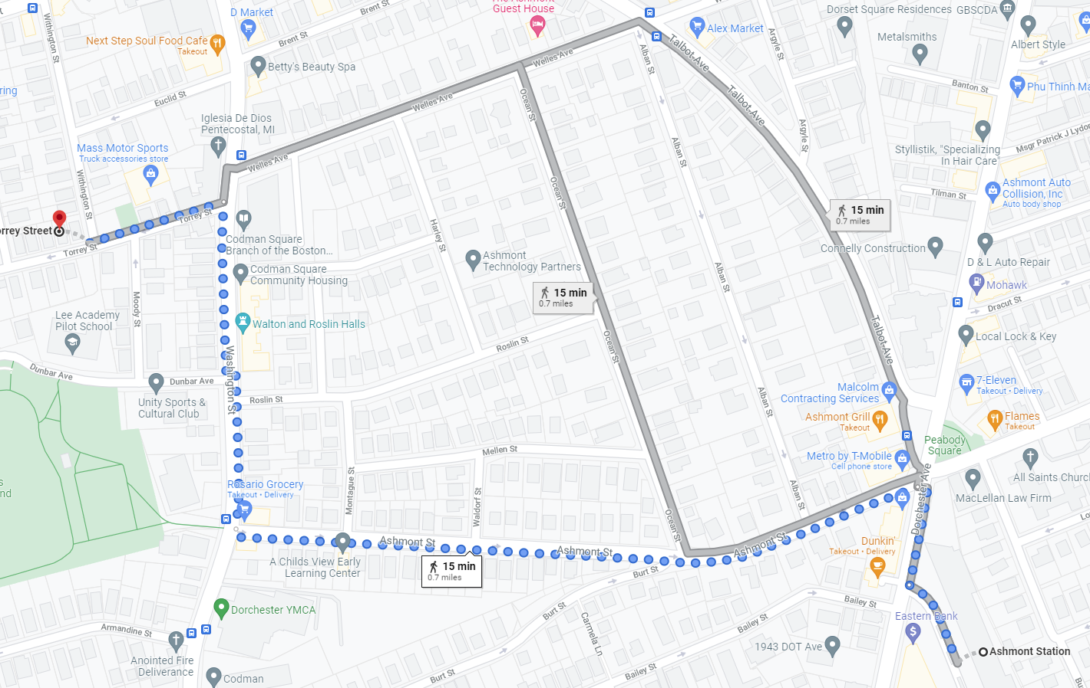
Navigating At-Risk Neighborhoods: Don’t Walk this Path at Night

Slide 4
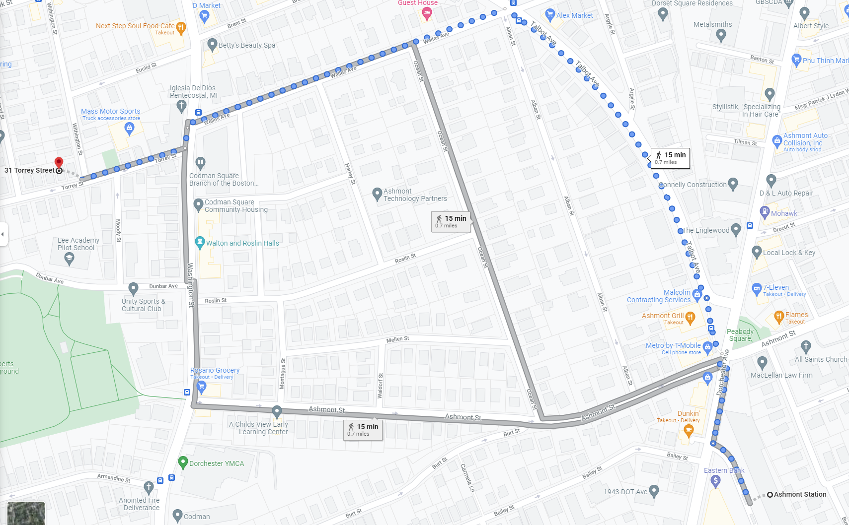
Navigating At-Risk Neighborhoods: Walk this Path
Notes:
Many people might think that it is dangerous to have conversations around race. It might be even more dangerous to navigate through controversial topics like Critical Race Theory. The goal of this talk is to help you develop a map to on how to navigate these issues.

Slide 5
Why I Wanted to Give this Talk
Notes:
My Spiritual Heritage is that I have two parents:
Grew up attending white evangelical churches and schools and Black churches.
Grew up in racially mixed neighborhood
My first experience serving in ministry was at City Union Mission in Kansas City.
My spiritual formation in ministry came partly through mentorship of rescue missions and partly from CCDA and the black church
For most of our history about 2/3rds of our staff and board have been Black and Latino. Seasons where I was the only white person. That just felt normal to me.
The past few years, I feel like have two divorced parents that won’t talk to each other
I remember the good days when John Perkins was a keynote speaker at Promise Keepers events and racial reconciliation was “cool”.
Now you say the words “racial reconciliation” and far right accuses you of imposing critical race theory on them, the far left say it’s a term that’s too slanted toward white people
To help address this, one of our top strengths at City Vision has been in helping others grow in their own cultural intelligence.

Slide 6
Navigating Critical Race Theory: Big Picture and Origins
Social Sciences
Psychology
Sociology
Critical Theory
Clinical Psychology & Counseling
Critical
Race
Theory
Notes:
Critical Theory largely originated in Germany academic circles initially as a critique of Hitler’s Nazism.
CRT largely emerged in US academic circles in the 1980’s as “a collection of critical stances against the existing legal order from a race-based point of view”

Slide 7
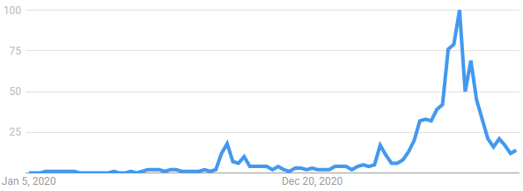
How Did “Critical Race Theory” become a Major Issue
Google Searches on Critical Race Theory
State Battles over
CRT in Education
Trump Releases
White House
Memo on CRT
Notes:
Was around since the 1980s, and similar theories with different names since the 1960’s, but was not a major issue
September 2020, Trump
Before that, the Manhatten Institute funded an initiative to focus on rebranding all “cultural insanities” under CRT

Slide 8
Critical Race Theory: The Big Picture
Critical Race Theory (CRT) is one of hundreds of frameworks
for understanding race (popular in secular academic circles)
The controversy around CRT is driven by polarization from social media and politics
Framing the race discussion primary through controversy around CRT largely shuts down the race discussion
Most Christian criticisms and controversies around CRT largely apply to other social sciences - i.e., debate over counseling/psychology

Slide 9


Slide 10
Five Approaches to Counseling & Christianity
Biblical Counseling
Transformational
Counseling
Christian
Psychology
Christian Integration
(light)
Levels of Explanation
(secular)
Church
Scattered
(in the
world)
Church
Gathered
(not of
the world)
Primarily Christian
Counselors
in Churches
Primarily Christian
Counselors in
Christian organizations
that take Insurance
Primary Christian
Counselors in
Secular Organizations

Slide 11
Dualism Heresy: Secular-Sacred Divide
Sacred
Personal beliefs
Church/religion
Sunday
Secular
Counseling/Psychology/Sociology
Science
The other 6 days
“The sacred-secular dualism is the worst heresy of the Christian church worldwide” – R. Paul Stevens
The whole world is sacred and under God. Ephesians 4:6, Isaiah 6:3, Psalm 139:8
Notes:
“[There is] one God and Father of all, who is over all and through all and in all.” (Ephesians 4:6)
“And one called to another and said: ‘Holy, holy, holy is the Lord of hosts; the whole earth is full of his glory!’” (Isaiah 6:3)
“If I ascend to heaven, you are there! If I make my bed in Sheol, you are there!” (Psalm 139:8)

Slide 12
Translating Social Sciences Through a Christian Worldview
Christian Worldview of Social Sciences
Secular Social Sciences
Church
Scattered
(sent into
the world)
Church
Gathered
(not of
the world)
Christian Community Development
Christian Identity + Cultural Identity
Cross-Cultural Ministry
Inadequate Translations
Social Gospel
Christians with Secular Worldview in their field
Any Identity > Christian identity
Political Science
History
Economics
Sociology
Critical Race Theory
Anthropology
Ethnic & Gender Studies
Social Identity Development
Notes:
Should we have Christians in Hollywood? In academia?

Slide 13
Part 1 Summary
Political leaders of both parties are trying to manipulate you and your constituents to be a part of their political agenda
Need to stay focused on your mission and Scripture
We need to grow in cultural intelligence, and one source for learning is the secular social sciences translated into a Christian worldview
Translating learning from secular social sciences into a Christian worldview is like learning to be “street savvy” while living in a “dangerous neighborhood”
Notes:
Compare emotional intelligence to cultural intelligence

Slide 14
A Framework for Growing Cultural Intelligence while Retaining a Christian Worldview

Slide 15
Christian vs. Secular Social Science Worldview
Christian Worldview Dominant Secular Social Science Worldview
Base Worldview Christian Worldview Secular Scientific Naturalism
Fundamental Problem? Sin Social/Psychological Problem: i.e. Unequal Power
Solution? Salvation Social/Counseling Solution (Power)
Who are we? In God’s Image but fallen Thinking animals/Collection of atoms
Identity in Christ Primary Identity is social/group identity
Where we came from? God Accidental Cosmic Chance
Philosophy? Spiritual, wholistic Materialistic, postmodern
What is truth? Biblical+ general revelation Entirely socially constructed
Values Bible-based Pretends (falsely) to be value-free
How should I live? Love God, Love Others Individual Pleasure Maximizing
and/or Social Activism
Sources: The Universe Next Door, Hidden Worldviews

Slide 16
How Universities are Typically Organized
Q1 Personal: Nurture (Humanities &
Personal Social Sciences) (I/mind)
Q2: Physical: Nature (Science & Technology)
(it/body)
Humanities
Western Theology
Ministry
Counseling
Psychology
Art for Self
Biology
Chemistry
Physics
Engineering
Medicine/Psychiatry
Healthcare/Life Sciences
Individual
Q3: Cultural
(we)
Q4: Societal (Social Sciences)
(they)
Ethnic/Gender/Cultural studies
Art for others
Cultural storytelling
Anthropology
Most non-Western religions/theology
Music/Worship
Micro
Organizational & Business Management
Microeconomics
Macro
Sociology/Social Work
Law/Political Science/Politics
Economics
History
Ecology
Collective
Internal (more subjective)
External (more objective/materialist)

Slide 17
How Universities are Typically Organized
Q1 Personal: Nurture (Humanities &
Personal Social Sciences) (I/mind)
Q2: Physical: Nature (Science & Technology)
(it/body)
Humanities
Western Theology
Ministry
Counseling
Psychology
Art for Self
Biology
Chemistry
Physics
Engineering
Medicine/Psychiatry
Healthcare/Life Sciences
Individual
All Disciplines Interpreted through
Lens of a Christian Worldview
Q3: Cultural
(we)
Q4: Societal (Social Sciences)
(they)
Cultural studies
Anthropology
Gender studies
Non-Western religions/theology
Music/Worship
Art for others
Micro
Organizational & Business Management
Microeconomics
Macro
Sociology/Social Work
Law/Political Science/Politics
Economics
History
Ecology
Collective
Internal (more subjective)
External (more objective/materialist)

Slide 18
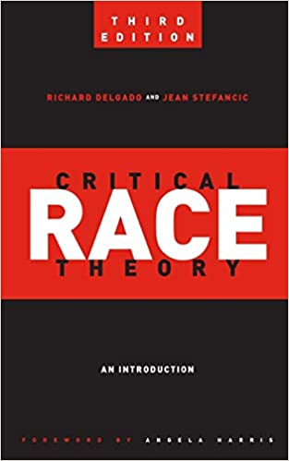
What is Critical Race Theory
“A collection of activists and scholars interested in studying and transforming the relationship among race, racism, and power”- R. Delgado
Stances of CRT
  Racism is pervasive in American society creating an unlevel playing field
  Because racism is most often concealed, CRT is skeptical of claims of neutrality, objectivity, colorblindness and meritocracy
  Subjective experience of people of color is important to
  understand racial inequality
  Racism is part of interlocking systems of oppression understood
  through intersectionality
  Critical race theory provides an alternative minority perspective
  across a variety of (largely) social science disciplines
Notes:
Randy Nabors from the New City Network says “It almost feels like a philosophy of “name calling” usually associated with the word “white;” white supremacy, white privilege, white fragility, etc. All of this implies and suggests “white guilt,””

Slide 19
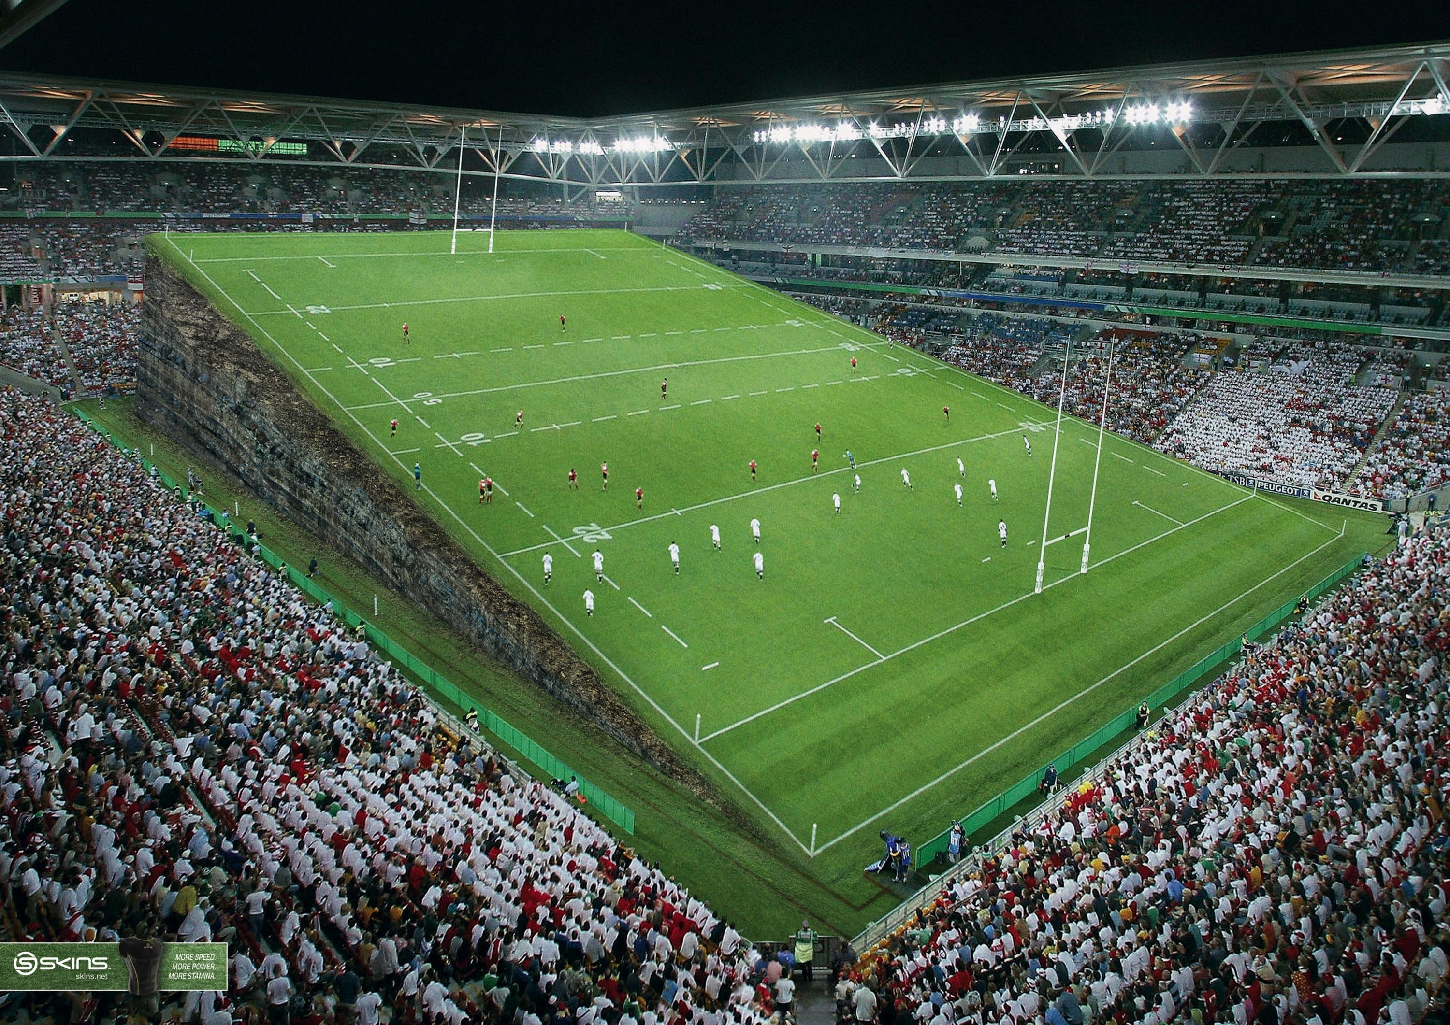
Critical Race Theory
is a secular intellectual
response to a perceived
unequal playing field

Slide 20
Critical Race Theory is an attempt to create a
intellectual framework to offset the
unequal playing field

Slide 21
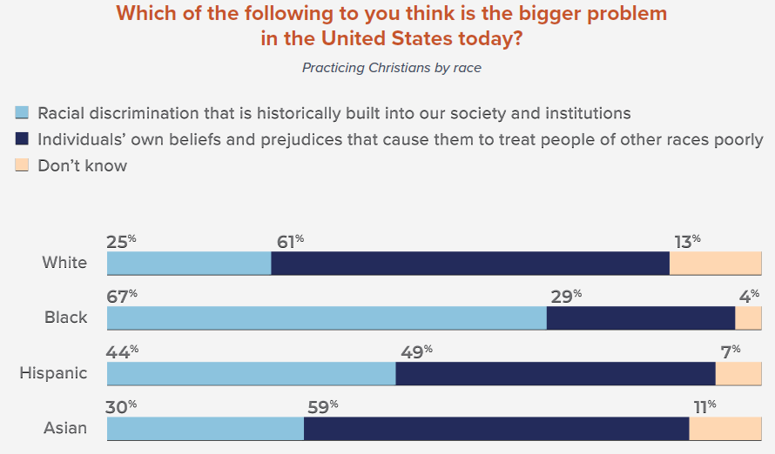
Different Christian Perspectives on Whether Institutions Create an Uneven Playing Field
Institutional Racism
Personal Racism
Gap Between White & Black Christian
Perspectives on Institutional Racism
Barna Beyond Diversity Study, 2019

Slide 22
Examples of Controversial Stances Out of CRT
CRT’s most controversial stances come from a materialist, collective worldview that is pervasive in the social sciences
  In general, CRT uses language and frameworks to offset an unequal playing field in larger society
  Works to create a “minority culture” framework to offset what is perceived inherently biased dominant framework
“People of color are not racist because they do not systematically benefit from racism” - Beverly Tatum
  Worldview: we are primarily defined by our collective identity
“If you are white in a white supremacist society, you are racist.”
- Ijeoma Oluo
  Worldview: our guilt is primarily defined by our collective identity

Slide 23

Understanding Biblical Justice (Tim Keller)
Community: Others have a claim on my wealth, so I must give voluntarily.
  Deuteronomy 24:17-22
Equity: Everyone must be treated equally and with dignity.
  Leviticus 19:13; 24:22, Isaiah 33:15, Deuteronomy 24:14-15, Deuteronomy 24:14-15
Corporate responsibility: I am sometimes responsible for and involved in other people’s sins.
  Daniel 9, 2 Samuel 21, Joshua 7, Numbers 16, 1 Samuel 15:2, Deuteronomy 23:3-8, Exodus 20:5, Leviticus 19:15, Exodus 22:25-27; Jeremiah 22:13, James 5:4, Deuteronomy 24:14-15
Individual responsibility: I am finally responsible for all my sins, but not for all my outcomes.
  Proverbs 6:6-7; 13:23; 23:21, Exodus 22:21-27, Ezekiel 18, Deuteronomy 24:16
Advocacy: We must have special concern for the poor and the marginalized.
  Leviticus 19:15, Isaiah 1:17, Psalm 41:1, Proverbs 31:8-9, Jeremiah 22:3, Zechariah 7:9-10
Source: Tim Keller https://quarterly.gospelinlife.com/a-biblical-critique-of-secular-justice-and-critical-theory/

Slide 24
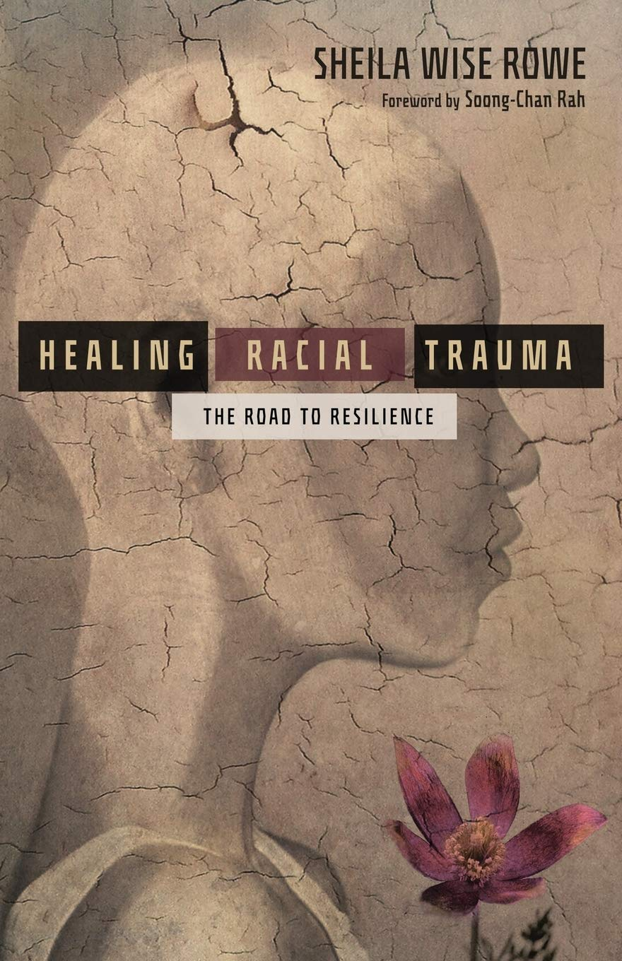
Developing a Trauma Informed Understanding on Race
Many rescue missions have separate men’s and women’s
residential recovery programs to increase safety
Recognize significance of group trauma
  Racial trauma, gender-based trauma, social class-based trauma
Much of conflict that happens is from group trauma being invalidated
  A woman with trauma from men in a co-ed group where it is not safe to discuss her trauma
  Someone with racial trauma in a white culture dominant group with mixed races where some group members deny the legitimacy of their trauma
  A white male experiencing social class-based trauma being told it is not valid, because only racial and gender-based trauma are legitimate group trauma
  A white male veteran whose trauma is discounted in a CRT framework
Group trauma is best healed in a group with people recovering from similar trauma without major risk of invalidation

Slide 25
How to Stay Focused on Your Mission
While Addressing Racial Injustice

Slide 26
Spectrum of Christian Understanding of Race
Priority 2: As a Generational Transition, Many Evangelical
Ministries Serving the Poor Will Need to Make this Transition
Priority 1: Resist Assimilative force of
non-Biblical secular worldviews
Separatist
White Fundamentalist Churches
White Evangelical
Churches & Ministries
Highly Multiethnic
Evangelical/
Bible-Based
Churches & Ministries
Working Class Black, first generation Hispanic & Asian American
Bible-Based
Churches
Upper Middle Class
Black, 2nd+ gen Latinx, Asian American Bible-Based Churches
Radical or Secular
Identity
Political
Movements
Nearly all-White
Nearly all non-White
Many Rescue Missions
Christian Community Dev’t
Intervarsity
Highly multiethnic Rescue Missions
Lausanne Statement on Holistic Mission of the Church (Billy Graham, 95% of evangelicals globally): Evangelism, relief, development and advocacy are all important with emphasis on evangelism
Notes:
Bob Jones Network
Dallas Statement on Social Justice
Renegade fear-mongers on social media
Is. 8:12-13: 12“Do not call conspiracy all that this people calls conspiracy, and do not fear what they fear, nor be in dread. 13But the Lord of hosts, him you shall honor as holy. Let him be your fear, and let him be your dread. ()
https://www.openbible.info/topics/fear_mongers
Overton_window

Slide 27
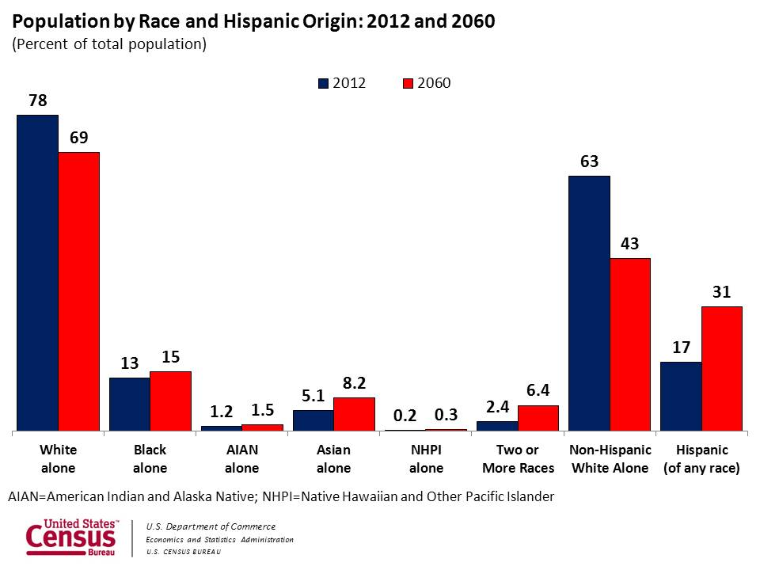
US Demographic Trends
3. Diversity
2. Balanced Social Change
1. Entrepreneurship
Notes:
What is changing generationally?

Slide 28
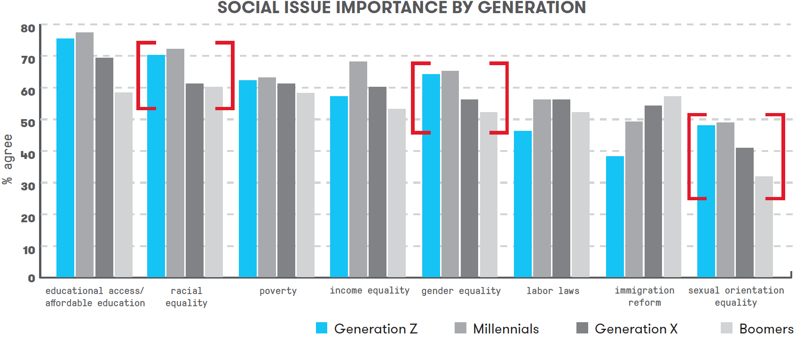
Generational Trends on Social Issues and Diversity
3. Diversity
2. Balanced Social Change
1. Entrepreneurship
Source: https://www.marketingprofs.com/charts/2018/33740/getting-to-know-gen-z-beliefs-preferences-and-behaviors
Notes:
Probably the most significant slide of the presentation
The top three generational differences on social issues are: race, gender and sexual orientation.
For organizations that uphold the traditional Biblical view on marriage and sexuality, it will be increasingly important to improve the racial and gender diversity of leadership to appeal to Gen X, Millennials & Gen Z donors. Donations today are still primarily driven by Boomers, so the real pressure will happen when donations are driven by younger generations.

Slide 29

Case Study: InterVarsity
Context
  Serves largely on secular college campuses that are racially diverse
  and are more left-leaning
Strategic choices
  Strongly promote gender equality and racial equality
  Developed policies to clearly affirm traditional view on marriage and sexuality
Implications
  InterVarsity Press became global leader on evangelical racial dialog
  Was banned from meeting on several leftist campuses creating social stigma and limited recruitment
  Some InterVarsity chapters at leftist campuses left InterVarsity
Notes:
So how to address these changes? InterVarsity serves as a good case study

Slide 30

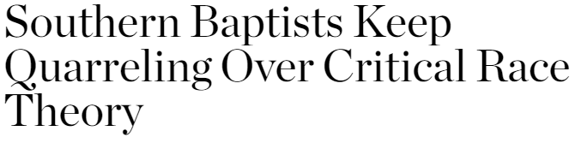

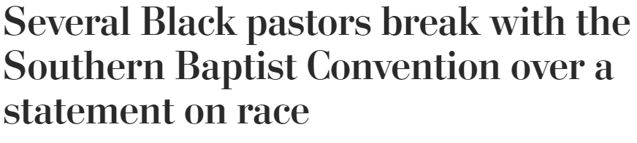
Case Study: Southern Baptists
Southern Baptists’ Seminary Presidents issue statement on CRT
Black Southern Baptist pastors
push back
Southern Baptist Convention elects bridge-builder Ed Litton as President
Image Source: https://www.pngegg.com/en/png-krljh

Slide 31
Developing a GPS to Grow in Cross-Cultural Intelligence

Slide 32
Growing in Cultural Intelligence
Know where you are
Know where you want to go
Have a plan for how to get there
Notes:
Many people might think that it is dangerous to have conversations around race. It might be even more dangerous to navigate through controversial topics like Critical Race Theory. The goal of this talk is to help you develop a map to on how to navigate these issues.

Slide 33
1. Know where you are Part 1.
Understand Cultural Degrees of Separation to Assess Cultural Distance
Ralph Winter represents cultural degrees of separation as E0 (same culture), E1 (one degree removed), E2 (2 degrees removed)
Key dimensions that may influence degrees of separation or distance
  Race/Ethnicity
  Social class: poor, working, middle, upper
  Gender
  Language
  Immigrant generation (first, second)
  Country of origin
  Christian vs. non-Christian (and various denominations)
  Organizational values alignment
You learn how these dimensions affect your cultural distance based on your knowledge of yourself, other cultures and experience
Notes:
The field of missions has had concepts similar to that of intersectionality, but have presented them within a Christian worldview.

Slide 34
1. Know where you are Part 2. Know Your Personal Cross-Cultural Sphere of Influence
Tier 3
International Middle Class
(other language)
Everyone Else
Tier 2
Tier 1
White
Upper
Middle
Class
Women
Black
Poor or
Middle
Class
White & Black
Working Class
White
Middle
Class
Poor
White
2+ Gen Latino/a &
Asian Working Class
First Generation, Poor or Middle
Class Latino/a or Asian

Slide 35
1. Know where you are Part 3. Understand How Maxwell’s Law of the Lid Can Apply Cross-Culturally
John Maxwell’s Law of the Lid: “If your leadership rates an 8, then your effectiveness can never be greater than a 7.” This is because you can only effectively lead those at a 7 or below.
Your leadership level will vary across different cross-cultural groups
  i.e., someone who is a level 8 leader with White middle-class men, might be a 5 with Black upper-middle class women
  Each person will have a different cross-cultural sphere of influence (or leadership levels) across various groups given their cultural background, identity and personality

Slide 36
How Cross-Cultural Law of the Lid Plays Out Organizationally
White Male, Middle Class Leader
(Levels: White 8, Asian 7, Black 6, Latino/a 4,
Female or Class Reduce 1)
White Male
Middle Class
Level 7 Leader
White Female Working Class Level 5 Leader
Black Male Middle Class
Level 5 Leader
Latina
Level 3 Leader
15 largely white staff
Black Male Working Class Level 3 Leader
Black Male Working Class
Level 3 Leader
Result: Senior Leadership is disproportionally White
Clients from other race and class groups do not have as strong of success rate

Slide 37
1. Know where you are. Part 4. Know Your Organizational Cross-Cultural Sphere of Influence
Tier 3
Non-Christians Seeking
Affordable Nonprofit Degrees
(largely adult White & Black working class)
Everyone Else
Tier 2
Christians
in Nonprofit Professions
(largely Adult White & Black Working Class)
Tier 1
Asian &
Latino
Christians
In Nonprofit
Professions
Or Program
Participants
Evangelicals
Serving the
Poor
(largely Adult
White & Black
Working Class)
International
Students
in NGOs or
Parachurch
Ministries
Participants from Evangelical
Programs Serving The Poor
(largely Adult White & Black
Working Class)
Christians Seeking
Affordable Degrees
(largely adult White &
Black working class)
Notes:
Recognize that much of systemic injustice is Caused by Cross-Cultural Limits of Dominant Groups

Slide 38
1. Know where you are Part 5. Conduct Evaluation to Get Honest Measure of Organization’s Cultural Sphere of Influence
Clients
  Assess demographics of participants (not showing up is a big indicator)
  Assess success rates and complaints of clients across key cultural dimensions
  Do you have adequate staffing that is culturally close to be able to meet their needs?
  What is the difference in success rates of clients across Race/Ethnicity? Other Factors?
  Diagnosis: If the success rates are much lower for key target groups, then you are not focused enough on meeting the cultural needs of your clients?
  See Sample Diversity Data Form at: https://www.philanthropyma.org/resources-tools/common-proposal-form
Those with resources
  What are the key factors that they value that you are lacking that are limiting your ability to access resources?
  Do you have adequate staffing to meet their needs (fundraising, accounting, volunteer management)?
  Diagnosis: If you cannot access adequate resources you probably are not focused enough on serving those with resources

Slide 39
2. Know Where You Want to Go
Use Appropriate Training & Leaders to Expand Cultural Intelligence
Identify Training & Leaders
Appropriate for Your Goals
Separatist
White Fundamentalist Churches
White Evangelical Churches & Ministries
Highly Multiethnic
Bible-Based
Churches & Ministries
Working Class Black, first generation Hispanic & Asian American
Bible Based
Churches
Upper Middle Class
Black, 2nd+ gen Latinx, Asian American Bible Based Churches
Radical or Secular
Identity
Political
Movements
Nearly all-White
Nearly all non-White
Brian Fikkert
Bob Lupton
Ray Bakke
Tim Keller
Intervarsity Press
John Perkins
Brenda Salter McNeil
Miles McPherson
Intervarsity Press
Sheila Wise Rowe
Robert Chao Romero
Carl Ellis
Notes:
Bob Jones Network
Dallas Statement on Social Justice
Renegade fear-mongers on social media
https://www.openbible.info/topics/fear_mongers
Overton_window

Slide 40
3. Develop a plan to grow your cultural intelligence individually & organizationally
Individually
  Head/Cognitive: Reading, taking a course, watching videos, learning a language
  Heart/Affective: Cross-cultural friendships, attending cross-cultural church as a minority, immersion in cross-cultural community as a minority, being supervised cross-culturally
  Hands/Psychomotor: Managing cross-culturally, working cross-culturally (peers), serving cross-culturally (clients)
Organizationally
  Develop a cross-cultural assessment plan
  Conduct interviews, analyze data & diagnose Problems
  Develop a plan with develop Goals & Outcomes that stretch organization but not beyond its limit
  Staffing & training strategy

Slide 41
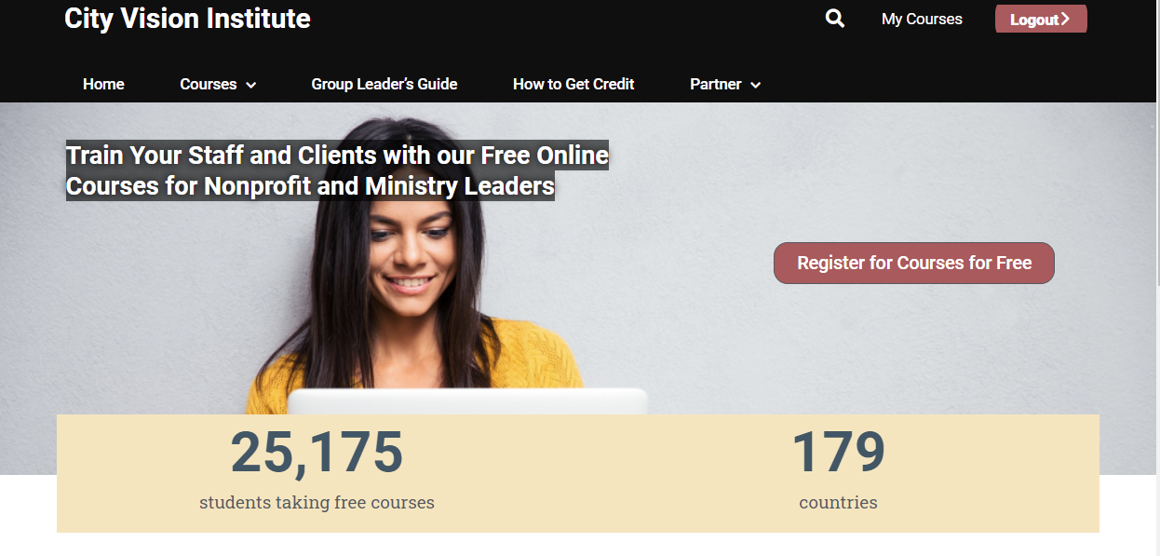
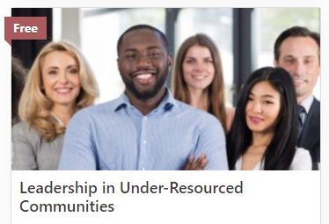


Slide 42
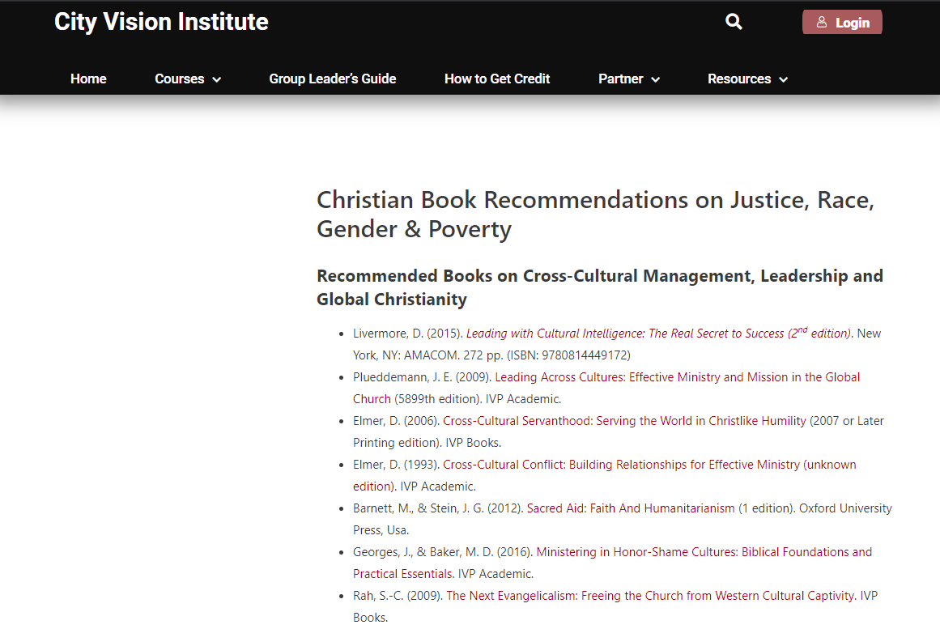

Slide 43
Appendix

Slide 44
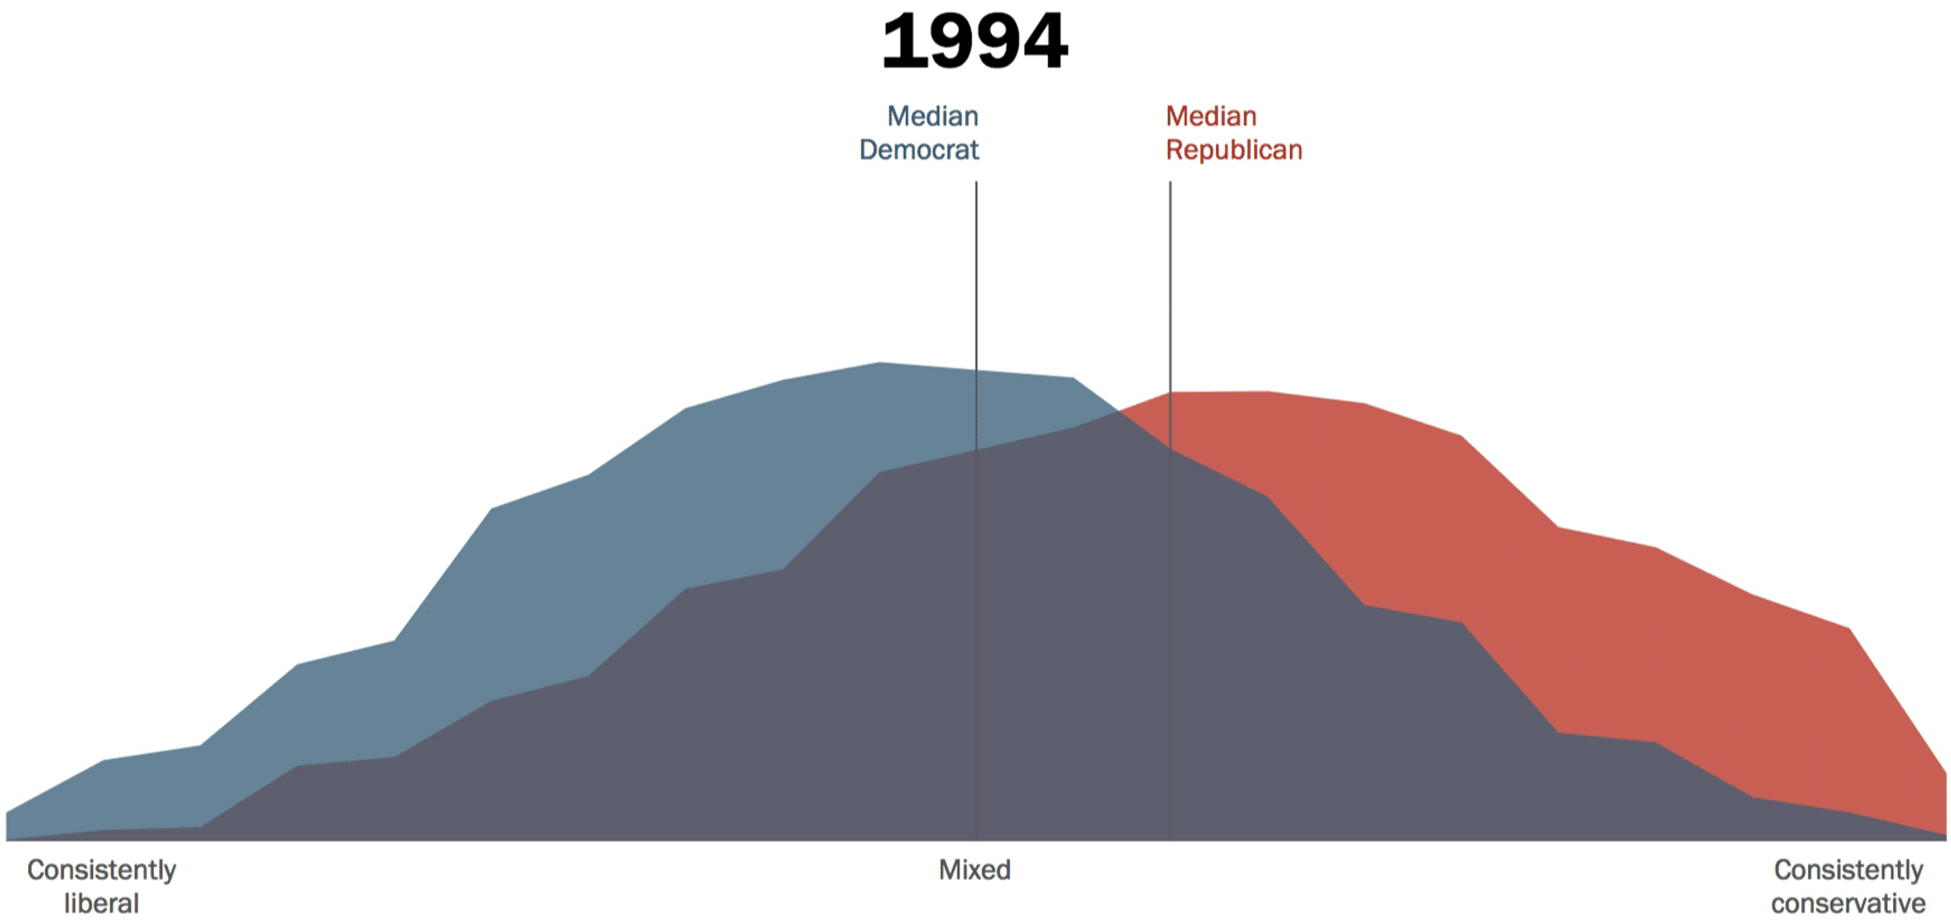
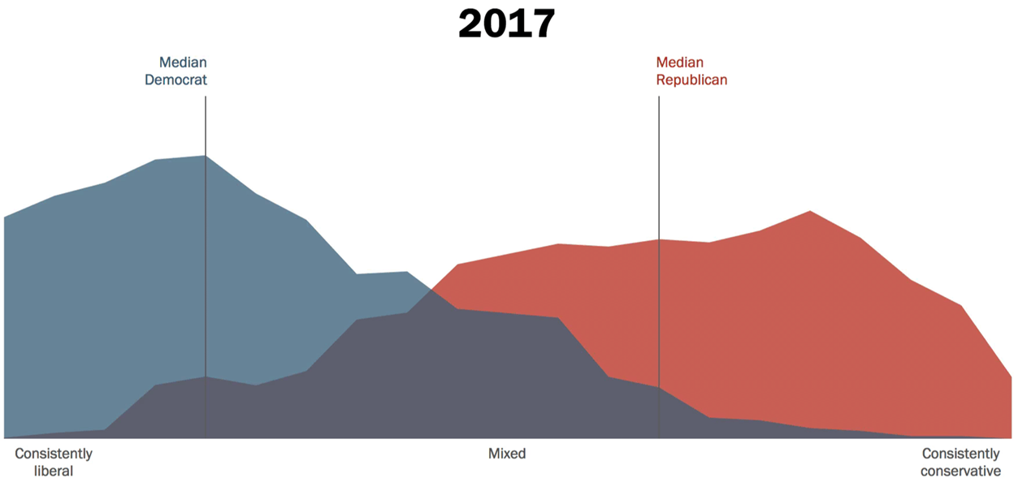
Increasing Political Polarization
Source: “The Partisan Divide on Political Values Grows Even Wider” Pew Report 2017

Slide 45
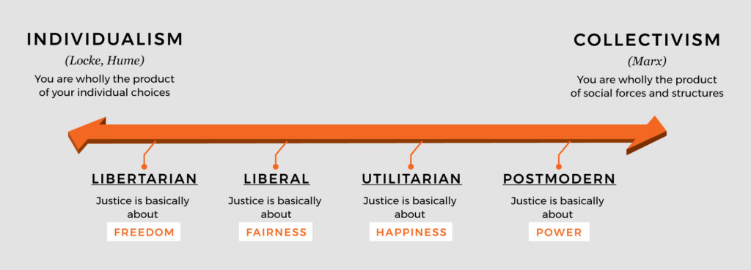
The Spectrum of Secular Justice Theories
Source: Tim Keller https://quarterly.gospelinlife.com/a-biblical-critique-of-secular-justice-and-critical-theory/

Slide 46
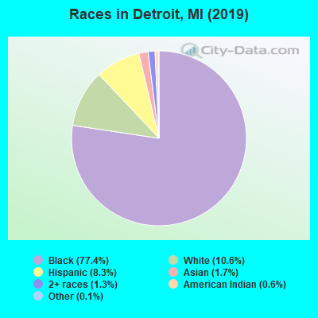
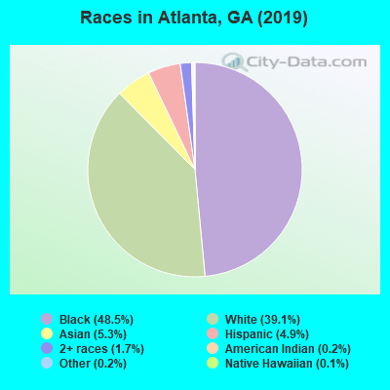
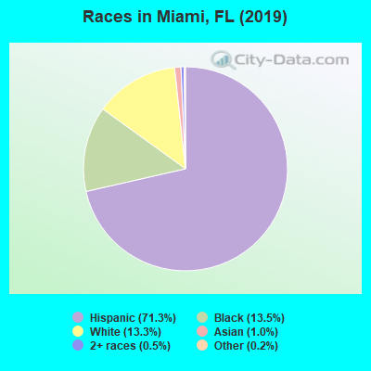
Demographics of Most Cities Are Decades Ahead of National Demographic Trends
3. Diversity
2. Balanced Social Change
1. Entrepreneurship
Notes:
What is it like growing up in a different racial context?
My story: Grew up attending white evangelical churches and schools and Black churches.
Grew up in racially mixed neighborhood
My spiritual formation in ministry came partly through mentorship of rescue missions and partly from CCDA and the black church
For most of our history about 2/3rds of our staff and board have been Black and Latino. Seasons where I was the only white person. That just felt normal to me.
The past few years, I feel like have two divorced parents that won’t talk to each other
I remember the good days when John Perkins was a keynote speaker at Promise keeper events and racial reconciliation was “cool”
Now you say the words “racial reconciliation” and far right accuses you of imposing critical race theory on them, the far left say it’s a term that’s too slanted toward white people
The reality is that many more people in younger generations are growing up in a context with more racial diversity than in previous generations.
To help address this, one of our top strengths at City Vision has been in helping others grow in their own cultural intelligence.

Slide 47
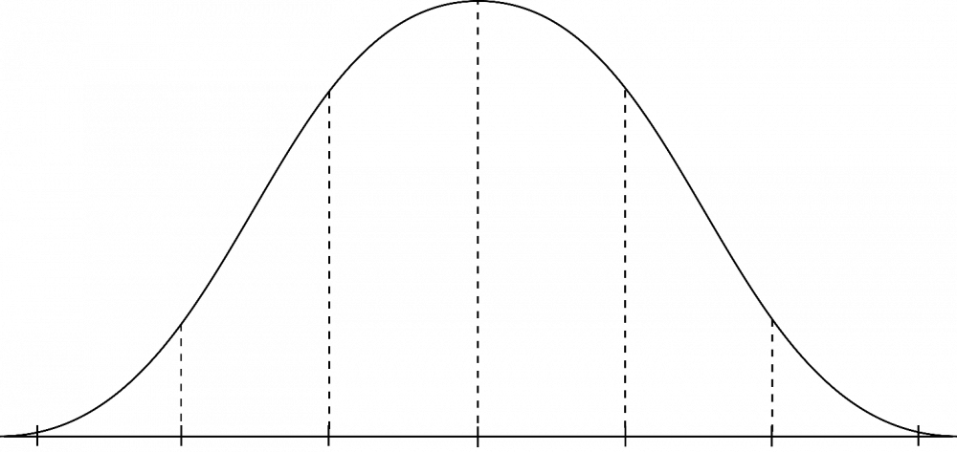
How Significant Are External Pressures for Change?
Great Need for Change
Less Immediate Need
Examples: Atlanta, Miami, Detroit, San Francisco, South Africa, etc.
Majority of clients are of different race/ethnicity of leadership
Extended community/city is different racial/ethnic group than leadership
Younger donors (including evangelicals) in your region strongly value diversity in leadership
Examples: ministries serving regions with predominantly white poverty (Montana, Omaha, etc.)
Limited differences in leadership and clients
Extended community/city is White and conservative
Donors in your region do not place significant value on diversity
Notes:
Part of what makes talking to a group like this difficult is the wide range of organizations and contexts you serve in.
Phrase “The future is already here, it’s just not evenly distributed.” not only applies to technology, but it also applies to demographic changes.
Younger donors may view rescue missions as too old school

Slide 48
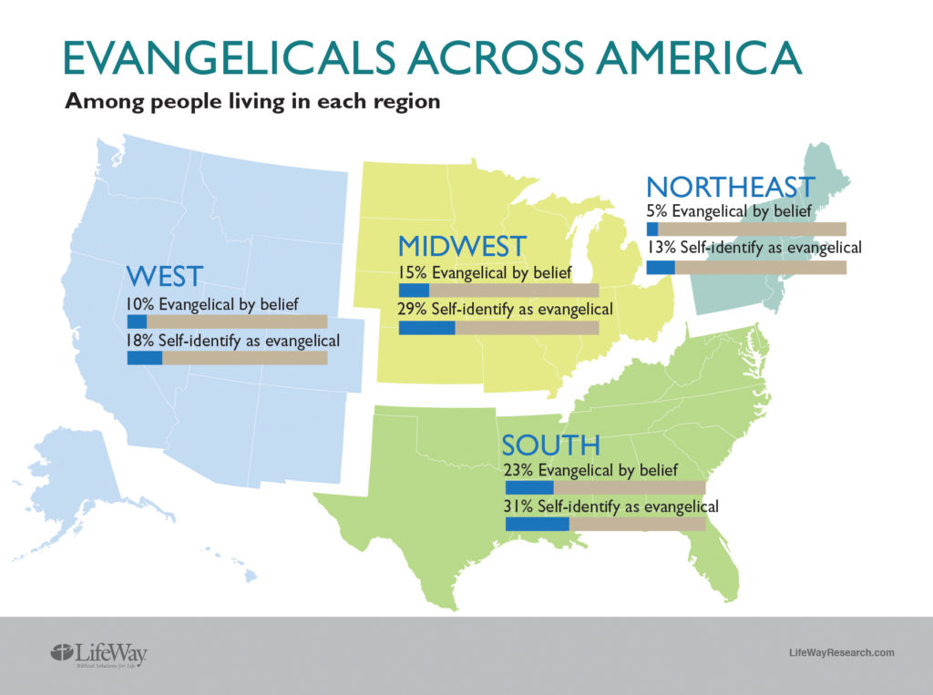
Source https://lifewayresearch.com/2017/12/06/many-evangelicals-dont-hold-evangelical-beliefs/

Slide 49
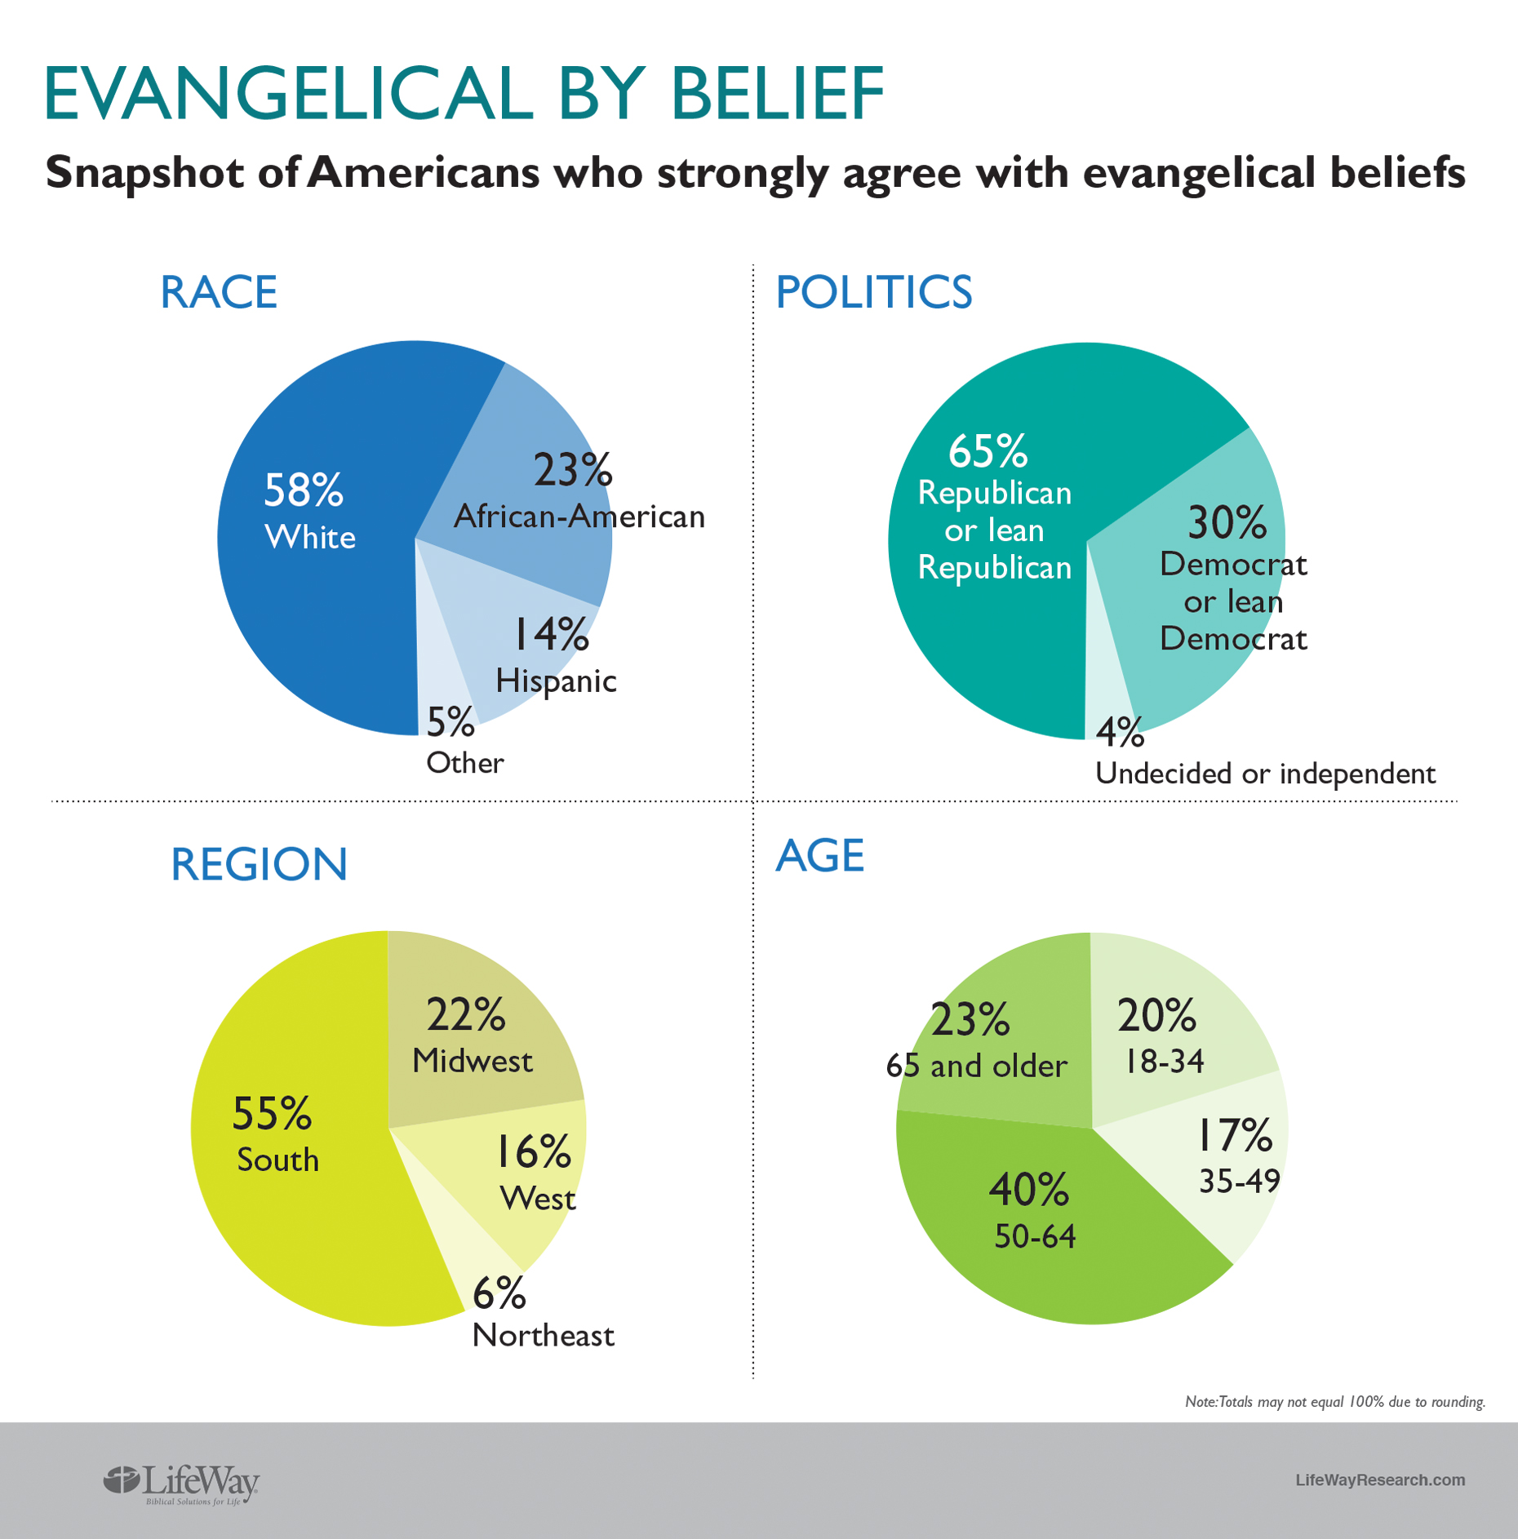
Source: http://lifewayresearch.com/wp-content/uploads/2017/12/Evangelical-Beliefs-and-Identity.pdf

Slide 50

Case Study: Cape Town City Mission
Context
  Leadership was White as apartheid was ending
  Radical change of cultural norms in post-apartheid South Africa
  Dominant culture viewed white-led missions as a colonial mentality and decided to stop supporting organizations that were disproportionately white in their leadership
Strategic Choices
  Transitioned from white leadership
  Many programs either were ended or became independent
  Dramatically increased focus on systemic change
Charity Focus vs. Systemic Focus
  10,000 street children in Cape Town with beds for 50
  Systemically-focused partnership with city that reduced number of street children to only 800 children on the street
3. Diversity
2. Balanced Social Change
1. Entrepreneurship
Notes:
I spent a summer in 1993 at Cape Town City Mission while apartheid was being dismantled. Visited them about 15 years later

Slide 51

Case Study TechMission (parent of City Vision University)
Context
  AmeriCorps National Grantee until 2013
  National leader in racial diversity in entire AmeriCorps program
  Targeted by Obama administration for defending religious hiring rights of evangelical AmeriCorps sites
Strategic Choices
  Walked away from 75% of funding rather than compromise religious hiring rights
  Stopped taking direct government grants
  Pivoted funding model from 75% donor income to 75% earned income
3. Diversity
2. Balanced Social Change
1. Entrepreneurship
Notes:
Should not have ignored cautions about taking government funds

Slide 52
5. Recognize and Work Against the Fact That Most Non-Intentional Systemic Injustice is Caused by Cross-Cultural Limits of Dominant Groups
Even with the best intentions, the limitations of your cultural sphere of influence will create extra barriers (bias) for those more on the outside
  Resources tend to be concentrated in White, Western, Middle/Upper Class and Male
  See presentation at: https://www.slideshare.net/techmission/nonprofit-funding-bias-and-foundation-diversity
Goals
  Achieve balance between stretching your personal and organizational cultural sphere of influence to the extent possible, but not so much that it creates personal or organizational disfunction that hurt your ability to achieve your mission
  Don’t discriminate in ways that would perpetuate injustice, but also don’t mislead
  Know your cultural identity, stretch your identity, but live within the limits of your identity

Slide 53

Goal: Stretch organization’s cross-cultural limits to maximize long-term mission effectiveness
Our Clients
Resources
Funders
Dominant Culture

Slide 54
7. Recognize Factors that Will Make Cross-Cultural Challenges More Difficult for Individuals
Factors
  How strong is the fit with the organizational values? (on the right bus)
  How strong is the alignment of the person with the requirements of their position? (on the right seat on the bus)
  How healthy is the organization overall?
Principles
  If any of these are off, it will make cross-cultural challenges much more difficult
  Some organizations will push justice too far to the point where it creates organizational dysfunction that decrease its organizational sphere of influence
  Other organizations will “cheat” and gain the short-term performance benefit of not stretching cross-culturally (homogeneous unit principle of ministry)

Slide 55
9. Develop a plan to grow your organizational cross-cultural sphere of influence
Situational Analysis
  Develop a cross-cultural assessment plan
  Conduct interviews & analyze data
  Diagnose Problems
Develop Plan
  Develop Goals & Outcomes that stretch organization but not beyond its limit
  Staffing strategy

Slide 56
Christian Organizations Specialize in Processing Different Types of Group Trauma
Racial Trauma
Dominant Culture
Organizations
Ethnic Churches
& Organizations
Good for Healing
Personal Trauma
Lower/working Class
White Churches
& Organizations
Gender Specific Groups
Class-Based
Trauma
Gender-Based
Trauma
Group dynamics make it difficult to process all three in the same group
Interpreting racial ideologies through a trauma-informed perspective
helps avoid some unhelpful intellectual and political bickering

Slide 57
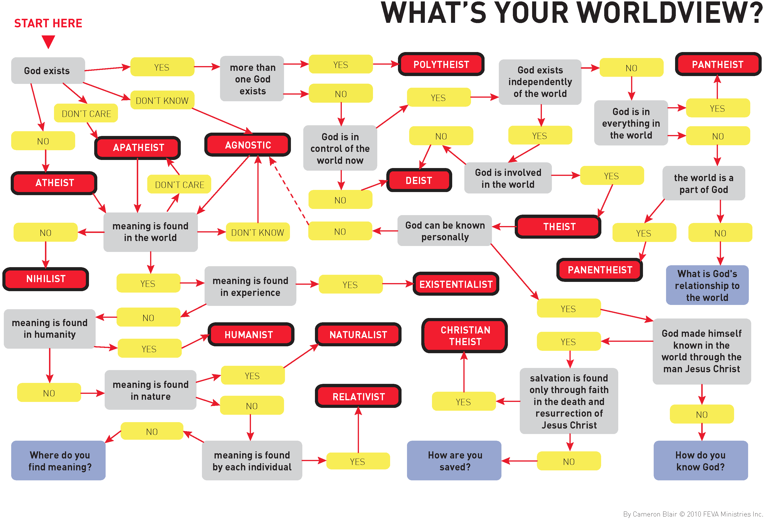

Slide 58

Weak Integration: The Problem with a Christmas Tree Approach to Christian Integration
Christian
Concept
Secular
Worldview

