Slide 1
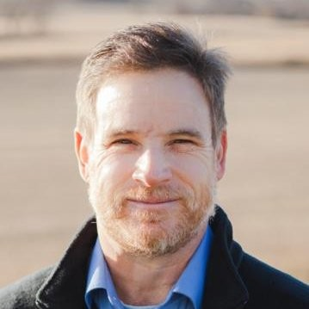
Leading Purposeful Programs
Dr. Charles McElveen, MBA
City Vision University
Notes:
Welcome to Leading Purposeful Programs, a presentation first delivered at the Gospel Rescue Mission Fellowship annual conference in 2021.

Slide 2
Seminar Goal
Key word: Intentionality
Acquire practical tools to help reduce uncertainty and increase confidence in program operation.

Slide 3
Topics
Biblical Models of Planning
Tools
Layers
Measurement

Slide 4
Biblical Models of Planning

Slide 6
Nehemiah
Nehemiah learns that the wall of Jerusalem is destroyed, prays, asks to return to Jerusalem to rebuild
Receives aid, returns to Jerusalem, Carries letters of authorization from the king, inspects the walls
Begins rebuilding Jerusalem
A plot arises, so Jews work with weapons in their hand
Nehemiah sees Jewish nobles oppressing the poor; forces the cancellation of all debt and mortgages
Appoints officials
Sets guards
Establishes Residency
Notes:
In the 20th year of Artaxerxes I of Persia, Nehemiah, cup-bearer to the King in Susa (the Persian capital), learns that the wall of Jerusalem is destroyed.
He prays to God, recalling the sins of Israel and God's promise of restoration to the Land
Asks Artaxerxes for leave to return to Jerusalem and rebuild its walls
The king is receptive and extends his aid to this mission.
Nehemiah returns to Jerusalem, carrying letters of authorization from the king
He inspects the walls.
Nehemiah and the Jews, begin rebuilding Jerusalem.
The enemies of the Jews plot to attack Jerusalem so Jews work with weapons in their hands.
Nehemiah sees that the Jewish nobles are oppressing the poor, and forces the cancellation of all debt and mortgages
Nehemiah appoints officials
Sets guards on the wall and gates
Plans to register the Jews and finds the Census of those who had returned earlier.

Slide 7
Nehemiah
Spiritual Revival
Assembles the people, Ezra reads the Law, institute the Feast of Booths, people enter a covenant
Jerusalem is repopulated
Conducts Census
Closing Stages
After 12 years Nehemiah returns to Susa
Returns to Jerusalem and finds backsliding, enforces earlier reforms
Notes:
Spiritual Revival
Nehemiah assembles the people and has Ezra read to them the law-book of Moses
Nehemiah, Ezra and the Levites institute the Feast of Booths in accordance with the Law.
The Jews assemble in penance and prayer, recalling their past sins, God's help to them, and his promise of the land.
The priests, Levites and the Israelite people enter into a covenant, agreeing to separate themselves from the surrounding peoples and to keep the Law.
Jerusalem is repopulated
A list of priests and Levites who returned in the days of Cyrus (the first returnees from Babylon) is presented
Nehemiah, aided by Ezra, oversees the dedication of the walls and the rebuilt city.
Closing Stages
After 12 years Nehemiah returns to Susa
Later comes back to Jerusalem, and finds that there has been backsliding in his absence
He takes measures to enforce his earlier reforms and asks for God's favor.

Slide 8
Luke 14: 25-34
The Tower
28 “Suppose one of you wants to build a tower. Won’t you first sit down and estimate the cost to see if you have enough money to complete it? 29 For if you lay the foundation and are not able to finish it, everyone who sees it will ridicule you, 30 saying, ‘This person began to build and wasn’t able to finish.’
The War
31 “Or suppose a king is about to go to war against another king. Won’t he first sit down and consider whether he is able with ten thousand men to oppose the one coming against him with twenty thousand? 32 If he is not able, he will send a delegation while the other is still a long way off and will ask for terms of peace.

Slide 9
Tools

Slide 10
Tools
Tool 1: Focus on Your Participants
Focus on the itch, not the scratch. Make sure you will be scratching where there is an actual itch!
Best Practice: Intake Assessment, Other Programs, Current Literature
Tool 2: Align with Organizational Values and Capacity
The tool you scratch with is one the organization would use
Best Practice: The “S” from SWOT

Slide 11
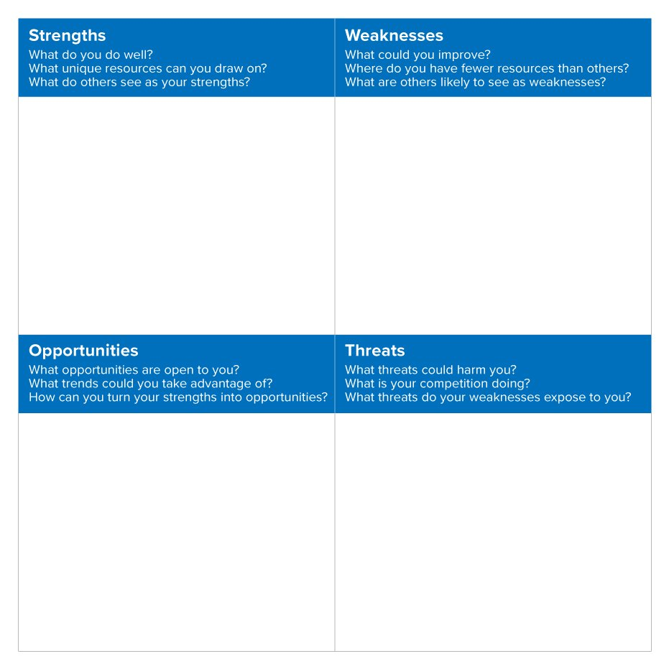

Slide 12
Tools
Tool 3: Choose the right activities
Determine when, how, and how long to scratch to relieve the itch
Best Practice: Other programs, Current literature,
Tool 4: Capitalize on resources/partnerships
What do I need to do to scratch? Do I have one? Where can I get one? Do I need help scratching?
Best Practice: Sector organizations, Colleges/Universities, Clearing houses such as rescuemissioncurriculum.org and cityvisioninstitute.org

Slide 13
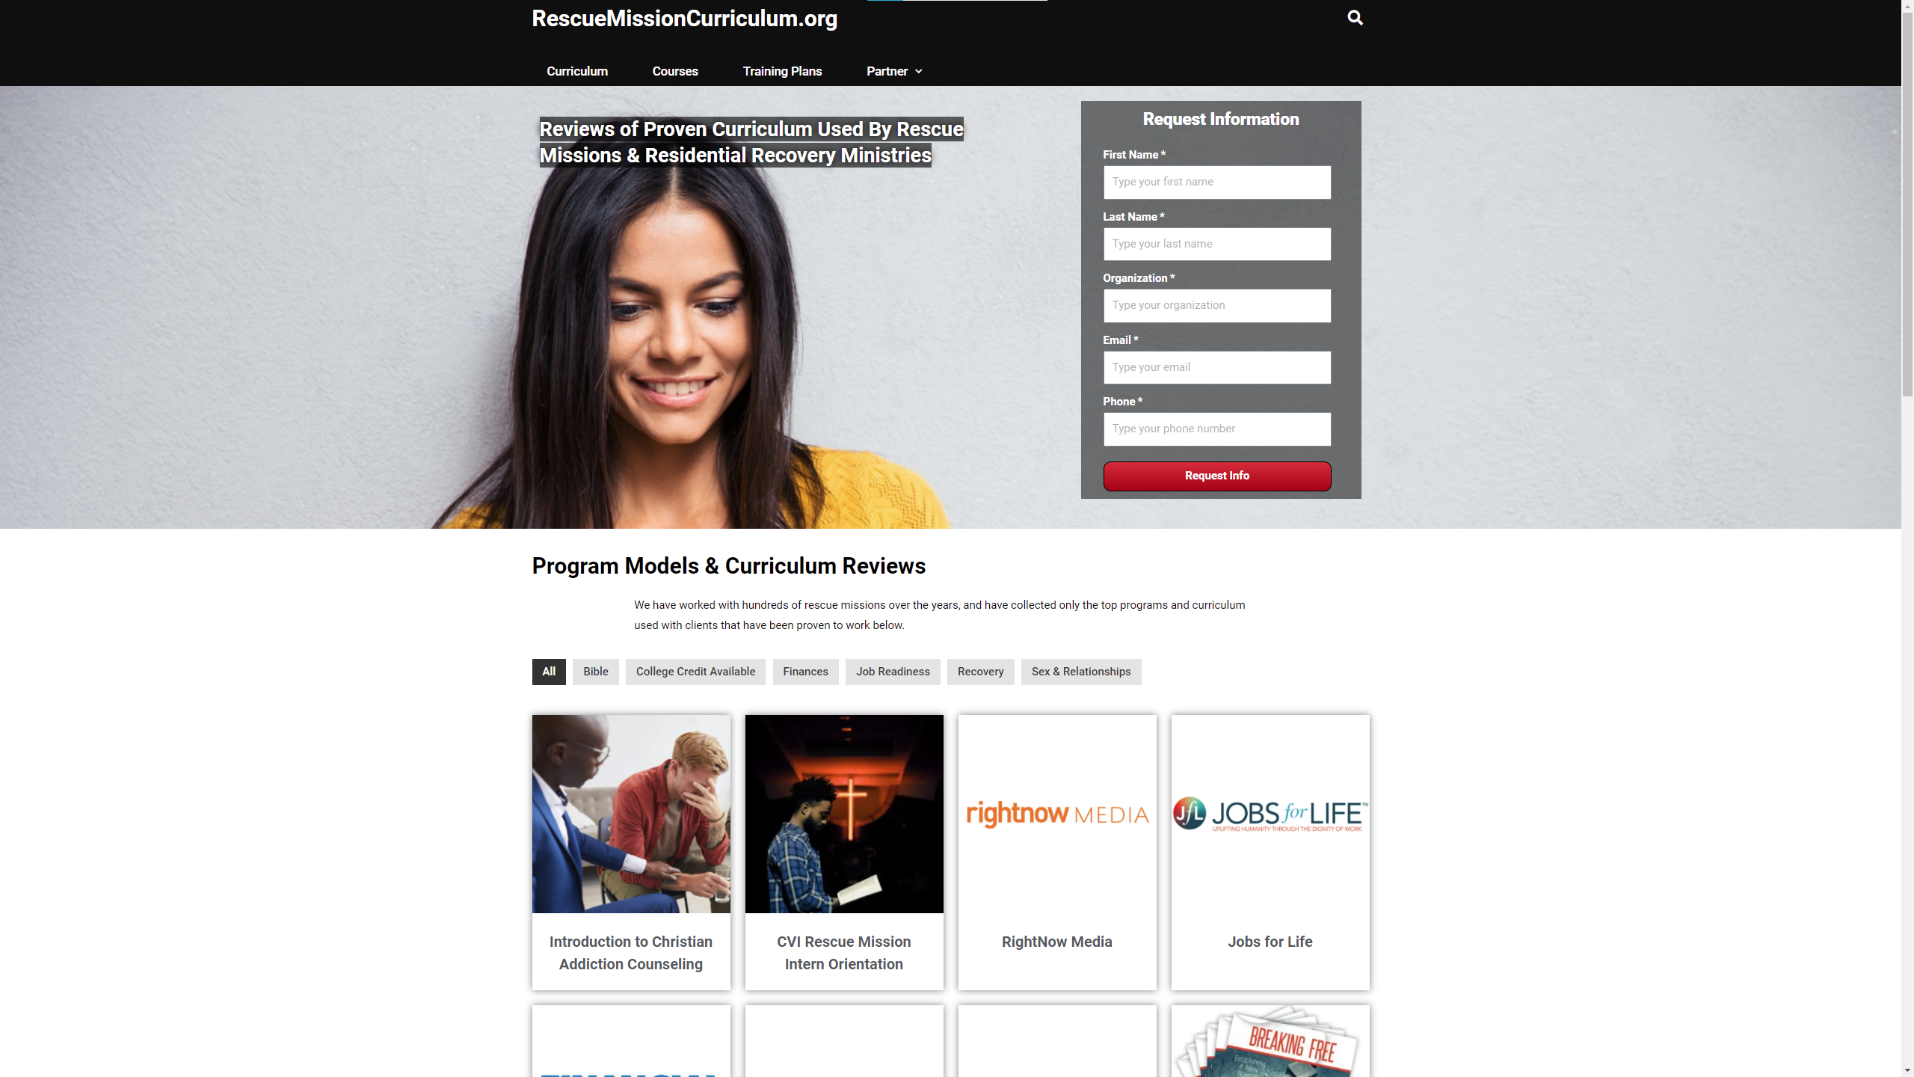

Slide 15
Tools
Tool 5: Monitor and Evaluate
Is our scratch relieving their itch?
Best Practice Data Sources: Exit interviews, Focus Groups, Surveys
Best Practice Metrics: Stakeholder-driven, selectivity, regularity
Tool 6: Communicate
Do I have a way to tell others about my scratching method and process? Do I have a way to tell them about its effectiveness?
Best Practice: Stakeholder-driven and qualified periodicity, format for channel (e.g., email, webpage, paper, etc.)

Slide 16
Tools
Tool 7: Adapt
Are there way(s) in which I need to change my scratch to be more effective in relieving the itch?
Best Practice: Program review at set internals versus ad-hoc, or “as needed” written process for incorporating lessons learned

Slide 17
Layers

Slide 18
Program Designs and Exemplars
Theory of Change
Establishes the high-level rationale that supports the program and its design
Answers the “Why?”
Exemplar: Center for Theory of Change
Logic Model
Illustrates the theory of change in a high-level graphic form
Answers the “What?”
Exemplars: W.K. Kellogg Foundation, Center for Disease Control

Slide 19
Study from Large Residential Recovery Ministry
Theory of Change
Goal: recovery program graduates will remain sober one year after graduation
Success rate = 80% if the following three things are in place:
Job
Housing
Supportive church community
Success rate without these supports = 10%
Logic Model
Inputs = $150 million program (staff, facilities, etc.)
Outputs: 7,500 participants in 6-month residential work-therapy ministry
Short-Term Outcome: 2,500 graduate the program
Long-Term Outcome: Success = remain sober for 12 months after graduation

Slide 20
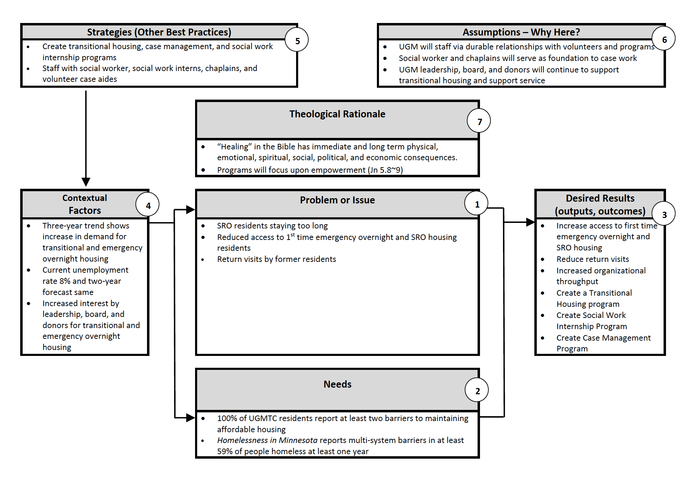
Theory of Change

Slide 21
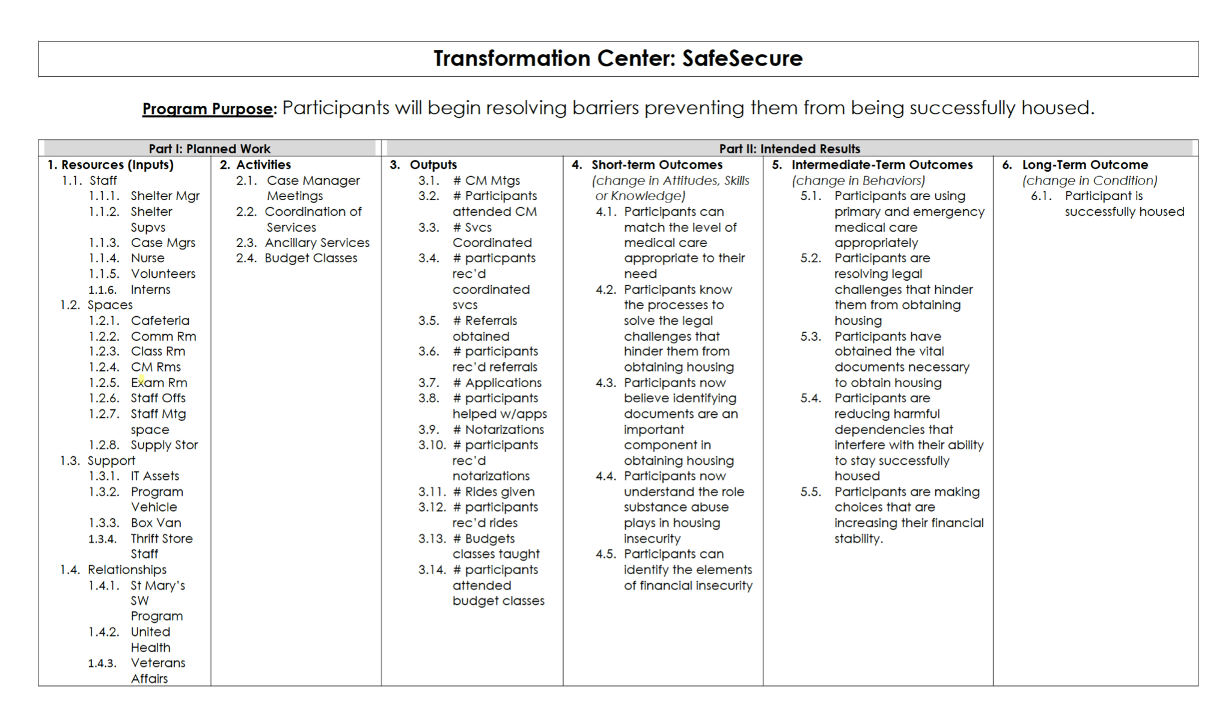
Logic Model

Slide 22
Logic Model

Slide 23
Monitoring and Evaluation

Slide 24
Measure What Matters!
Outcomes
The hoped-for short-, intermediate-, and long-term changes that occurs as a result of an activity
Indicators
Evidence the outcome has occurred and/or, by how much
Outputs
Evidence your services were delivered

Slide 25
Measurements are Power!
Participants achieve short-, intermediate-, and long-term outcomes
Participants’ outcomes achievements are evidence of the organization’s commitment to its mission and vision
Stakeholders see connection between participants’ outcome achievement and the organization’s commitment
= more participants
= more committed and confident staff
= more volunteers and donors

