Slide 1
Organizational Culture and the Next Generations of Leaders
Andrew Sears
President
City Vision University
Notes:
I want to share a little of my story of how I first got involved in urban ministry because I think shows of some of the generational transition issues that you all are facing.
In 1992, when I was 19, I joined the summer staff of City Union Mission in Kansas City. I grew up in the ‘hood in Kansas City where I felt weird because I wasn’t having sex and using drugs in elementary school. In high school I worked at a Burger King that was essentially a drug house where employees were doing meth and dealing drugs. My drug of choice was workaholism.
The real reason joined summer staff at City Union Mission was I had read the Bible, and I was looking for God, but a lot of the Christians I knew growing up were abusive. I figured if anyone was really doing what was in the Bible, it was those at the Rescue Mission. The first time in my life, I met loving Christians that were actually following what was in the Bible, and it changed my life.
I went on to grad school at MIT and co-founded a research group with one of the father’s of the Internet. I had a dot-com startup. Became a consultant. Had a life burnout, and realized my heart was for the poor. So I started a national ministry called TechMission where we provided free training resources to those serving the poor and addicted.
By 2008, we had grown fairly quickly. That was also the year that John Ashmen became President of AGRM, and he decided to transfer AGRM’s Rescue College to TechMission. Rescue College was started in 1998 as a one-year program to train rescue mission workers. It was accredited in 2005, but wasn’t really sustainable within AGRM because it only had about 30 students. We have grown it to 250 students and have added many more programs.
We started as a university founded by rescue missions for rescue mission, but we have grown to largely serve Christian organizations that serve the poor and addicted.

Slide 2
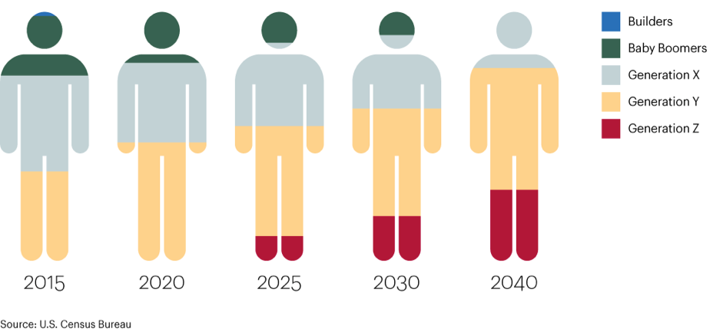
Changing Generational Composition of the Workforce
Societal Changes Across Generations
1925-1945
1946-1964
1965-1980
1980-1994
1996-2015
Primary
Focus
Image Source: https://tpsconsultingltd.com/2018/06/04/our-future-of-work-leading-our-next-generation/
Notes:
You can see the birth years that comprise the different generations. Gen Y is also called millennials
Our students are mostly Gen X & Millennials: Boomer 13%, Gen X 41%, Millennials 46%
Most of our students are in organizations that are transitioning leadership from boomers to younger generations
I want to focus this talk, not just on what’s different about the younger generations, but what’s changed in society that the younger generations will face.

Slide 3
Framing the Rescue Mission Movement in History
Agricultural
Age
Industrial Age
Rescue Mission Movement 1.0
Information Age
Mass Addiction
God’s Movements 2.0
Alcoholism
Breakdown of family
Urbanization
Notes:
I’m a big picture person, so I’m going to start with the big picture context
Information Age
Alvin Toffler one of the most popular futurists said that in this transition many of our social institutions will break down, and it will be the job of future generations to address this.
To put it in Biblical terms from Mathew 24: “All these are the beginning of birth pains” of what God’s plans are.
I believe that God speaks to each generation the words he spoke to Esther: “You were made For such a time as this.”
What is the unique role each generation will play?

Slide 4
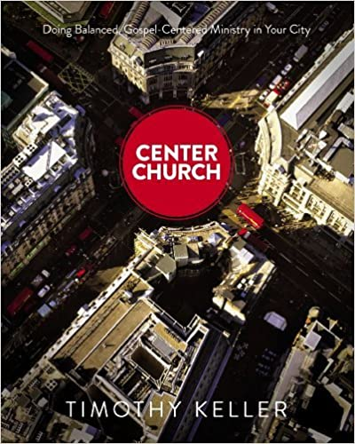
What Changes and Remains the Same Across Generations for Ministry?
What to Believe
How to See
What to Do
Doctrinal Foundation
Theological Vision
Ministry Expression
Timeless truths from the Bible
about God, our relationship to Him,
and His purposes in the world
Theological tradition
Organizational statement of faith
Systematic & biblical theology
A faithful restatement of the gospel with rich
implications for life, ministry, and mission
in a particular culture at a moment in history
Vision and values
Ministry “DNA”
Philosophy of ministry
Emphases & stances
How the gospel is expressed
in a particular ministry in one
community at a point in time
Local cultural adaptation
Programs & processes
Organizational structure
Adapted from Tim Keller’s Center Church
Notes:
I like to think that part of our role as a university that grew out of the rescue mission movement is as an innovation hub similar to the relationship with Stanford and Silicon valley.
The problem is that as soon as you use the word innovation in ministry people get worried that you might change things that shouldn’t change.
So what can change and what remains the same across generations for ministry?
The best book I’ve read it Tim Keller’s Center Church

Slide 5

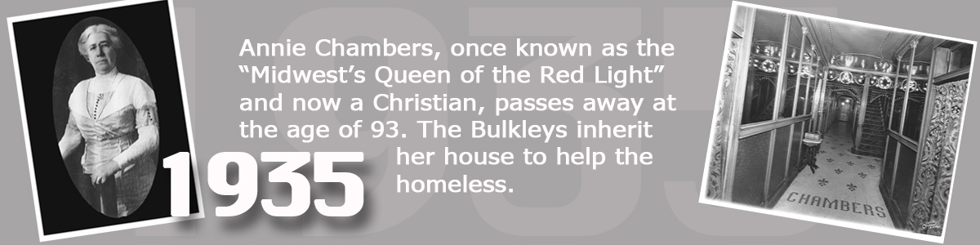
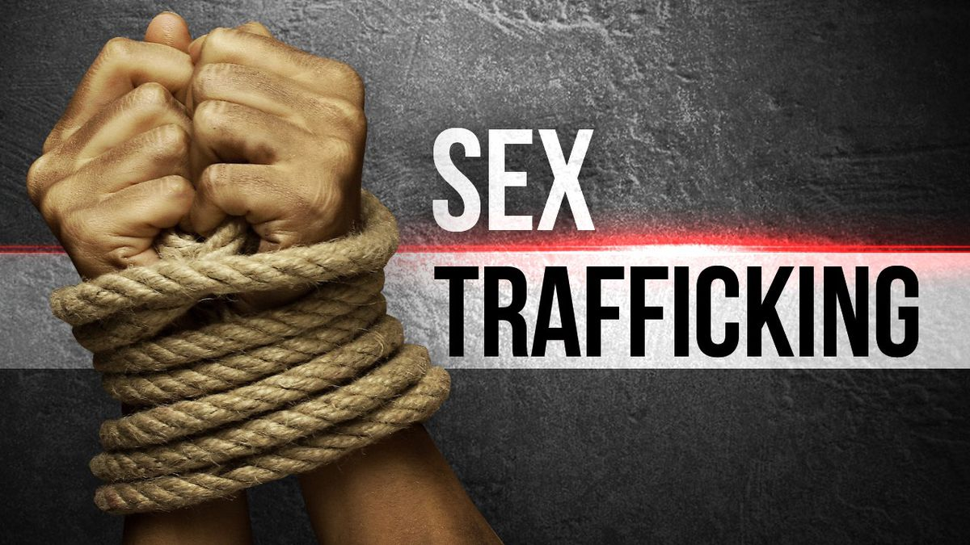
Example of Generational Reframing of What We Do
Ministry to
Prostitutes
Sex Trafficking Ministry
Image Sources: https://sciencenordic.com/anthropology-children-and-adolescents-denmark/myths-about-the-prostitute-lifestyle/1372810
https://www.13abc.com/content/news/UT-study-links-social-media-and-sex-trafficking-496046031.html
Notes:
Madam Annie Chambers gave her brothel to City Union Mission in Kansas City
Possible the social issue that younger generation Christians are the most passionate about is sex trafficking.
It is an example of starting with different emphasis and priorities based on a new context, how you could recast a similar ministry to a new generation.
I met some of the top ministry leaders in sex trafficking ministries, the challenge is they are often under-resourced
Many thought they had to do it on their own rather than working with a rescue mission.
Part of what I want to answer in this talk is why that might be.

Slide 6
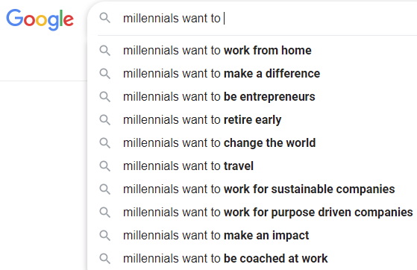
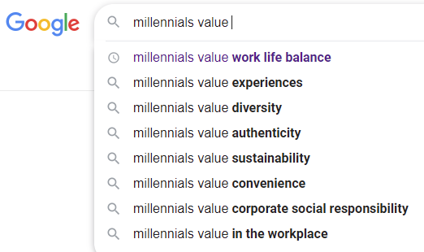
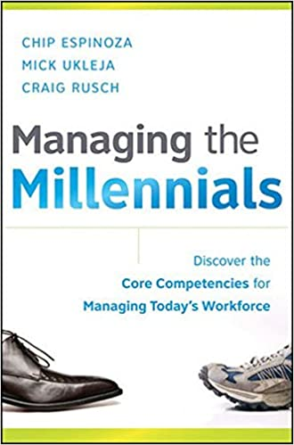
Outline: Key Generational Cultural Value Differences
Value technology, innovation and entrepreneurship
Value changing the world while balancing relational & business values
Value diversity
Notes:
Worked with hundreds of students and hundreds of organizations. These are the three most significant cultural value differences between generations based on our experience.
Will focus primarily on Gen X and Millennials.
Many of these trends are similar between generations, but in many ways amplified.

Slide 7
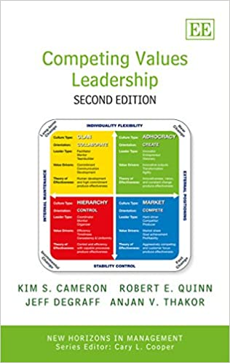
Assessing Organizational Culture in Christian Organizations using OCAI
Cultural Relevance
Flexible
Ministry Mindset
(Clan)
Entrepreneurial Mindset
(Adhocracy)
Church
Gathered
(not of the world)
External
Church
Scattered
(in the world)
Internal
Control
Mindset
(Hierarchy)
Business Mindset
(Market)
Stable
Doctrinal Purity
Notes:
We have worked with students in hundreds of organizations, and in at least one of their classes, nearly all of our students use a tool to assess organizational culture called the Organizational Culture Assessment Instrument (OCAI).
Think of it like a Myers-Briggs personality test but for an organization’s culture.
This is the most widely used tool in the world to assess organizational culture
As a university president focused on ministries serving the poor and addicted, this is the most helpful tool I’ve found in the past decade.
It can be useful for many things: one is to assess cultural differences between generations

Slide 8
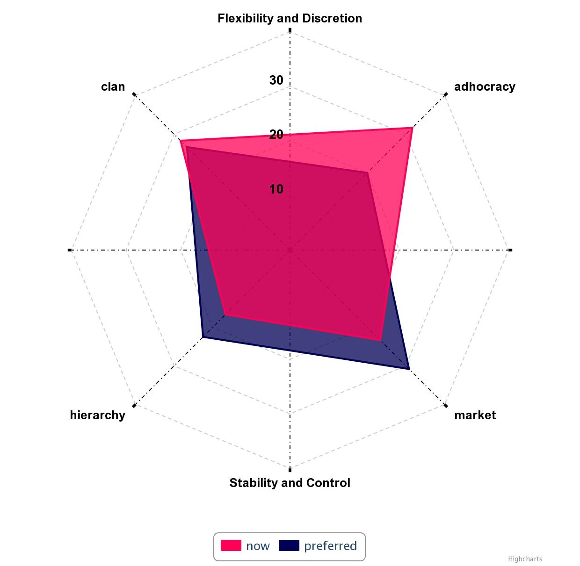
Using OCAI as a Strategy Planning Roadmap
Relational Goals (20%)
Goal 3: Faculty & Staff Capacity
Entrepreneurial/Disruptive Goals (20%)
Goal 2: Radically Affordable Education
Operations & Governance Goals (30%)
Goal 1: Educational Program Quality
Goal 4: Support Systems
Business & Funding Goals (40%)
Goal 5: Financial Growth
Notes:
The OCAI can also be used as a strategic planning and change management process roadmap.

Slide 9
Part 1: Innovation & Entrepreneurship
Value technology, innovation and entrepreneurship
Value changing the world while balancing relational & business values
Value diversity
1. Entrepreneurship
Notes:
Probably the most common challenge I’ve seen with younger generations and the culture of rescue missions and similar ministries is that the younger generations have a stronger value on technology, innovation and entrepreneurship
I think this is one of the key value difference between many of the leaders I’ve met with a passion for addressing sex trafficking. They just take an incredibly entrepreneurial approach.
The challenge is that they often need many of the strengths that rescue missions have.
I’ve found that true for myself. When I was on summer staff at City Union Mission there were a lot of people there that didn’t know what to do with an engineering student who kept working at rescue missions.
I just didn’t see a place for myself in rescue missions 20 years ago, but people in the movement did reach out to me to partner, which ultimately lead to me becoming head of City Vision

Slide 10
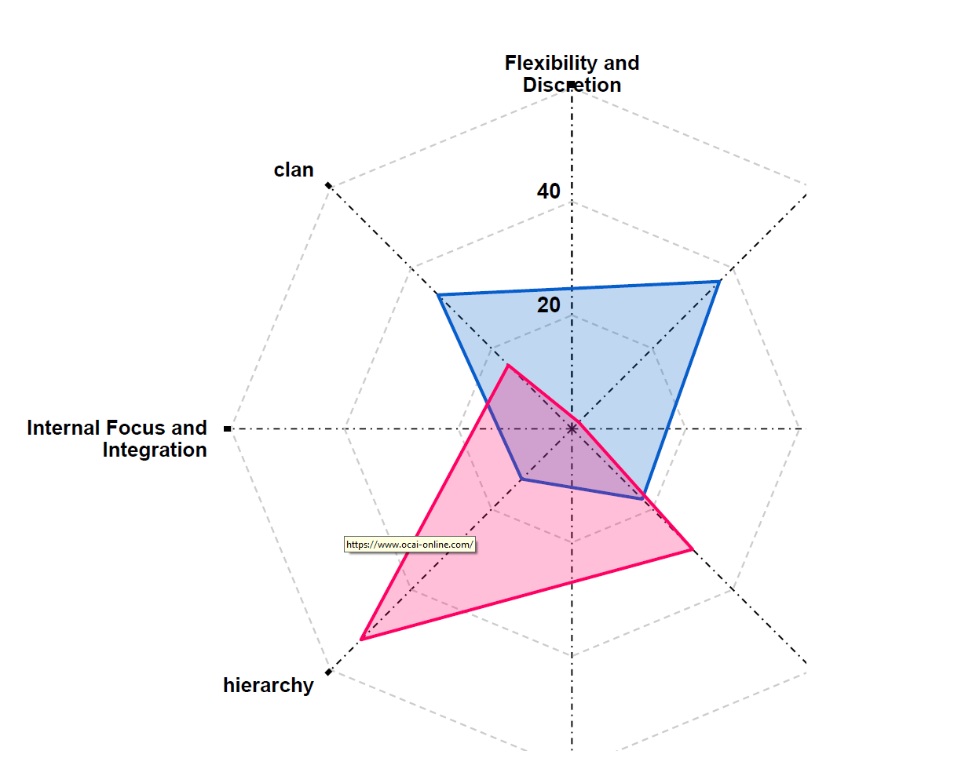
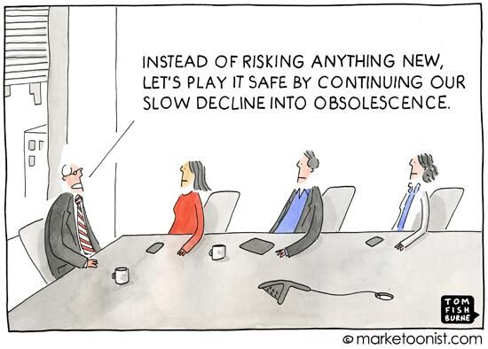
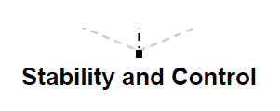

Example Gen X Profile Perception of Bureaucratic Ministry
1. Entrepreneurship
Notes:
We have our students map their current organizational culture and their preferred culture. This is one example result.
Some of the need for increased focus on innovation and entrepreneurship has to do with generational differences, but some has to do with differences in the life stage of the organization.
Over time organizations start entrepreneurial, then become clan or family, then become a bureaucracy or hierarchy

Slide 11
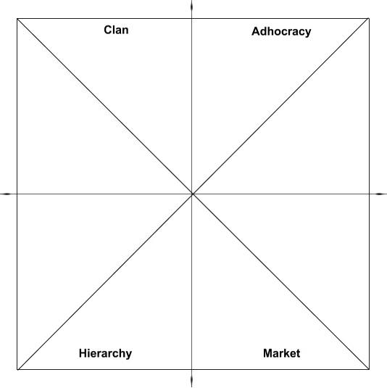
Challenge of Being Organizationally Innovative, but Biblically Conservative
Example: Too many entrepreneurs (NP)
Risks
“All ideas are good ideas”
Catastrophe from too much risk
Relativism & liberal syncretism
Entrepreneurial Mindset
Solution 1: Recruit strong Christian
entrepreneurs who value other quadrants
Solution 2: Expand social enterprise programs
Solution 3: Provide strong training in the Bible
& other quadrants
Example: Too many accountants
& lawyers (SJ)
Risks:
Stifling Bureaucracy
Decline from being too risk-averse
Legalism
Operations
Mindset
1. Entrepreneurship
Notes:
Some say to avoid risk of secularization, you should avoid all risk
There are a lot of Biblically conservative, but innovative: World Vision, Cru, Saddleback

Slide 12
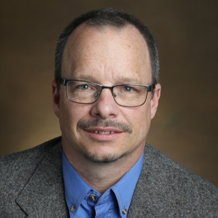


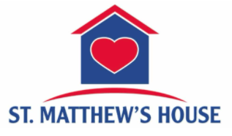
Citygate Member Organizations Excelling in Entrepreneurial Growth
Jeff Cook
VP of Programs and Operations
Vann Ellison
President and CEO
Notes:
Examples
Jeff Cook & Springs Rescue Mission. Taking cohort of leaders through leadership development process
St. Matthew’s House: over 60% of budget comes from social enterprises including half of their 240 employees

Slide 13
Part 2: Key Generational Value Differences
Value technology, innovation and entrepreneurship
Value changing the world while balancing relational & business values
Value diversity
1. Entrepreneurship
2. Balanced Social Change
Notes:
I’ve noticed a change that has happened over the last 25 years. 25 years ago, I was at MIT taking technology and business course, trying to figure out how to use them to bring social change.
Now, social entrepreneurship and corporate social responsibility, have gone more mainstream.
It’s not either business or a social cause, it’s both.

Slide 14
Culture Wars at Christian Nonprofit Organizations of Previous Generations
Vision: “Ministry as family”
Who: Ministry & Counselors (FP)
Often indigenous leaders raised within ministry
Risks
Nepotism and/or ”Holy Huddle”
Financial decline
Christian tribalism
Staff with Ministry Mindset
Solution 2: Train ministry staff in
business skills
Solution 3: Recruit bi-vocational ministers
& promote those who are “bilingual”
Solution 1: Provide cross-cultural ministry
training to staff from business background
Staff with Business Mindset
Vision: “Best practices of business world”
Who: Business Background (TJ)
Often “outside hires”
Risks
Culture of “it’s just business”
Gentrification of ministry
Dilution of culture from growth
1. Entrepreneurship
2. Balanced Social Change
Notes:
The challenge is that over the past 20 years, I’ve seen wars of organizational culture between two different mindsets
I’ve seen students from a business background judging the ministry side as “soft”
Those from the ministry side just the other side as “it’s just business”

Slide 15
Summary of Part’s 1 and 2
Staff with Ministry Mindset
Entrepreneurial Mindset
Balance
Operations
Mindset
Staff with Business Mindset
1. Entrepreneurship
2. Balanced Social Change

Slide 16
Part 3: Key Generational Cultural Value Differences
Value technology, innovation and entrepreneurship
Value changing the world while balancing relational & business values
Value diversity
3. Diversity
2. Balanced Social Change
1. Entrepreneurship

Slide 17
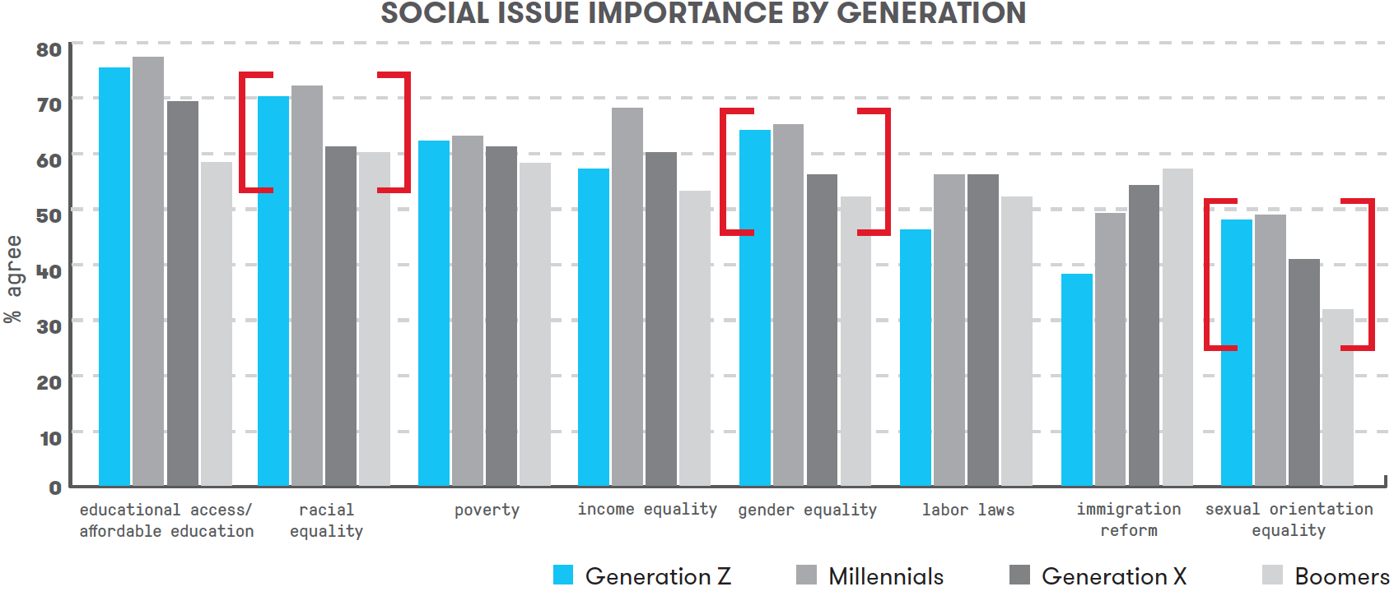
Generational Trends on Social Issues and Diversity
3. Diversity
2. Balanced Social Change
1. Entrepreneurship
Source: https://www.marketingprofs.com/charts/2018/33740/getting-to-know-gen-z-beliefs-preferences-and-behaviors
Notes:
The top three generational differences on social issues are: race, gender and sexual orientation.
Donations today are still primarily driven by Boomers, so the real pressure will happen when donations are driven by younger generations.
For organizations that uphold the traditional Biblical view on marriage and sexuality, it will be increasingly important to improve the racial and gender diversity of leadership to appeal to Gen X, Millennials & Gen Z donors.

Slide 18
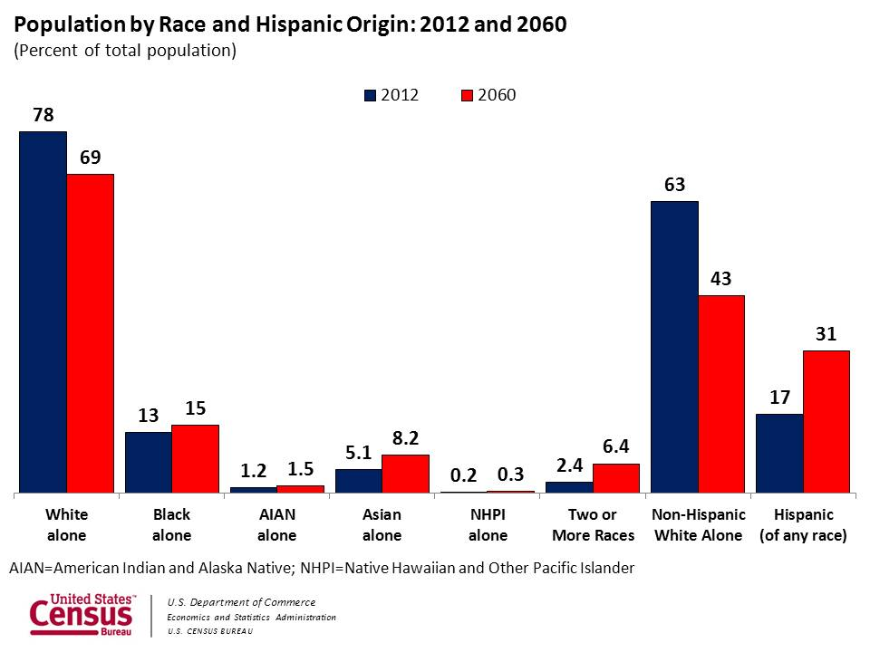
US Demographic Trends
3. Diversity
2. Balanced Social Change
1. Entrepreneurship
Notes:
What is changing generationally?

Slide 19
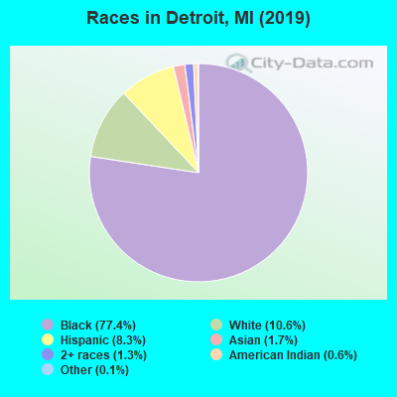
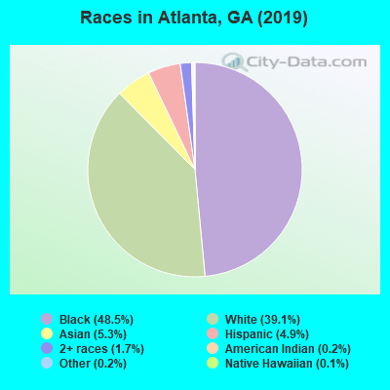
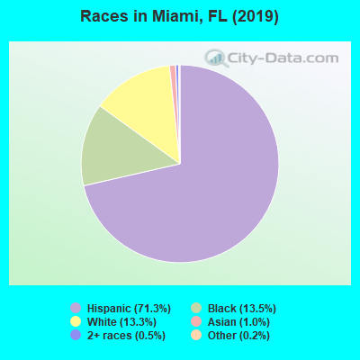
Demographics of Most Cities Are Decades Ahead of National Demographic Trends
3. Diversity
2. Balanced Social Change
1. Entrepreneurship
Notes:
What is it like growing up in a different racial context?
My story: Grew up attending white evangelical churches and schools and Black churches.
Grew up in racially mixed neighborhood
My spiritual formation in ministry came partly through mentorship of rescue missions and partly from CCDA and the black church
For most of our history about 2/3rds of our staff and board have been Black and Latino. Seasons where I was the only white person. That just felt normal to me.
The past few years, I feel like have two divorced parents that won’t talk to each other
I remember the good days when John Perkins was a keynote speaker at Promise keeper events and racial reconciliation was “cool”
Now you say the words “racial reconciliation” and far right accuses you of imposing critical race theory on them, the far left say it’s a term that’s too slanted toward white people
The reality is that many more people in younger generations are growing up in a context with more racial diversity than in previous generations.
To help address this, one of our top strengths at City Vision has been in helping others grow in their own cultural intelligence.

Slide 20
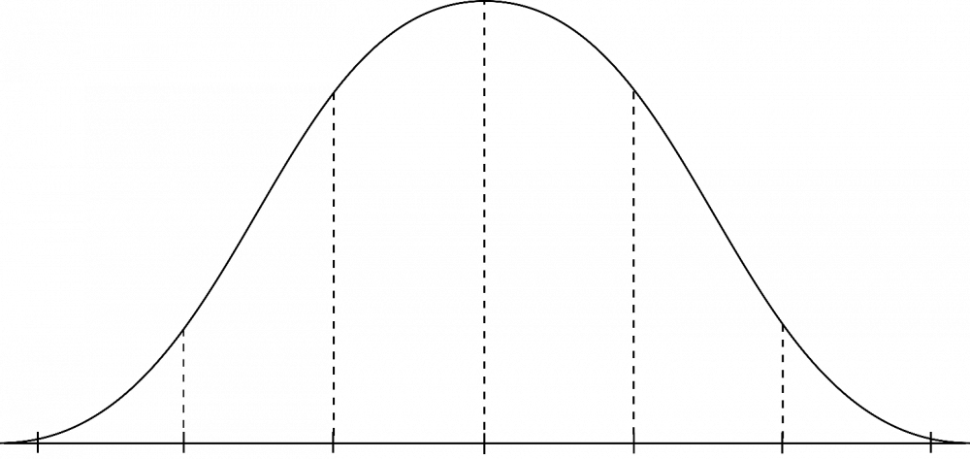
How Significant Are External Pressures for Change?
Great Need for Change
Less Immediate Need
Examples: Atlanta, Miami, Detroit, San Francisco, South Africa, etc.
Majority of clients are of different race/ethnicity of leadership
Extended community/city is different racial/ethnic group than leadership
Younger donors (including evangelicals) in your region strongly value diversity in leadership
Examples: ministries serving regions with predominantly white poverty (Montana, Omaha, etc.)
Limited differences in leadership and clients
Extended community/city is White and conservative
Donors in your region do not place significant value on diversity
Organization should make changes according to
its core values regardless of external pressures
3. Diversity
2. Balanced Social Change
1. Entrepreneurship
Notes:
Part of what makes talking to a group like this difficult is the wide range of organizations and contexts you serve in.
Phrase “The future is already here, it’s just not evenly distributed.” not only applies to technology, but it also applies to demographic changes.

Slide 21
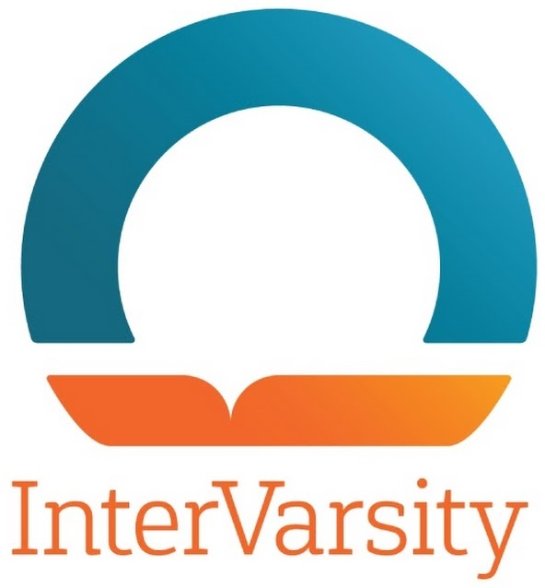
Case Study: InterVarsity
Context
  Serves largely on secular college campuses that are racially diverse
  and are more left-leaning
Strategic choices
  Strongly promote gender equality and racial equality
  Developed policies to clearly affirm traditional view on marriage and sexuality
Implications
  InterVarsity Press became global leader on evangelical racial dialog
  Was banned from meeting on several leftist campuses creating social stigma and limited recruitment
  Some InterVarsity chapters at leftist campuses left InterVarsity
3. Diversity
2. Balanced Social Change
1. Entrepreneurship
Notes:
So how to address these changes? InterVarsity serves as a good case study

Slide 22

Case Study: Cape Town City Mission
Context
  Leadership was disproportionately White as apartheid was ending
  Radical change of cultural norms in post-apartheid South Africa
  Dominant culture viewed white-led missions as a colonial mentality and decided to stop supporting organizations that were disproportionately white in their leadership
Strategic Choices
  Many programs either were ended or became independent
  Dramatically increased focus on systemic change
  Transitioned from white leadership
Charity Focus vs. Systemic Focus
  10,000 street children in Cape Town with beds for 50
  Systemically-focused partnership with city that reduced number of street children to only 800 children on the street
3. Diversity
2. Balanced Social Change
1. Entrepreneurship
Notes:
I spent a summer in 1993 at Cape Town City Mission while apartheid was being dismantled. Visited them about 15 years later

Slide 23

Case Study TechMission (parent of City Vision University)
Context
  AmeriCorps National Grantee until 2013
  National leader in racial diversity in entire AmeriCorps program
  Targeted by Obama administration for defending religious hiring rights of evangelical AmeriCorps sites
Strategic Choices
  Walked away from 75% of funding rather than compromise religious hiring rights
  Stopped taking direct government grants
  Pivoted funding model from 75% donor income to 75% earned income
3. Diversity
2. Balanced Social Change
1. Entrepreneurship
Notes:
Lessons
Should not have ignored cautions about taking government funds
Had season where we overprioritized diversity and I tried to lead beyond our cross-cultural sphere of influence
I’m a better entrepreneur than I am at navigating bureaucratic red tape

Slide 24
Summary: Three Increased Emphases Affecting Organizational Culture Across Generations
What to Believe
How to See
What to Do
Doctrinal Foundation
Theological Vision
Ministry Expression
Timeless truths from the Bible
about God, our relationship to Him,
and His purposes in the world
Theological tradition
Organizational statement of faith
Systematic & biblical theology
A faithful restatement of the gospel with rich
implications for life, ministry, and mission
in a particular culture at a moment in history
Vision and values
Ministry “DNA”
Philosophy of ministry
Emphases & stances
  Entrepreneurship
  Balanced relational & business values
  Diversity
How the gospel is expressed
in a particular ministry in one
community at a point in time
Local cultural adaptation
Programs & processes
Organizational structure
Adapted from Tim Keller’s Center Church
Notes:
In summary, I think there are three key values that need more emphasis in our organizational cultures across generations…

Slide 25
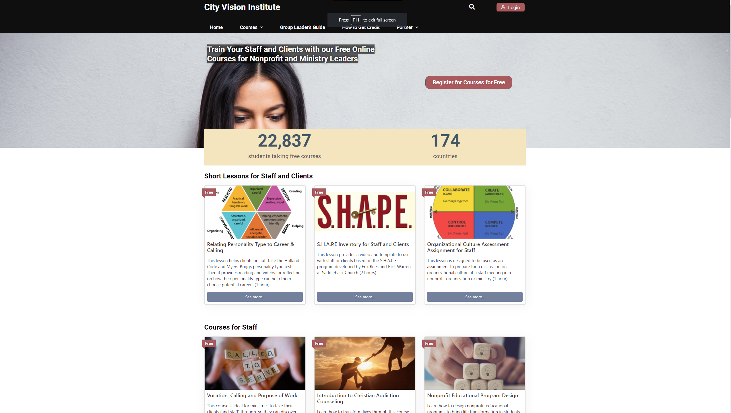
Potential Next Step
Conduct a free Cultural
Assessment with Staff at
www.cityvisioninstitute.org

Slide 26
Discussion

Slide 27
Four Lessons on Organizational Diversity

Slide 28
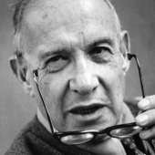
Lesson 1. Measure Cross-Cultural Effectiveness
“What you don’t measure, you can’t improve.”
- Peter Drucker
3. Diversity
2. Balanced Social Change
1. Entrepreneurship

Slide 29
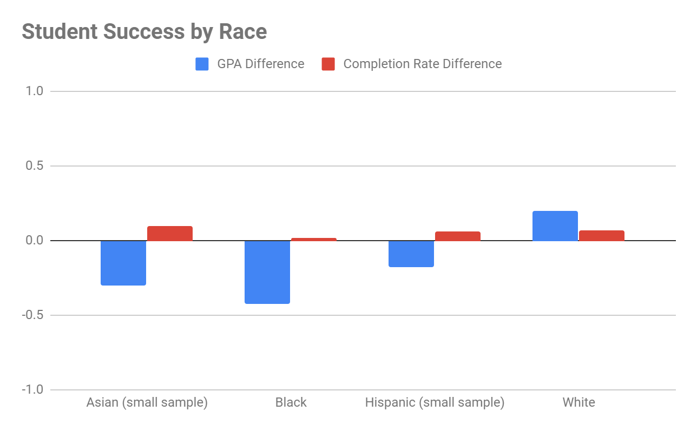
Lesson 1. Example of Measuring Cross-Cultural Effectiveness (City Vision example)
3. Diversity
2. Balanced Social Change
1. Entrepreneurship

Slide 30
Lesson 2. Understand and Expand Your Organization’s Cross-Cultural Sphere of Influence
Tier 3
International Middle Class
(other language)
Everyone Else
Tier 2
Tier 1
White
Upper
Middle
Class
Women
Black
Poor or
Middle
Class
White & Black
Working Class
White
Middle
Class
Poor
White
2+ Gen Latino/a &
Asian Working Class
First Generation, Poor or Middle
Class Latino/a or Asian
3. Diversity
2. Balanced Social Change
1. Entrepreneurship
Notes:
My example of mutiny

Slide 31

Lesson 3. Your Sphere of Influence is Determined by Cross-Cultural Law of the Lid
In Cross Cultural Contexts: Your leadership ability will vary across different cross-cultural groups
3. Diversity
2. Balanced Social Change
1. Entrepreneurship
Image Source: https://sajigroup.com/the-21-irrefutable-laws-of-leadership-the-law-of-the-lid/
Notes:
John Maxwell’s Law of the Lid: “If your leadership rates an 8, then your effectiveness can never be greater than a 7.” This is because you can only effectively lead those at a 7 or below.
i.e. someone who is a level 8 leader with White middle-class men, might be a 5 with Black upper-middle-class womenEach person will have a different cross-cultural sphere of influence (or leadership levels) across various groups given their cultural background, identity and personality

Slide 32
Lesson 3. How Cross-Cultural Law of the Lid Plays Out Organizationally
White Male, Middle Class Leader
(Levels: White 8, Asian 7, Black 6, Latino/a 6,
Female or Class Reduce 1)
White Male
Middle Class
Level 7 Leader
White Female Working Class Level 5 Leader
Black Male Middle Class
Level 5 Leader
Latina
Level 4 Leader
15 largely white staff
Black Male Working Class Level 3 Leader
Black Male Working Class
Level 3 Leader
3. Diversity
2. Balanced Social Change
1. Entrepreneurship
Notes:
Conflict.

Slide 33
Lesson 4. Develop a Leadership Pipeline Strategy to Increase Diversity
1. Diversity Measurements
& Intentionality
At Every Level
Board
Senior Management
Middle Management
Hiring & Entry Level Positions
2. Diversity At Every
Level Needed for
Leadership Pipeline
3. Recognize That Values & Culture Will Be Set
By Those With Power In The Organization
4. Recognize that leadership diversity priorities will be in tension with
other priorities. Focus on maximizing mission in the long-term.
3. Diversity
2. Balanced Social Change
1. Entrepreneurship
Notes:
Military as a good example
Peter Drucker: If you don’t measure it, you can’t manage it.
World Vision

Slide 34
Backup Slides

Slide 35
Creating Organizational Balance to Maximize Mission Impact & Avoid Risk
Cultural Relevance
Example: All pastors or counselors
Risks
Insular ministry, nepotism & “holy huddle”
Financial decline
Cultural captivity of Christian tribalism
Example: All entrepreneurs
Risks
Relativism
Catastrophe from too much risk
Liberal syncretism
Flexible
Ministry Mindset
(Clan)
Entrepreneurial Mindset
(Adhocracy)
Church
Gathered
(not of the world)
External
Church
Scattered
(in the world)
Internal
Control
Mindset
(Hierarchy)
Business Mindset
(Market)
Example: All accountants
Risks:
Legalism
Decline from being too risk-averse
Example: All businesspeople
Risks
Lose ministry heart: Culture of “it’s just business”
Gentrification of ministry
Stable
Faithful to Scripture
1. Entrepreneurship
2. Balanced Social Change
Notes:
This slide is a summary of part 1 Entrepreneurship value and part 2 balance of my presentation

Slide 36
Using OCAI to Direct Staff Training & Organizational Change
Promote Staff Training in Direction You Want the Organization to Move Toward
Cross-cultural
Competencies
Ministry & Relational Competencies
• Cross-Cultural Management & Ministry
• Christian Community Development
• Urban Youth Ministry
• Organizational Behavior
• Vocation, Calling & Purpose of Work
• Technology, Life Balance & Addiction
• Bible & Theology Courses
• Counseling Courses
Innovation Competencies
Social Entrepreneurship
Entrepreneurship
Leadership in Under-Resourced
Communities
Educational Program Development
Transformational Change Leadership
Ministry Mindset
Entrepreneurial Mindset
Spiritual
Formation
Balanced
Christian
Programs
Operations
Mindset
Business Mindset
Operations & Governance Competencies
Nonprofit Human Resources
Executive Leadership & Board Development
Nonprofit Financial Accounting
Project Management
Business & Funding Competencies
Marketing
Grant Writing
Nonprofit Fundraising
Nonprofit Managerial Accounting
Introduction to Business
1. Entrepreneurship
2. Balanced Social Change
Notes:
St. Matthew’s House

Slide 37
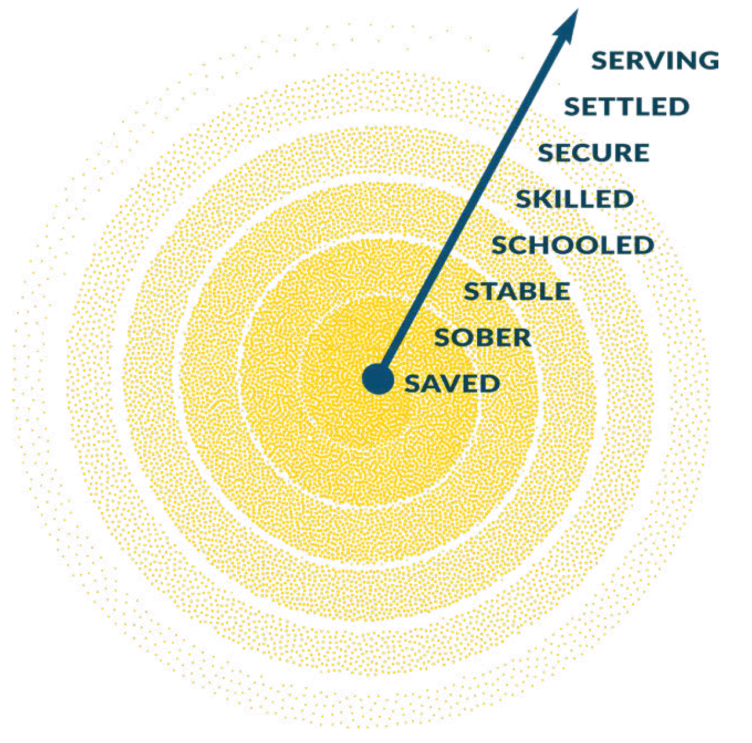
Citygate Network Life-Transformation Program Theory of Change
Serving: giving back to the community through missional living.
Settled: benefitting from having the same safe place of their own to stay every night;
Secure: able to provide financially for themselves and their loved ones;
Skilled: being academically credentialed and set on a career path;
Schooled: enriched with the fundamental knowledge to be competent and competitive;
Stable: mentally and emotionally balanced and enjoying good health;
Sober: no longer controlled by stimulants or depressants;
Saved: making choices that will keep them from chronic illness and physical death;
After-care/
Transition
Program
(individual development)
Residential
Recovery
Program
(rehabilitation)
Shelter & Food
Programs
(relief)
Notes:
Saved: making choices that will keep them from chronic illness and physical death;
Sober: no longer controlled by stimulants or depressants;
Stable: mentally and emotionally balanced and enjoying good health;
Schooled: enriched with the fundamental knowledge to be competent and competitive;
Skilled: being academically credentialed and set on a career path;
Secure: able to provide financially for themselves and their loved ones;
Settled: benefitting from having the same safe place of their own to stay every night;
Serving: giving back to the community through missional living.

Slide 38
Individual Development, Community Development & Reform
Relief/Charity give a man a fish
Individual Development teach a man to fish
Community Development microloan program for fishing equipment
loan to buy a lake
raise up indigenous leaders to train others
Advocacy/Reform teach on global structures of fishing industry
just laws to provide fair access to fishing
just macroeconomic policies to maximize
national revenue of fishing industry

Slide 39
Five Approaches to Counseling & Christianity
Biblical Counseling
Transformational
Counseling
Christian
Psychology
Christian Integration
(light)
Levels of Explanation
(secular)
Church
Scattered
(sent into
the world)
Church
Gathered
(not of
the world)
Primarily Christian
Counselors
in Churches
Primarily Christian
Counselors in
Christian organizations
that take Insurance
Primary Christian
Counselors in
Secular Organizations

Slide 40
Translating Social Sciences Through an Evangelical Lens
New Cross-Cultural Competencies Needed
to Manage Demographic Transition in Society
Evangelical
Translation of Social Sciences
Secular Social Sciences
Church
Scattered
(sent into
the world)
Church
Gathered
(not of
the world)
City Vision Courses
Christian Community Dev’t
Cross-Cultural Ministry
Leadership in Under
Resourced Environments
Inadequate Translations
Levels of Explanation in Counseling
Weak Integration Christian Counseling
Social Gospel
Christians with Secular Worldview in their field
Political Science
History
Economics
Sociology
Critical Race Theory
Anthropology
Cultural Studies
Gender Studies
Social Identity Development
Notes:
Should we have Christians in Hollywood? In academia?

Slide 41
Spectrum of Evangelical Understanding of Race
Priority 2: As a Generational Transition, Many Evangelical
Ministries Serving the Poor Will Need to Make this Transition
Priority 1: Resist Assimilative force of
non-Biblical secular worldviews on race
Separatist
White Fundamentalist Churches
White Evangelical Churches & Ministries
Highly Multiethnic
Evangelical Churches & Ministries
Working Class Black, first generation Hispanic & Asian American
Evangelical
Churches
Upper Middle Class
Black, 2nd+ gen Latinx, Asian American Evangelical Churches
Radical or Secular
Identity
Political
Movements
Nearly all-White
Nearly all non-White
Christian Community Dev’t
Intervarsity
Lausanne Statement on Holistic Mission of the Church (Billy Graham, 95% of evangelicals globally): Evangelism, relief, development and advocacy are all important with emphasis on evangelism
Notes:
Bob Jones Network
Dallas Statement on Social Justice
Renegade fear-mongers on social media
https://www.openbible.info/topics/fear_mongers
Overton_window

Slide 42
Center Church Balance Vision
Source: Center Church, Tim Keller

Slide 43
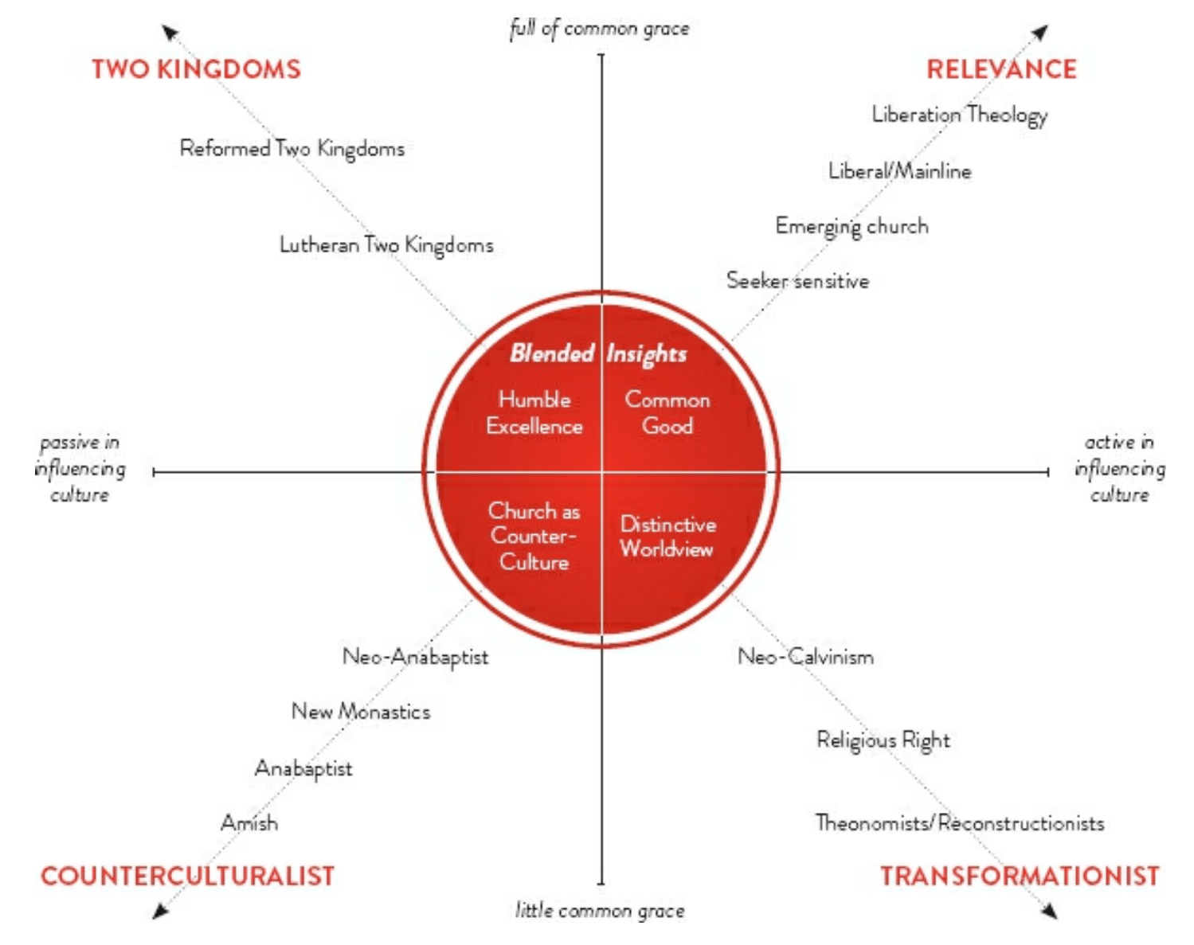
Competing Responses of the Church to Cultural Change
Source: Center Church, Tim Keller

Slide 44
Modified Questions from Center Church
What is the gospel, and how do we bring it to bear on the hearts of people today?
How does where we serve and who we serve affect our ministry?
What is their culture like, and how can we both connect to it and challenge it?
Who we are?
How innovative will our ministry be and how traditional ?
How will our church relate to other churches in our city and region?
How will we make our case to the culture about the truth of Christianity?

Slide 45
4D Gospel: Charity, Development and Structural Change: Give a Man a Fish
Q1 Personal: Nurture (Humanities)
(Relational)
Q2: Physical: Nature
(physical needs)
Character for world-class fishing and
a fulfilling life
Charity: give a man a fish
Individual development: Teach a man to fish
Individual
Q3: Cultural
(cultural transformation)
Q4: Societal (Social Sciences)
(Systems)
Culture of world-class fishing and
relational & community health
Raise up indigenous leaders to train
indigenous leaders in fishing
Community Development
Provide microloan for fishing equipment
Loan to buy lake
Macro (advocacy & structural change)
Teaching about global structures of fishing industry
Just laws to provide fair access to fishing
Just macroeconomic policies to maximize national revenue of fishing industry
Collective
Internal (subjective)
External (objective)

Slide 46
Nonprofit Leadership Does Not Reflect Racial Community It Serves
Source: http://www.aecf.org/upload/publicationfiles/executive_transition_survey_report2004.pdf
Notes:
1.4 million registered nonprofits in USA
1,169,000 White-led nonprofits
138,600 Black-led nonprofits
50,400 Latino-led nonprofits
12,600 nonprofits led by other races
Source: Number of nonprofits from Independent Sector; racial breakdown extrapolated based on survey results at:
http://www.aecf.org/upload/publicationfiles/executive_transition_survey_report2004.pdf

Slide 47
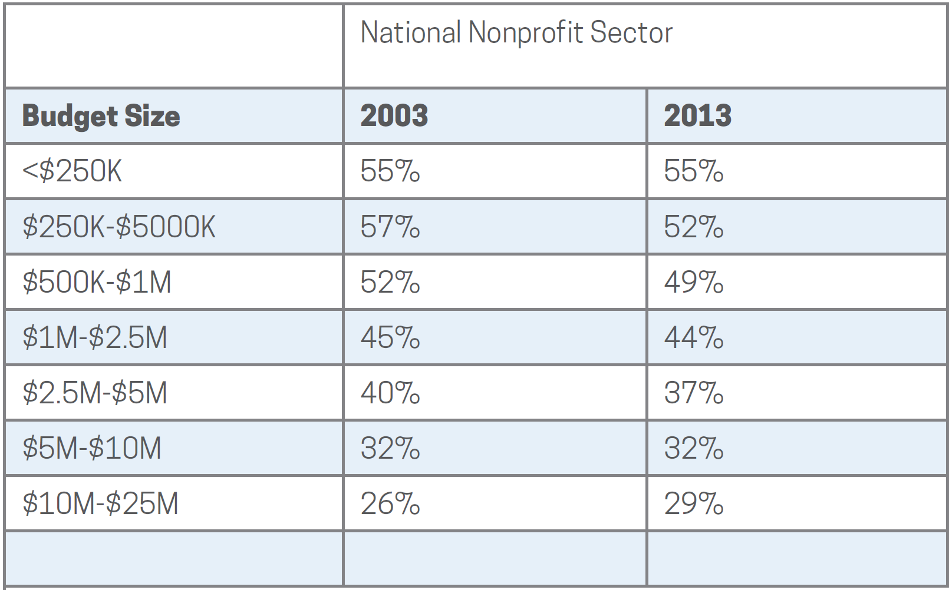
Percentage of Nonprofit Female CEOs
Source: Guidestar Compensation Survey 2015

Slide 48
Assess Organizational Demographics with a Diversity Data Form

Slide 49
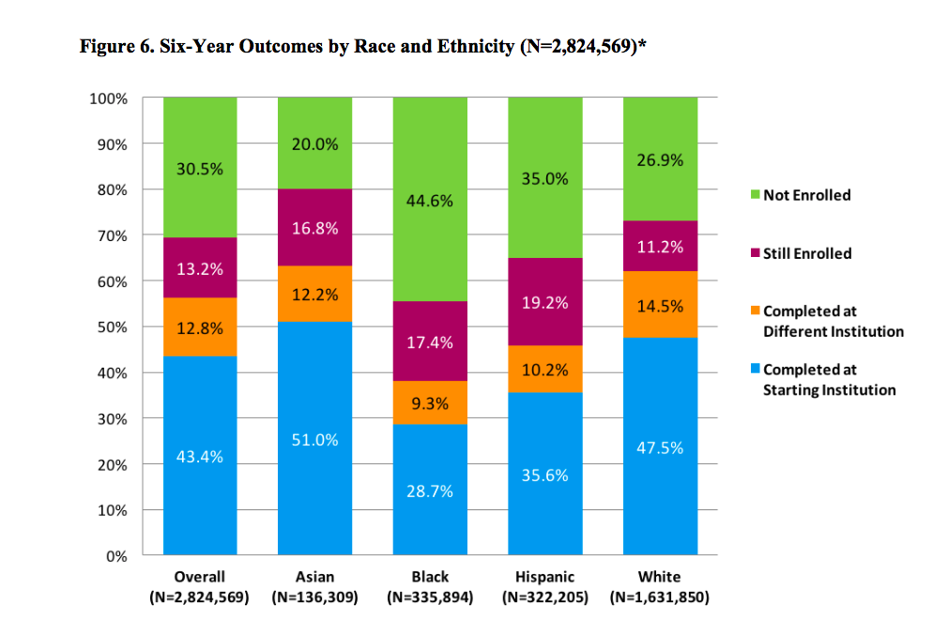
Lesson 1. Benchmarking Success Rates across Demographics to Industry
3. Diversity
2. Balanced Social Change
1. Entrepreneurship
Source: https://www.insidehighered.com/news/2017/04/26/college-completion-rates-vary-race-and-ethnicity-report-finds

Slide 50
Women in Leadership Evangelical Organizations vs. All Nonprofits
In Evangelical Organizations Women hold:
21% of board position
16% of CEOs
19% of top-paid leadership positions
Across All Nonprofits Women
hold:
43% of board position
40% of CEOs
Source: Women in Leadership National Study, Amy Reynolds, Wheaton College

Slide 51
Types of Educational Employee Benefits
Provide some type of educational benefit (92%)
Tuition assistance/reimbursement (63%)
In-house training seminars (61%)
Attendance at educational conferences (51%)
Continuing education courses (50%)
Coverage for licensing courses and exams (44%)
Personal development courses (35%)
529 college savings plans (10%)
Student loan repayment assistance (4%)
Source: https://blog.ifebp.org/index.php/education-benefits-student-loan-repayment
Notes:
loan repayment assistance benefit. Two percent are in the process of implementing a program and almost one quarter (23 percent) are considering implementing a program in the future—evidence that this is a growing benefit on the radar for many organizations.

Slide 52
Tuition Reimbursement Programs
How long has tuition reimbursement program existed
  57 percent of organizations have had tuition reimbursement programs in place for between six and 20 years,
  27 percent have had programs in place for 21 years or more.
Reimbursement policies
  87% reimburse after the end of study if employees meet certain requirements
  The most popular reimbursement amount to employees is $5,000-$5,999.
  If an employee leaves the organization within a year after obtaining their reimbursed education, more than half of employers (54 percent) require payback.
Only 1 to 5 percent of employees use of tuition reimbursement

Slide 53
Benefits to Employers of Tuition Reimbursement Programs
Employee Retention: Organizations with tuition assistance report an increase of employee applicants of 20%, increased retention of 10-40% with a 21% increase in promotions for participants and an RoI of 129%.
Fundraising: Tuition assistance creates new opportunities to fundraise toward an "education fund" to fund scholarships for both staff and program participants.
Values Alignment: For faith-based organizations, tuition assistance with organizations with shared values, like City Vision, can help ministries and nonprofits promote values-aligned employees from within.

